Slide 1
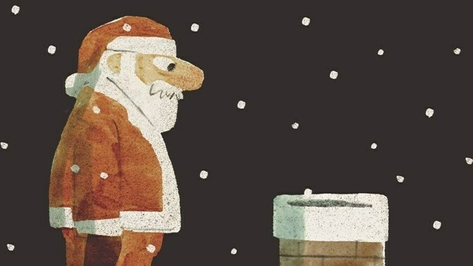

Go & See – Theatre
Visual Guide Resource
A visual guide to support pupils’ understanding of going to see a theatre show at The Unicorn Theatre in Southwark.
You can access additional resources on A New Direction’s website.
This visual guide could be particularly relevant to pupils who benefit from Social Stories. Teachers could read it with their classes before the trip and it could be shared as a handout for grownups to read at home too.
To find out more about Social Stories, please visit this website.
Go & See: Schools’ Resources

Slide 2
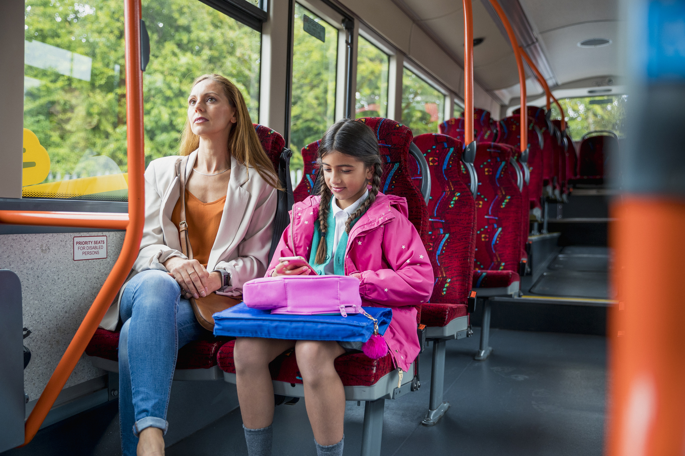
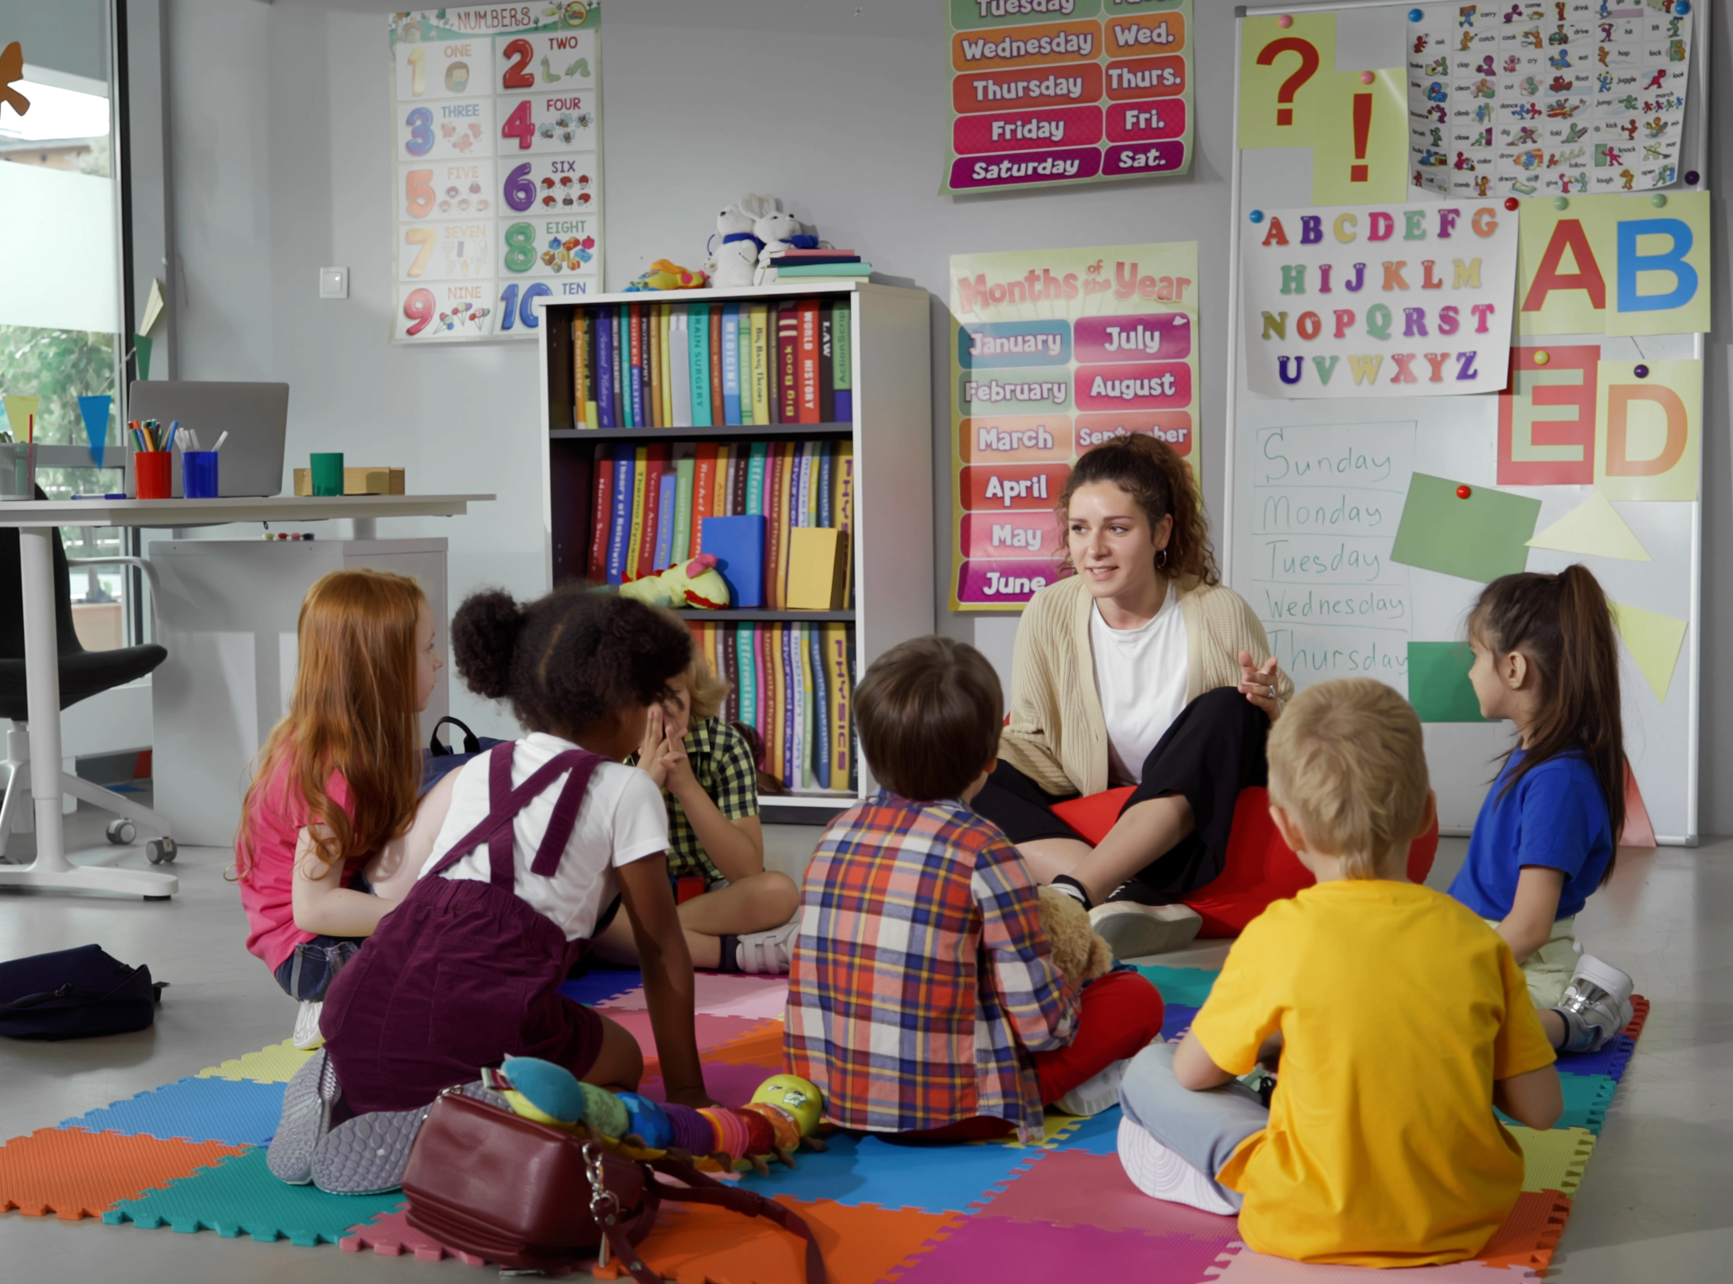
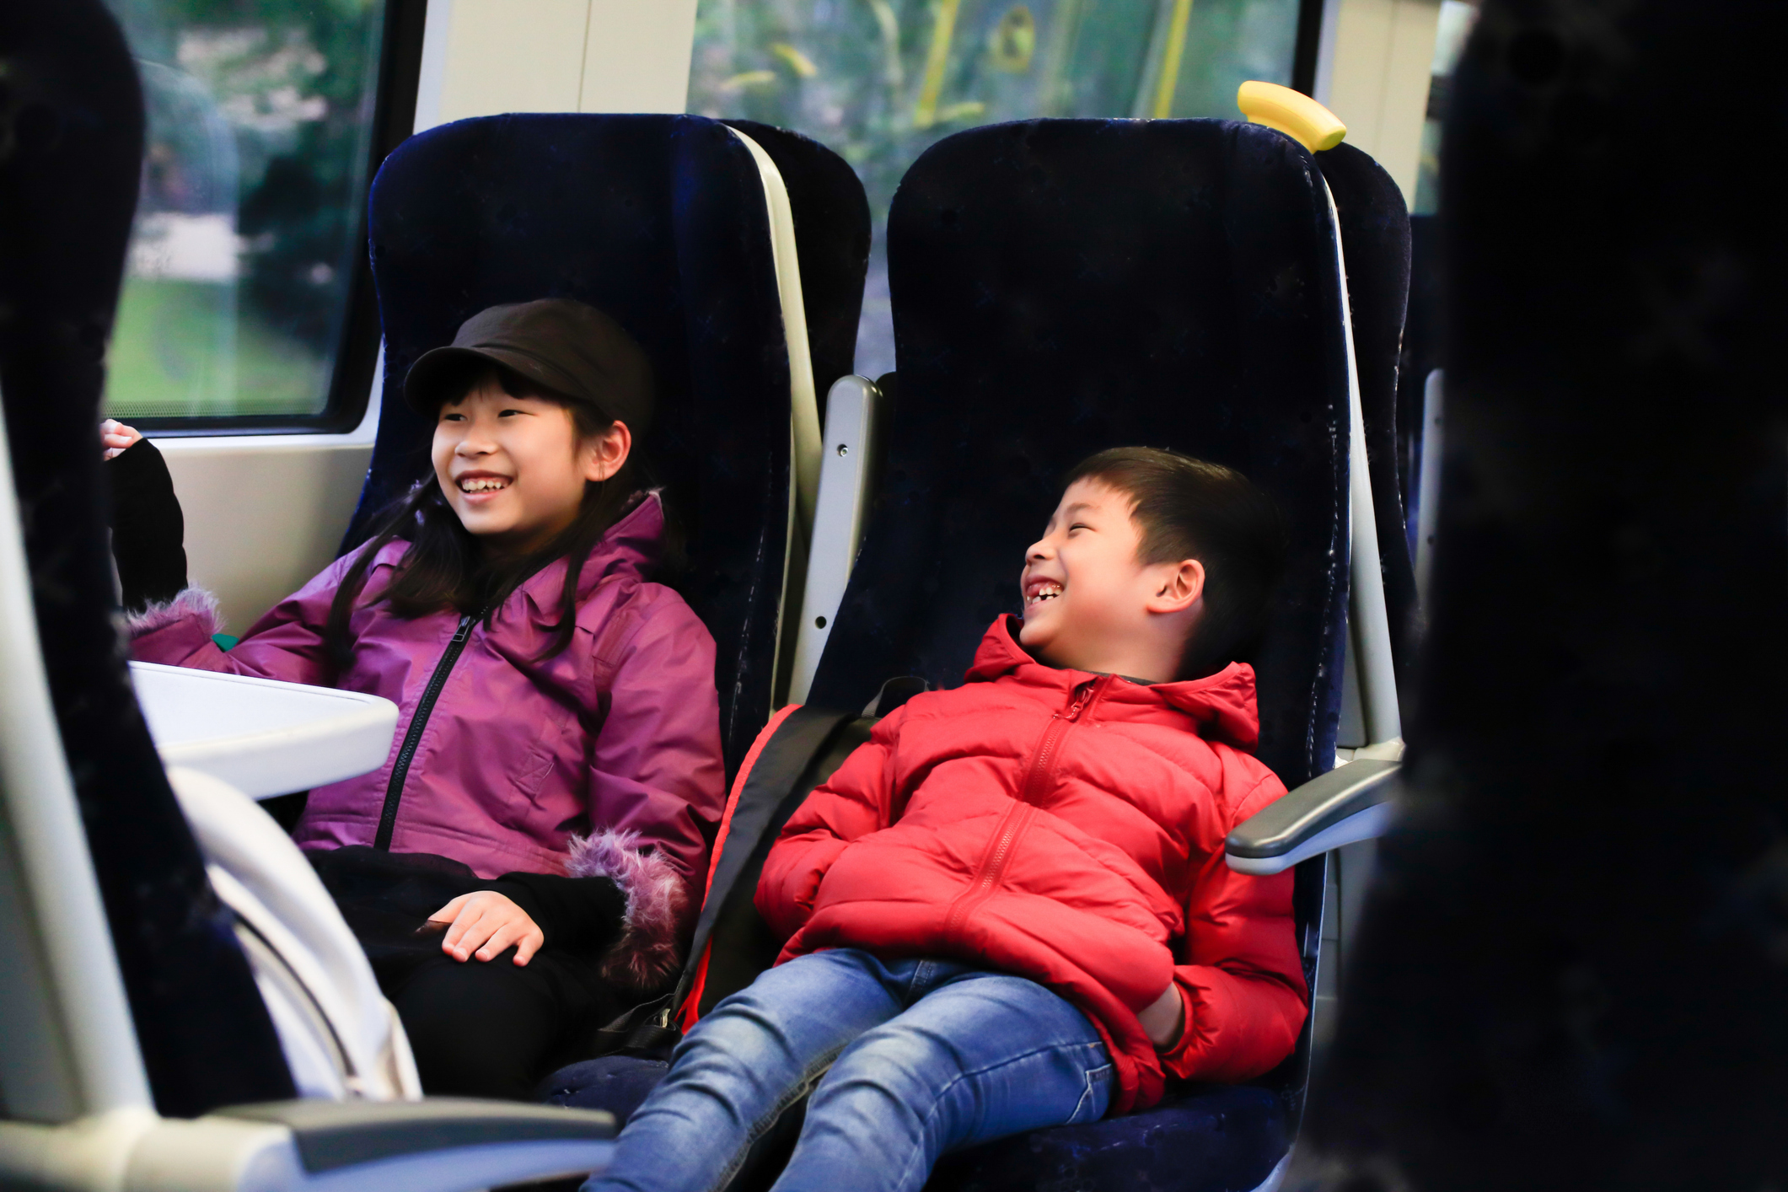

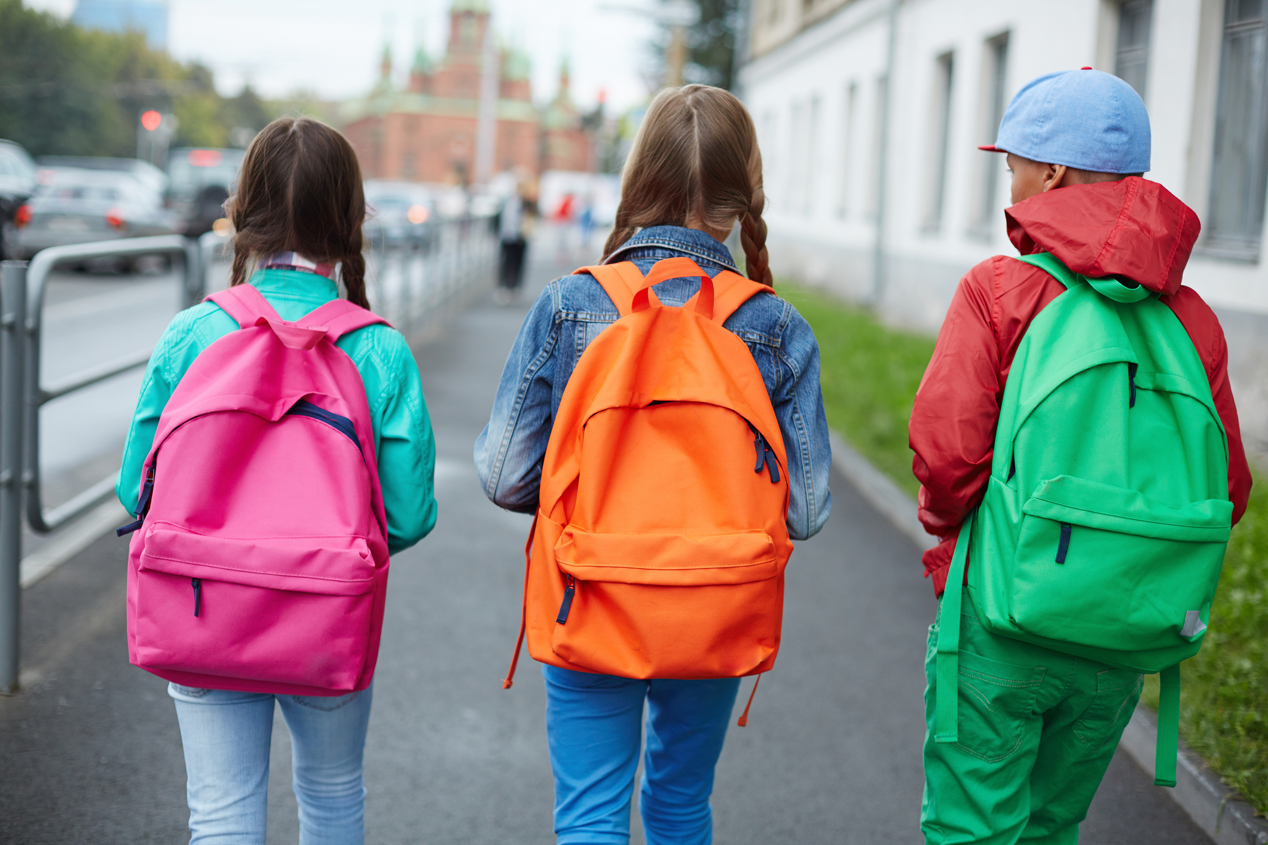
We’re going to the theatre!
I will travel to the Unicorn Theatre.
I might be travelling by bus,
or by train,
or on foot.
My class will be going there too.
My teachers will going be there too.

Slide 3
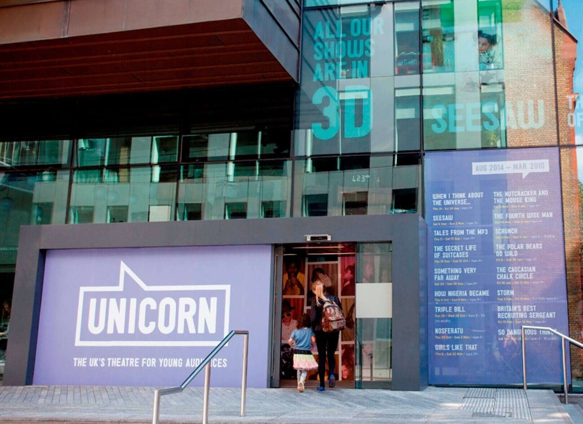
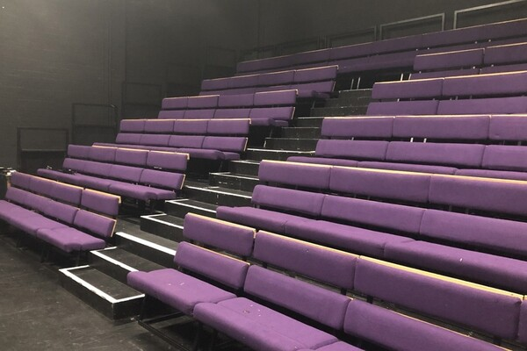
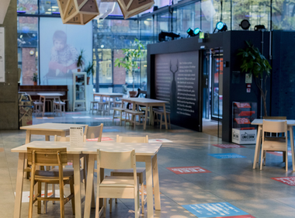
The Location
This is the outside of the theatre.
This is the inside of the building.
This is where I will watch the show.

Slide 4
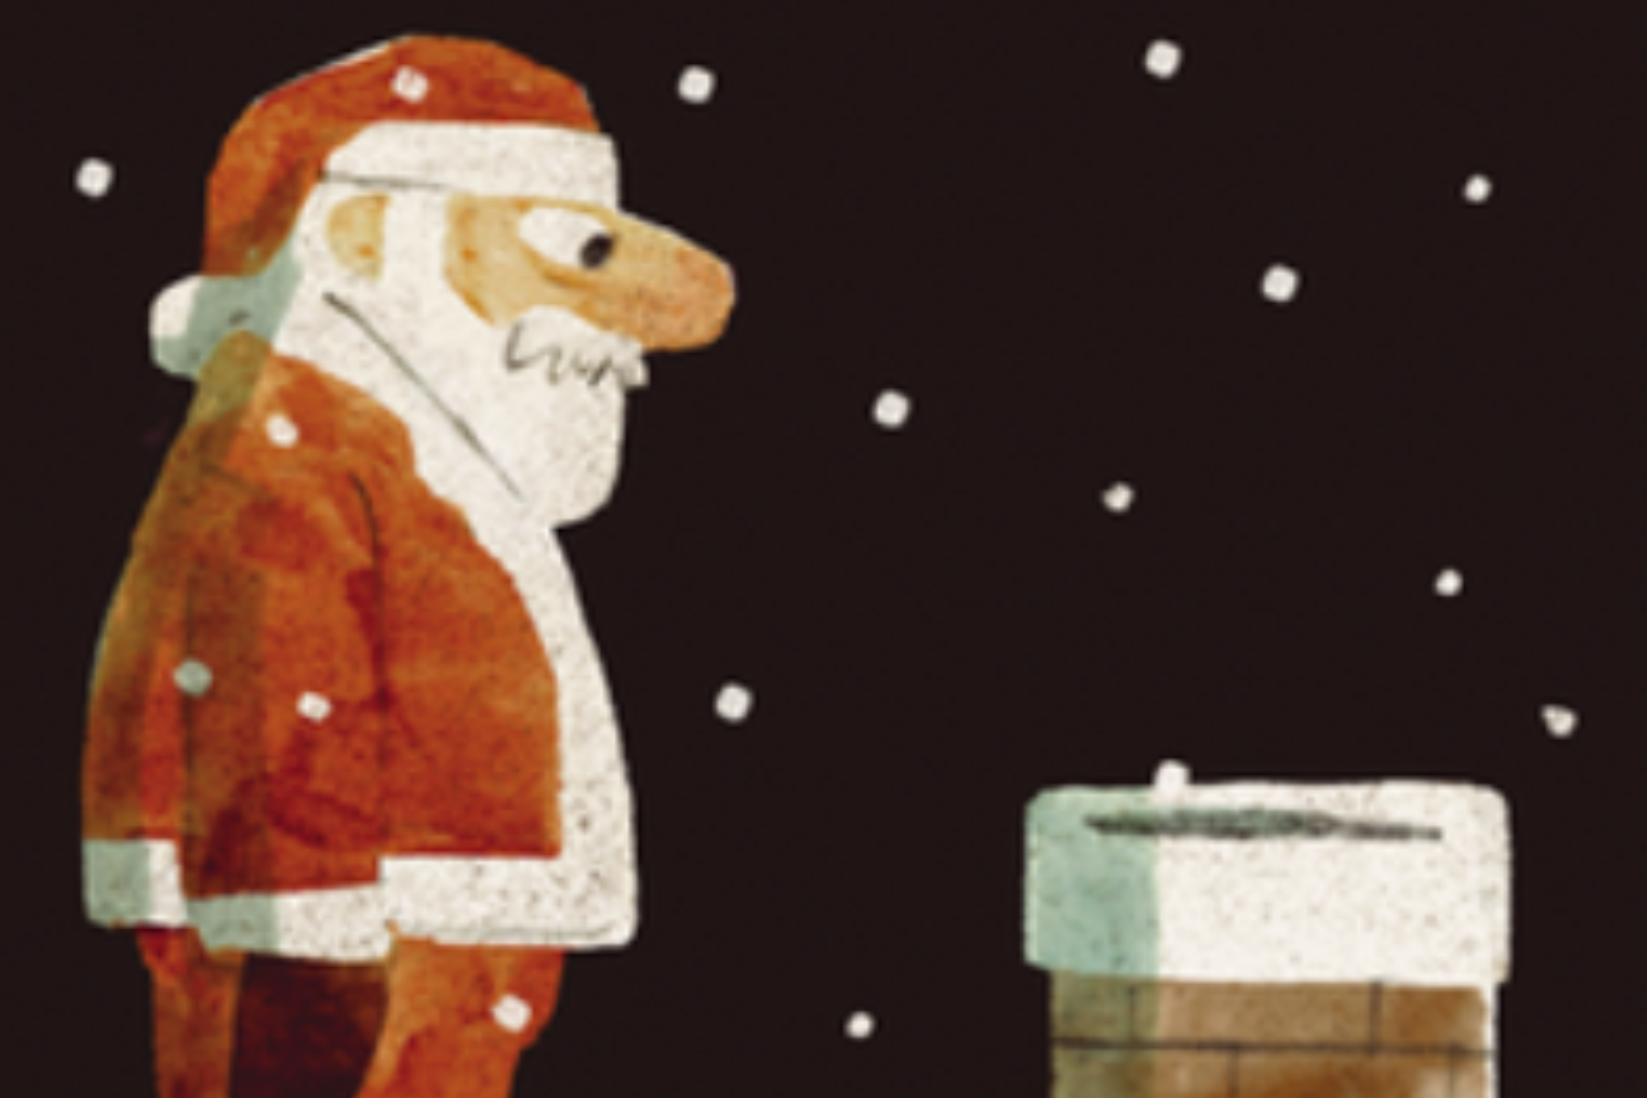
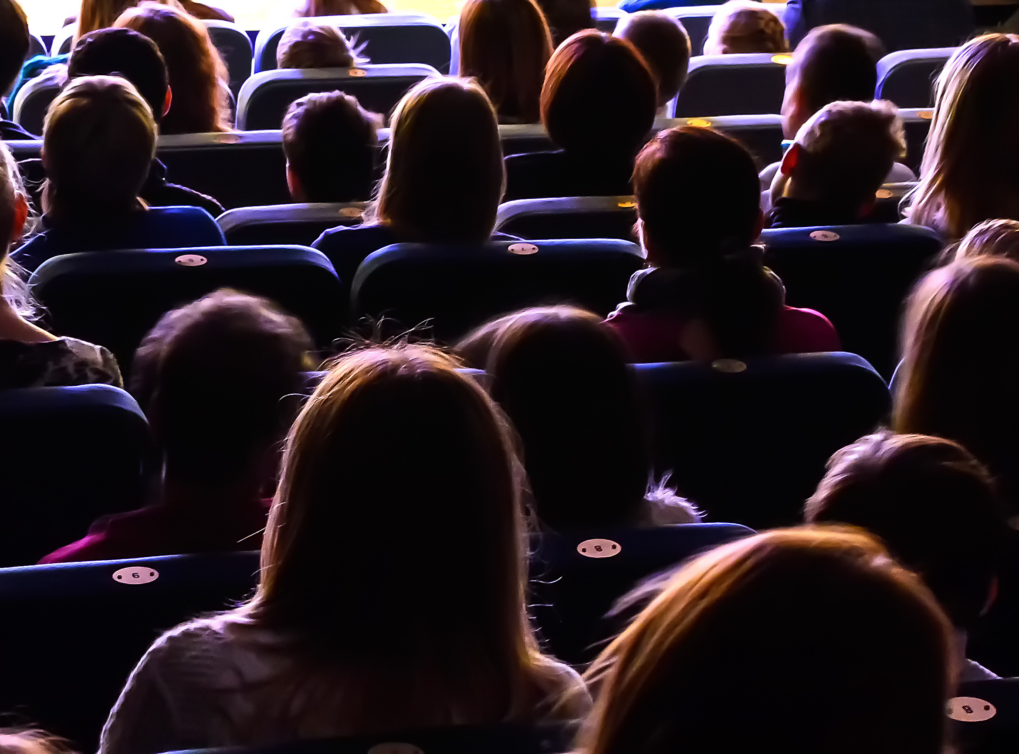
The Theatre
The venue staff will show me where to go and how to get to my seat.
The lights will be on to help me find my seat.
Once the show starts, it will go dark.
I will see the show .
It is 2 hours long. It has a break in the middle called an interval.
Here is some more information about the show:
Ever wondered how Santa goes down the chimney? Feet first? Head first? Or on a zip wire? What if he gets stuck, or there’s no chimney at all? Could he post himself in a parcel or step out of a Christmas movie on TV?
Join us for a thrilling fusion of physical comedy, live music and anarchic fun. Inspired by Mac Barnett and Jon Klassen’s irresistibly funny picture book, this lively engaging performance is the perfect festive treat for pupils of all abilities to wrap up the year.
You can also watch a video about the show here.

Slide 5
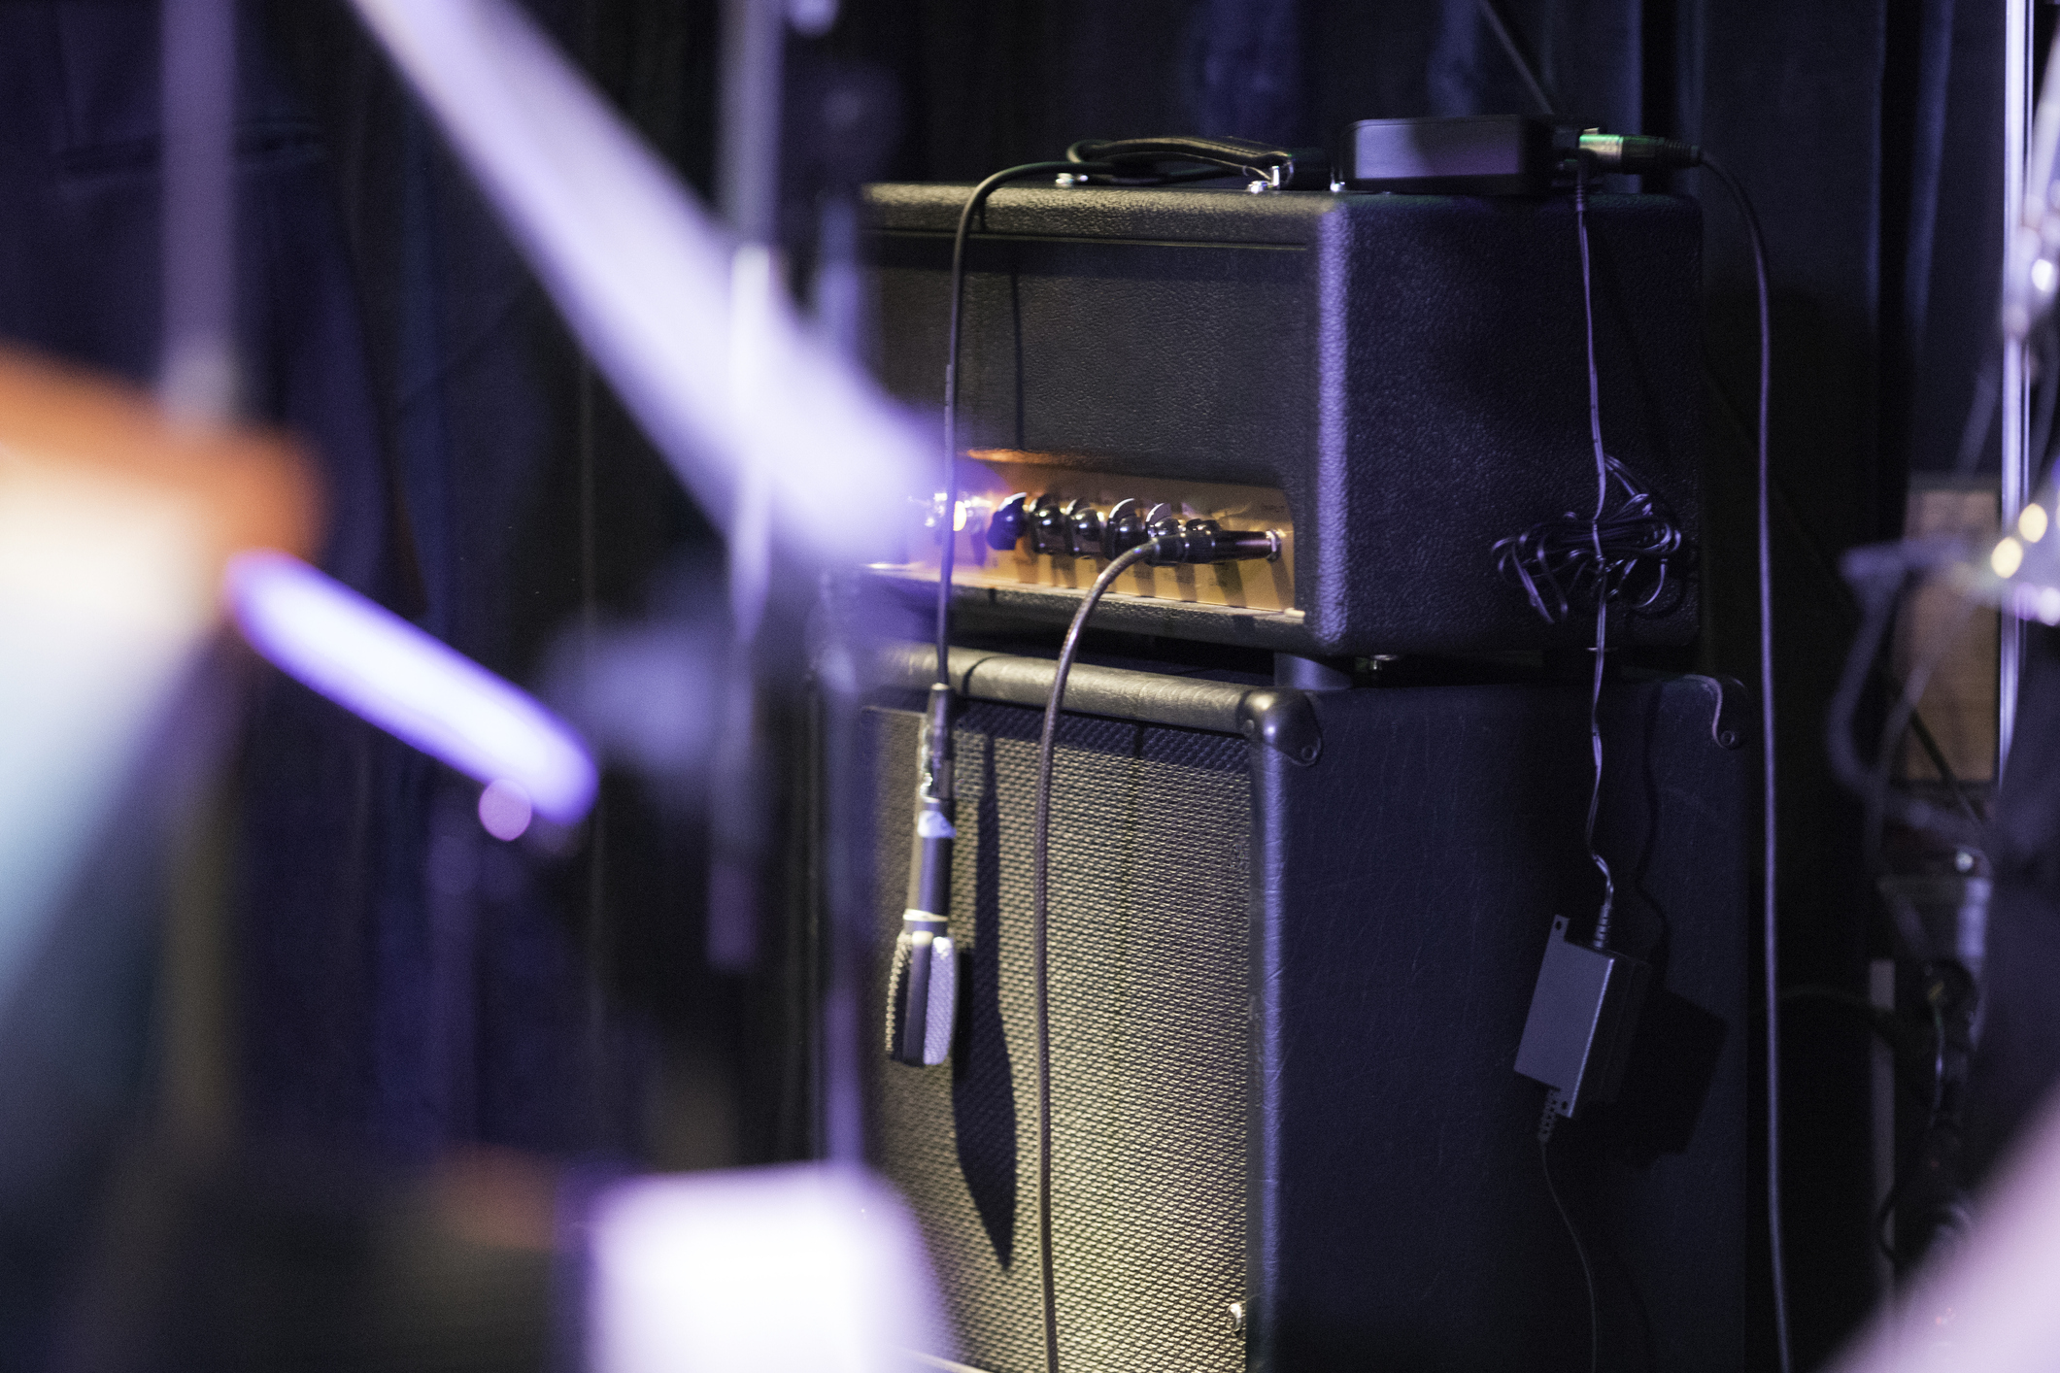
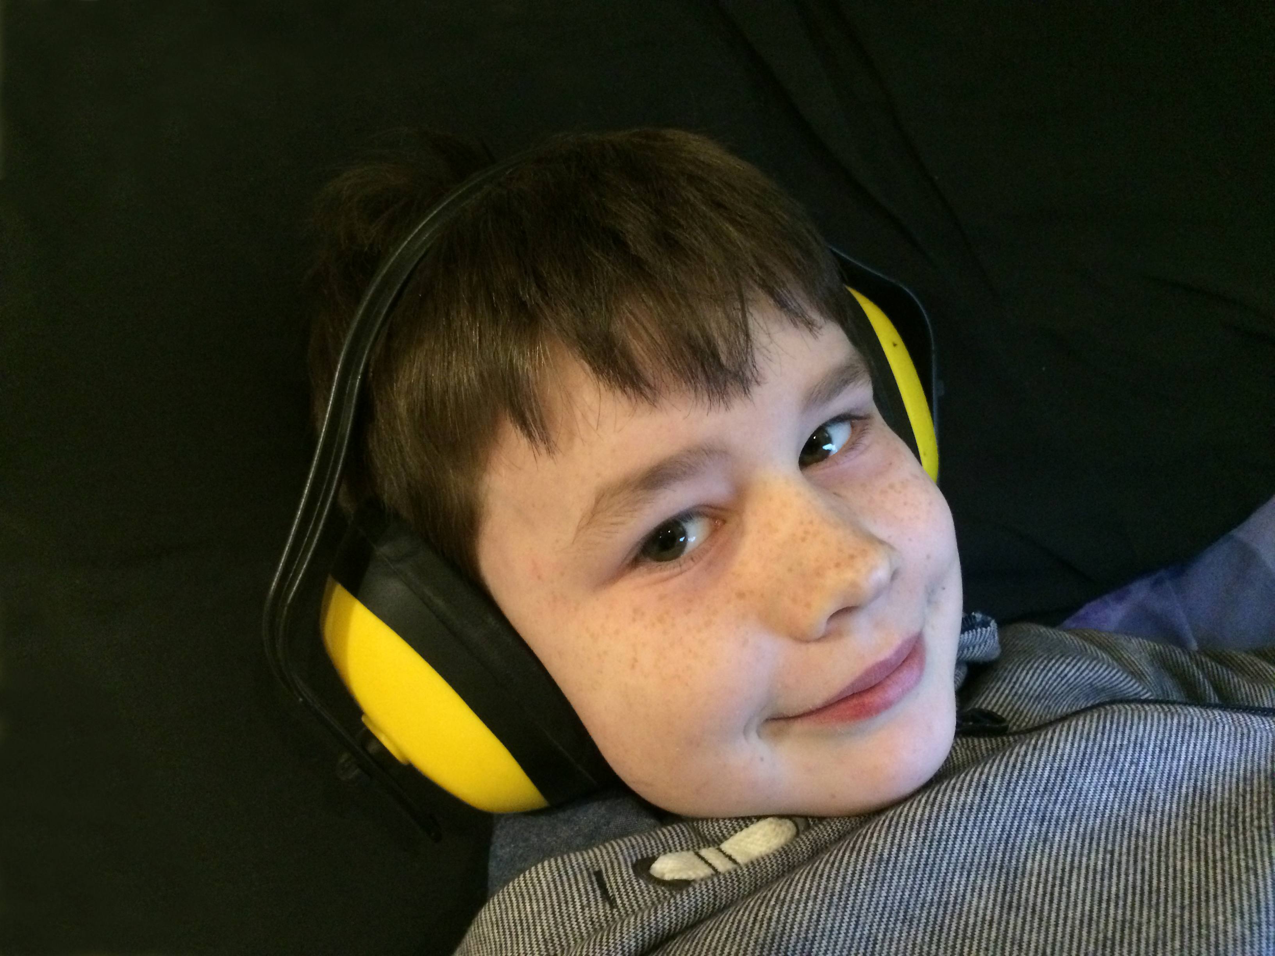
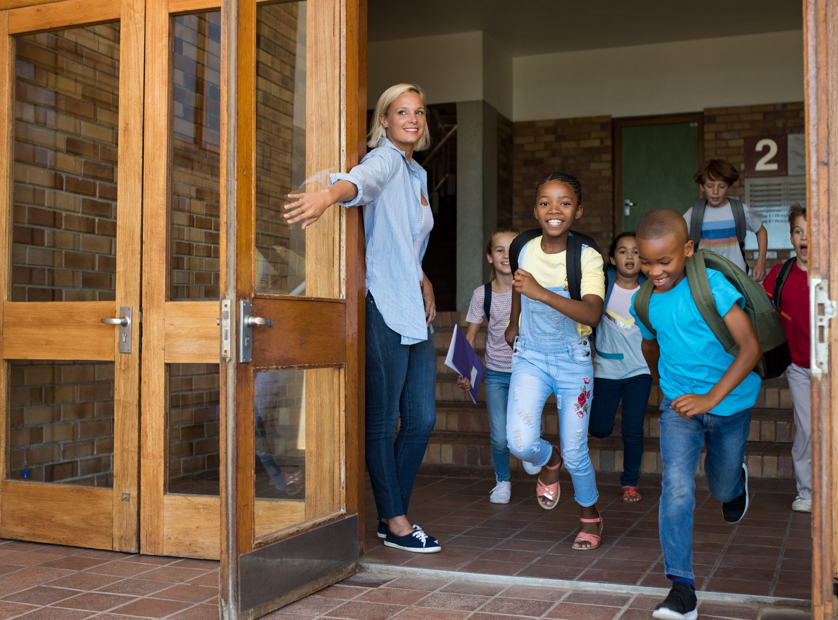
The Show
The show will have sounds and music.
If it is too loud, I can cover my ears or use ear defenders.
My class will be there.
Other schools might be there too.

Slide 6

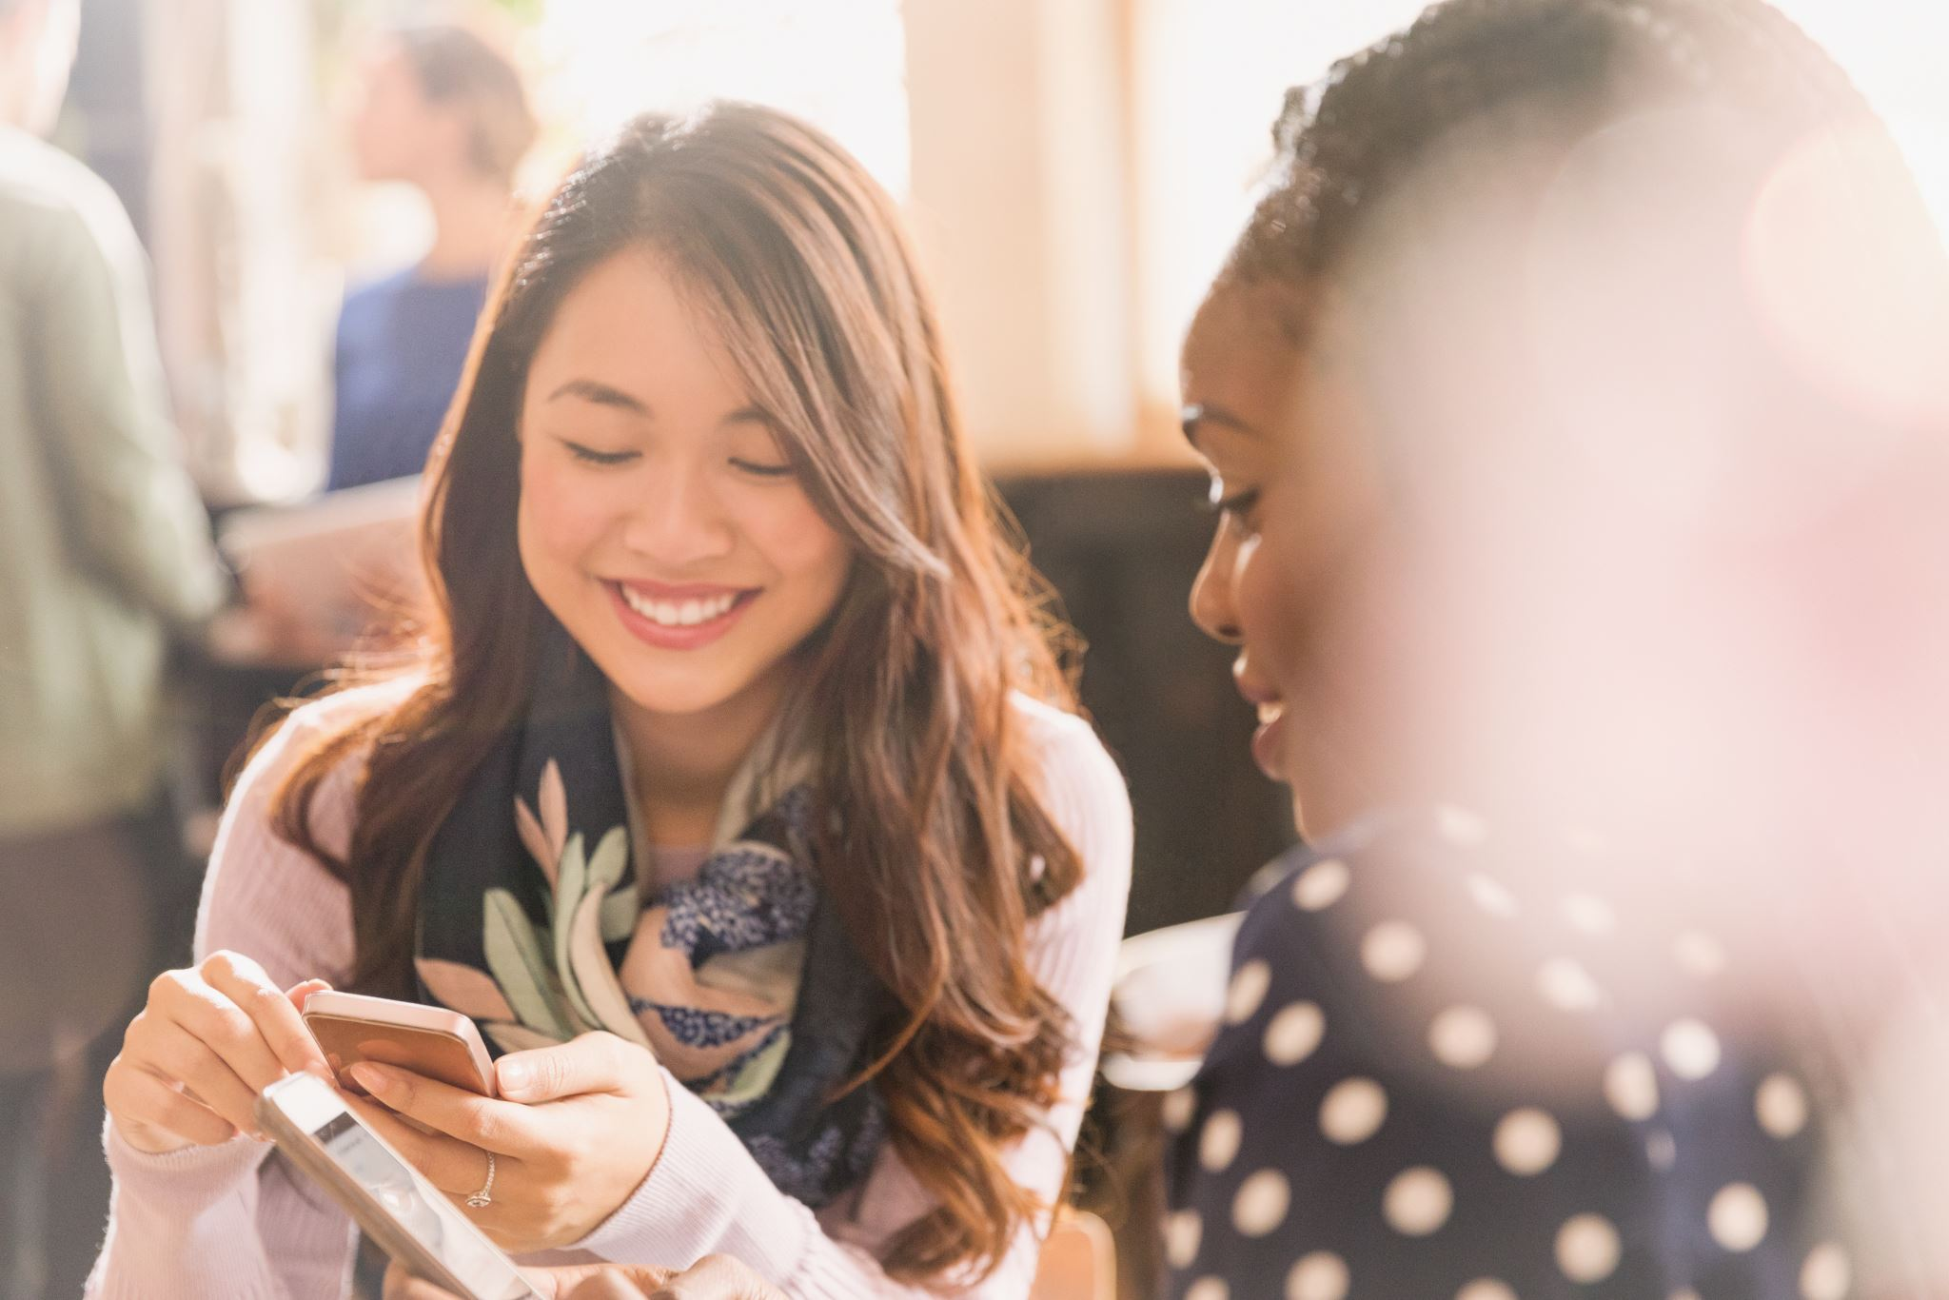

The Interval
There will be a short break in the middle of the show. This is called an interval.
The lights will come back on. The audience might clap.
People in the audience might talk and move around the theatre space.
When the interval ends and the show starts, it will go dark again.

Slide 7

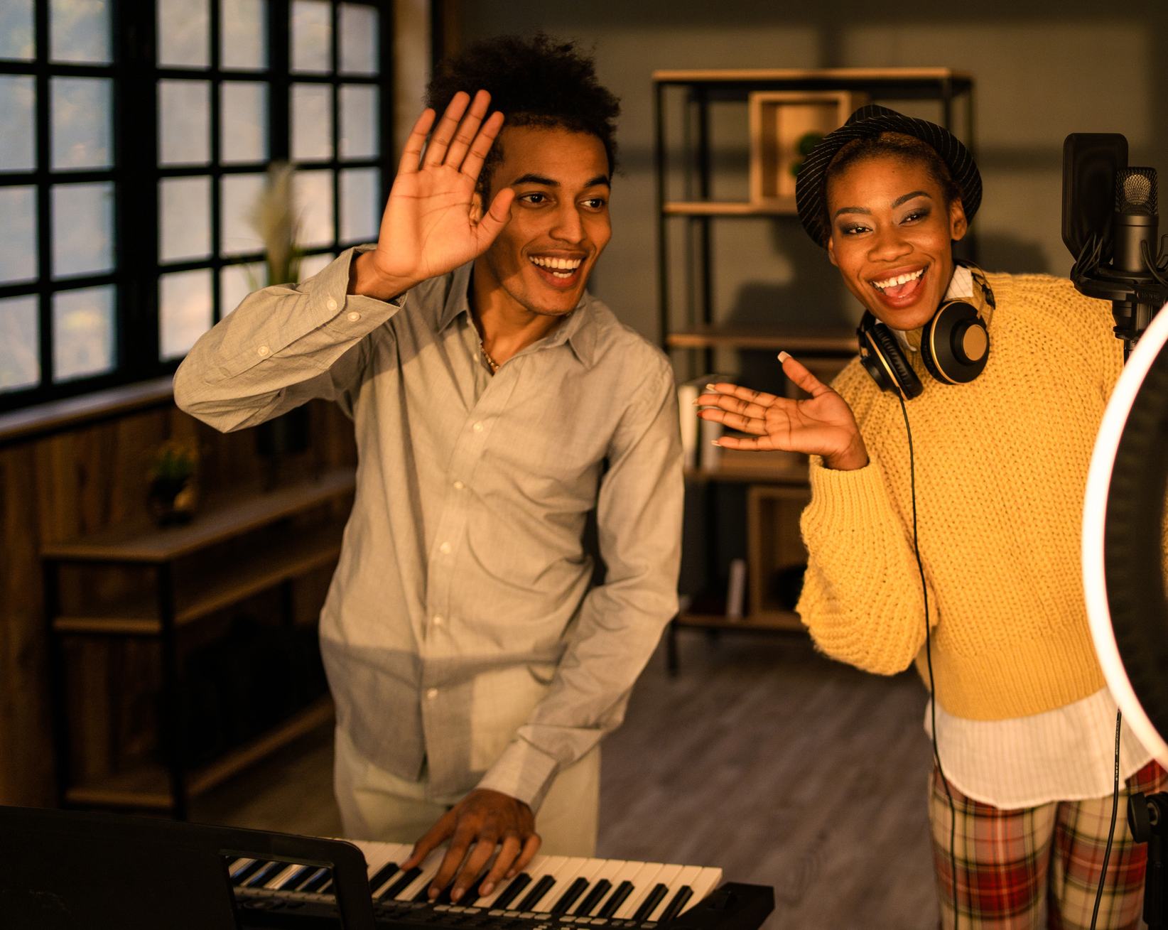
The End of the Show
When the show ends, the lights will come back on.
The audience might clap.
I will walk back to the main entrance.
I will say goodbye to the staff when I leave.
I will travel back to school with my teachers and class.

