Slide 1


Go & See – Theatre
Visual Guide Resource
A visual guide to support pupils’ understanding of going to see a theatre show at Stratford East in Stratford.
You can access additional resources on A New Direction’s website.
This visual guide could be particularly relevant to pupils who benefit from Social Stories. Teachers could read it with their classes before the trip and it could be shared as a handout for grownups to read at home too.
To find out more about Social Stories, please visit this website.
Go & See: Schools’ Resources

Slide 2
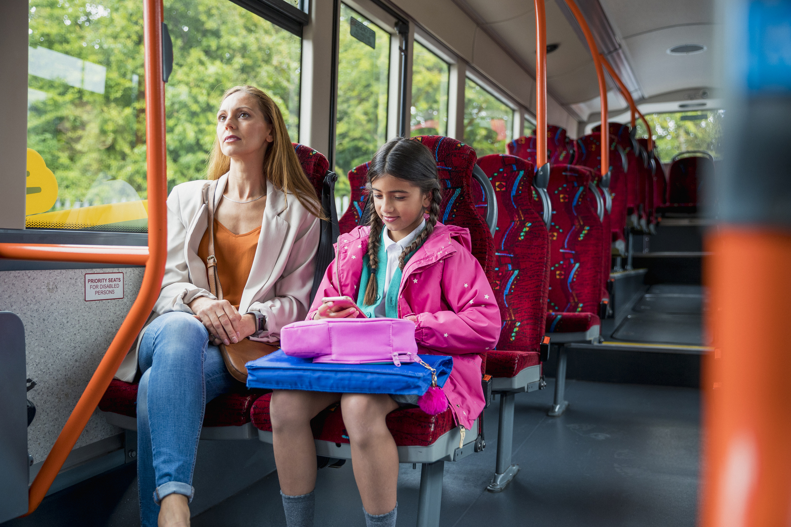
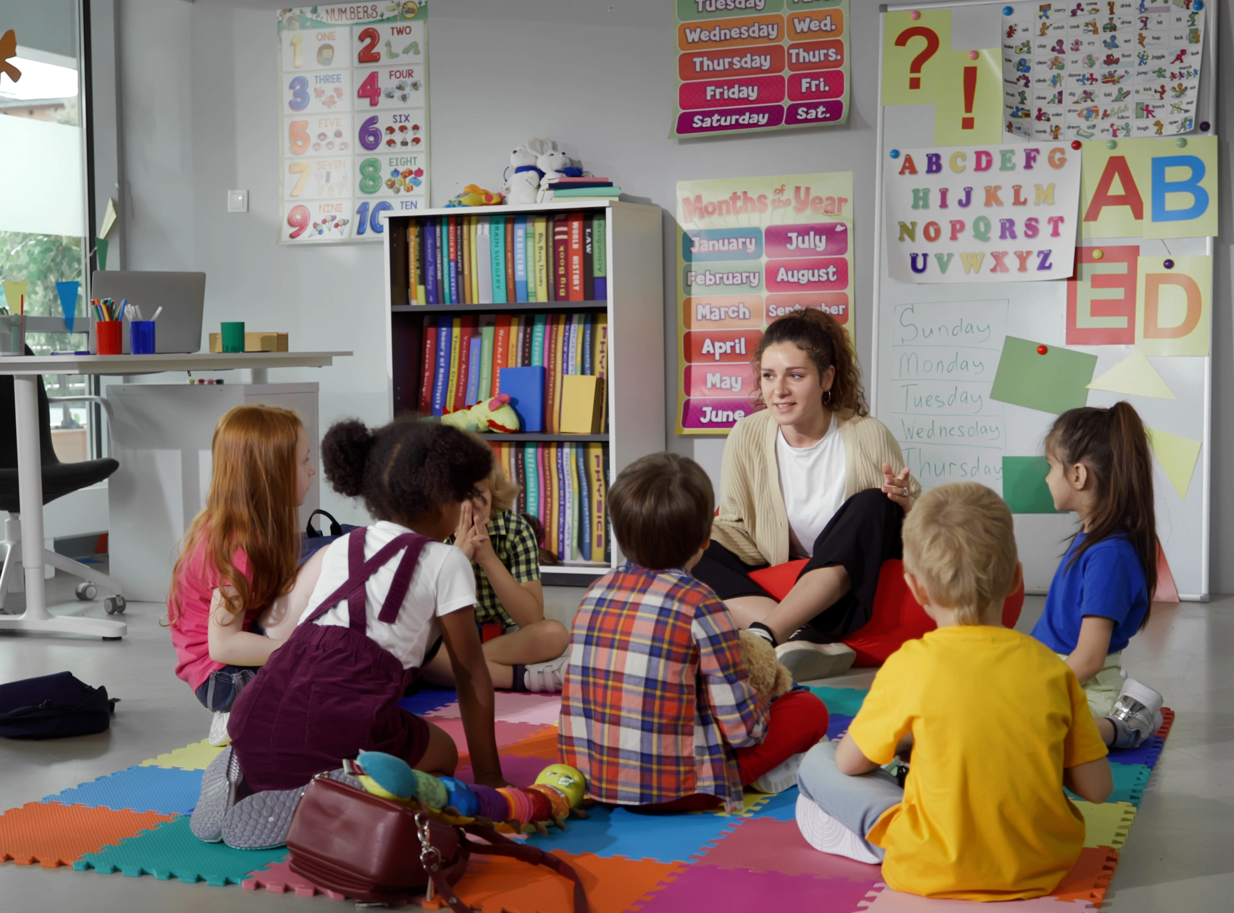
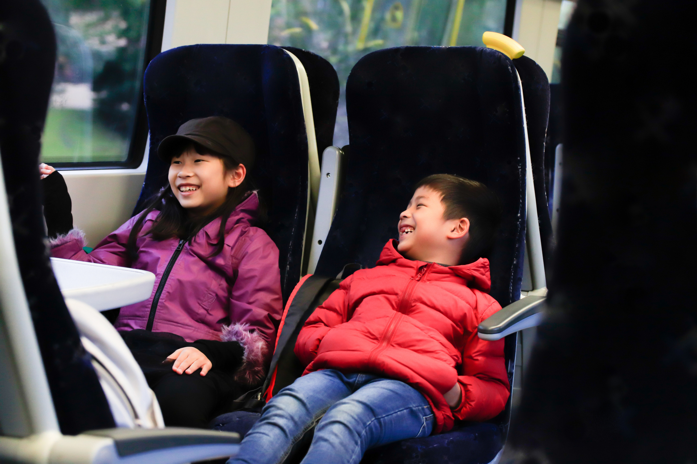
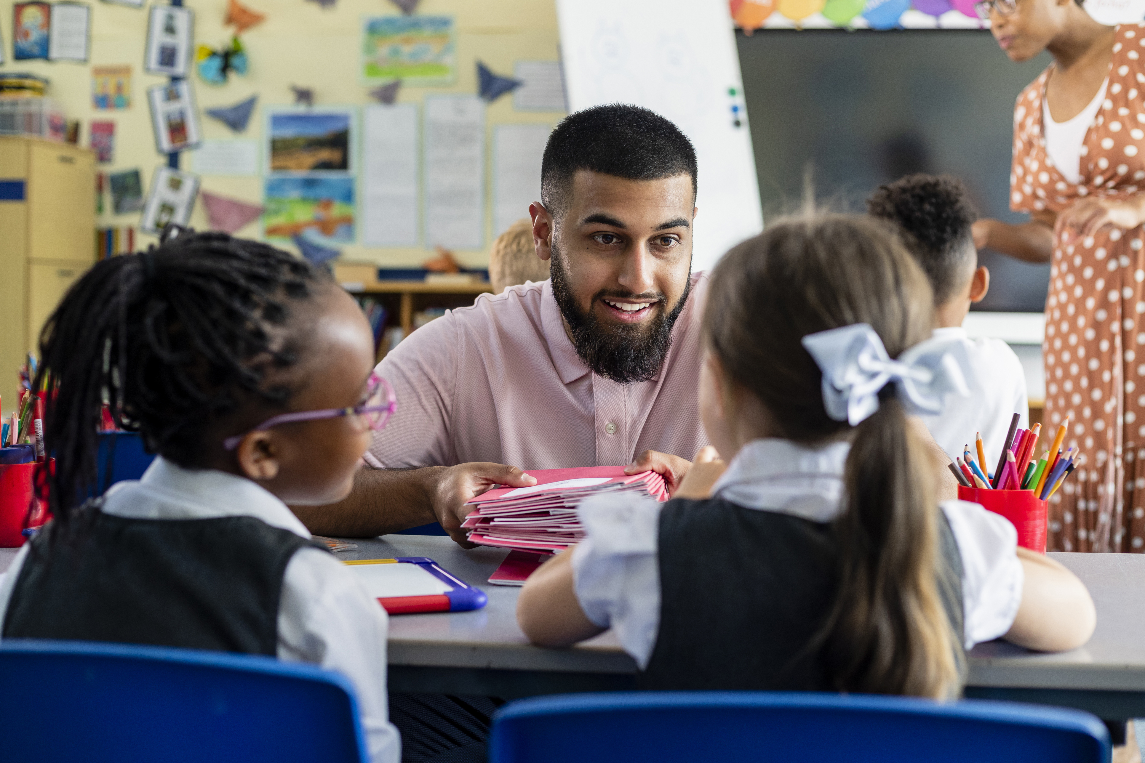
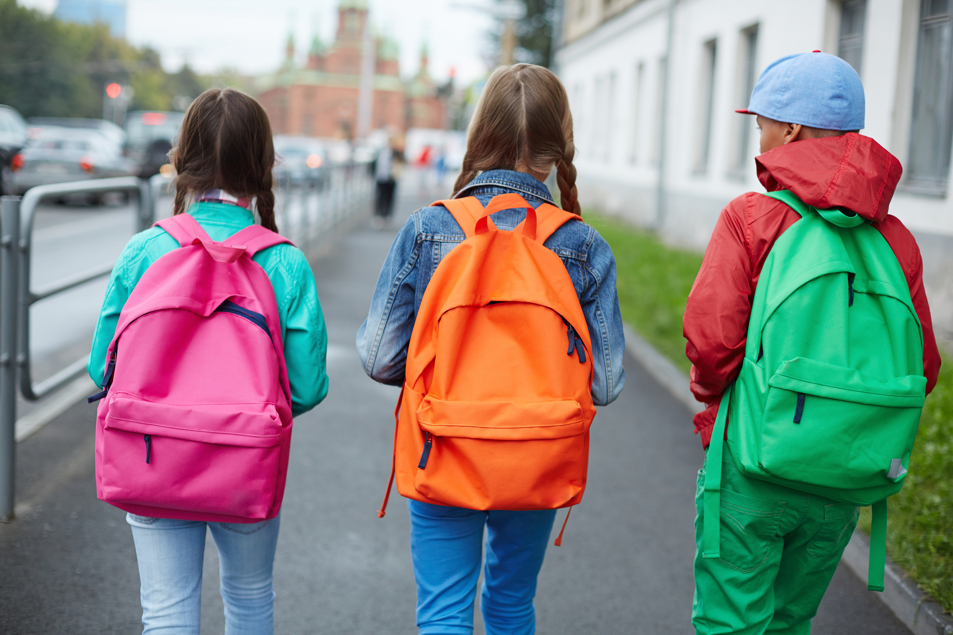
We’re going to the theatre!
I will travel to Stratford East theatre.
I might be travelling by bus,
or by train,
or on foot.
My class will be going there too.
My teachers will going be there too.

Slide 3
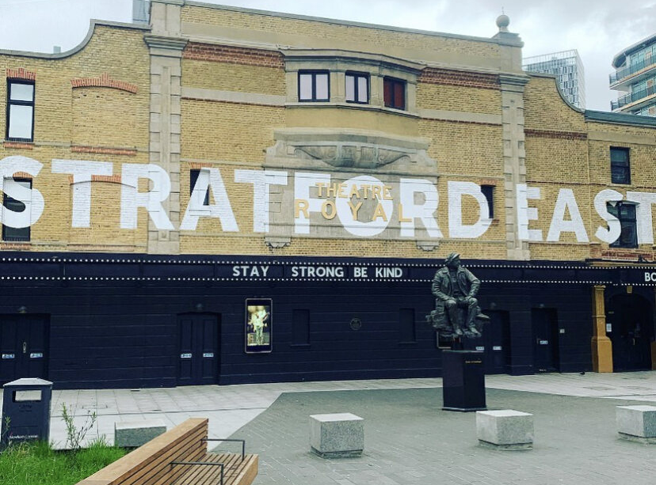
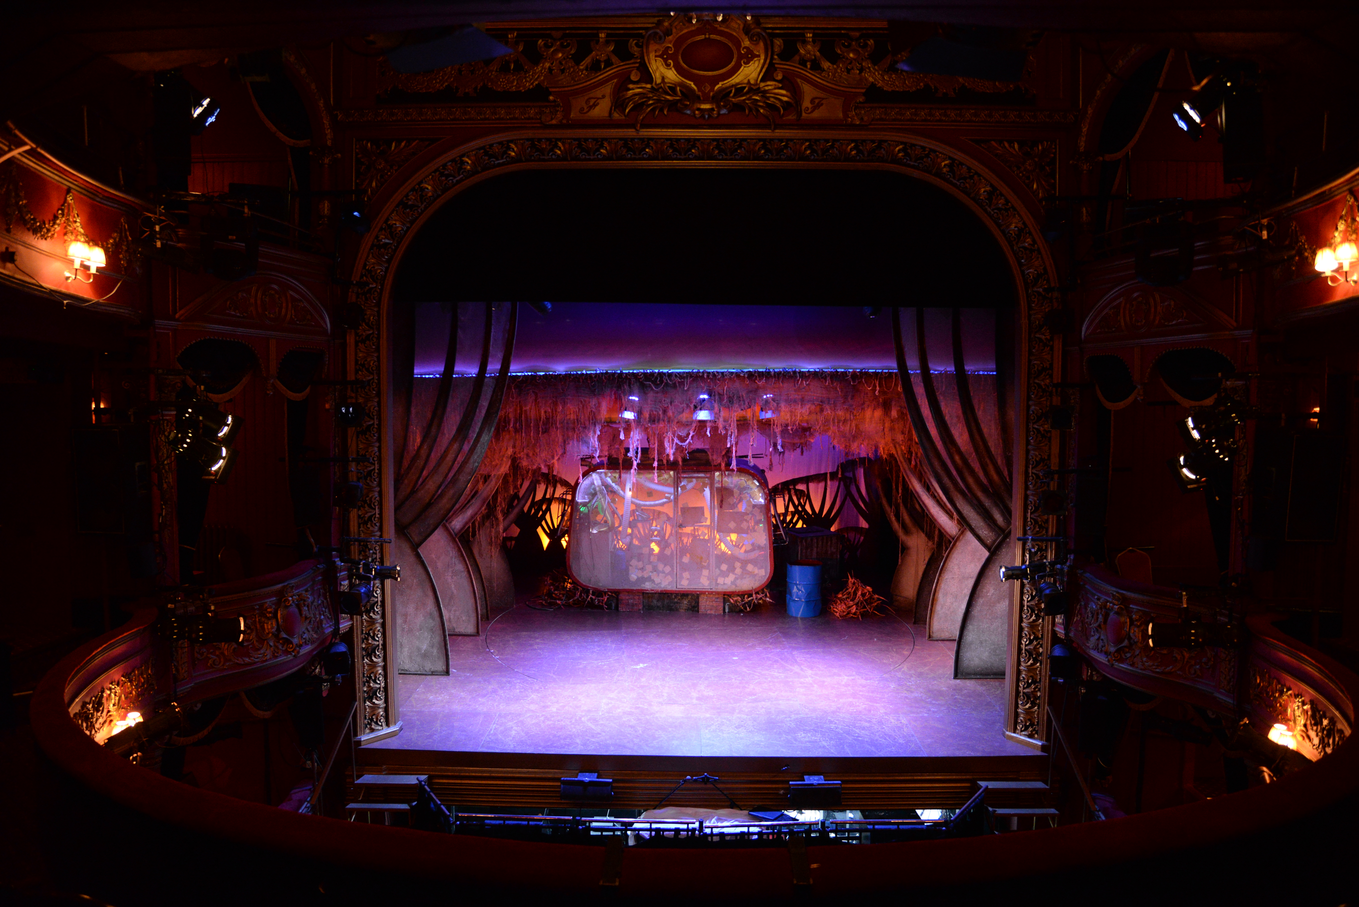
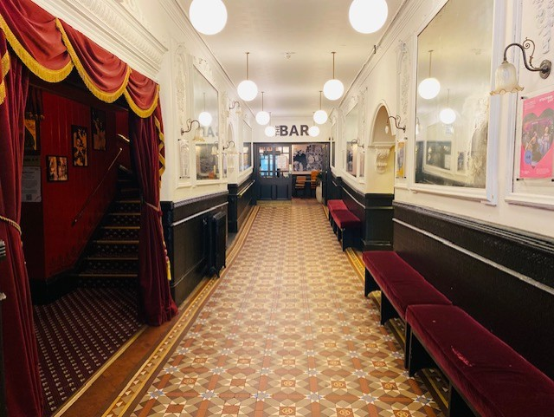
The Location
This is the outside of Stratford East.
This is the inside of the building.
This is where I will watch the show.

Slide 4
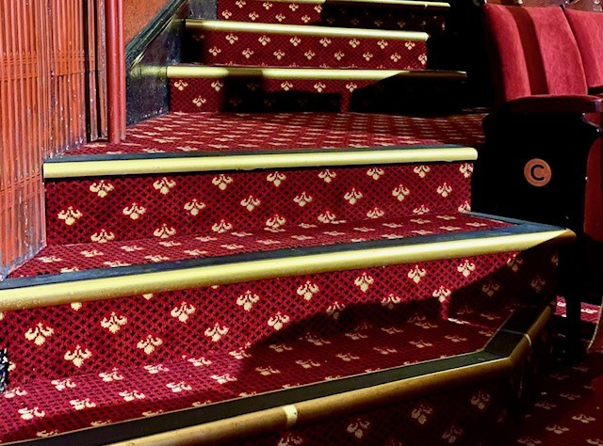
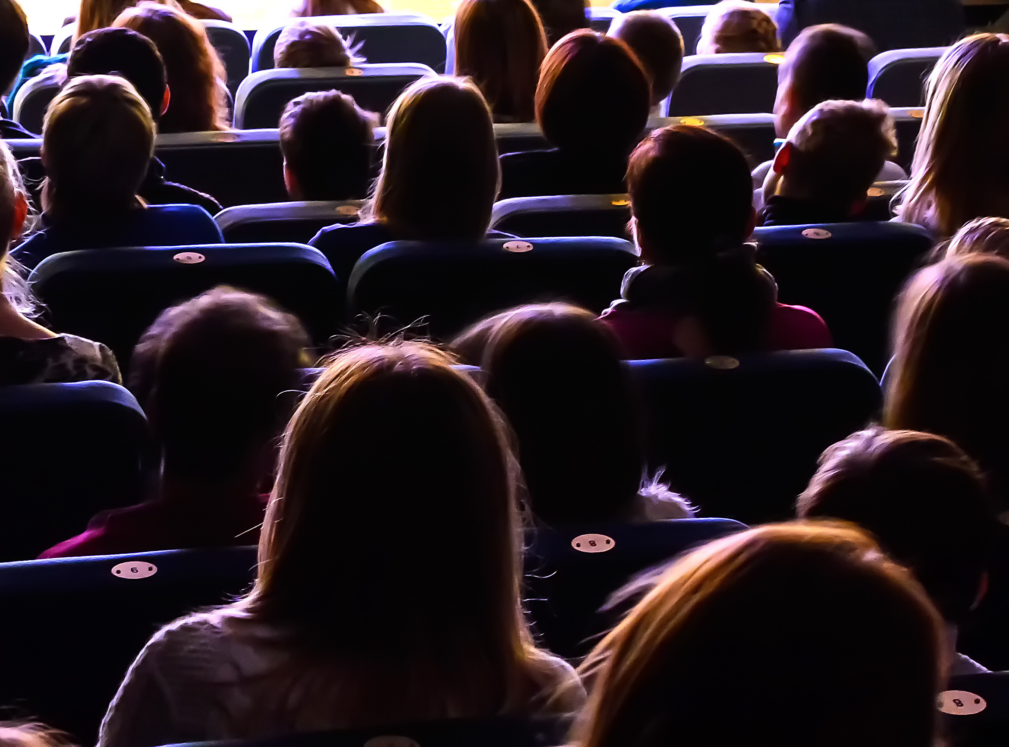
The Theatre
The venue staff will show me where to go and how to get to my seat.
The lights will be on to help me find my seat.
Once the show starts, it will go dark.
I will see the show Mama Goose.
It is 2 ½ hours long. It has a break in the middle called an interval.
Here is some more information about the show:
The show is about Mama Goose and her magical golden egg-laying goose!
Will Mama Goose be able to resist the temptations of fame and fortune, or will she learn that the best things in life are free?

Slide 5
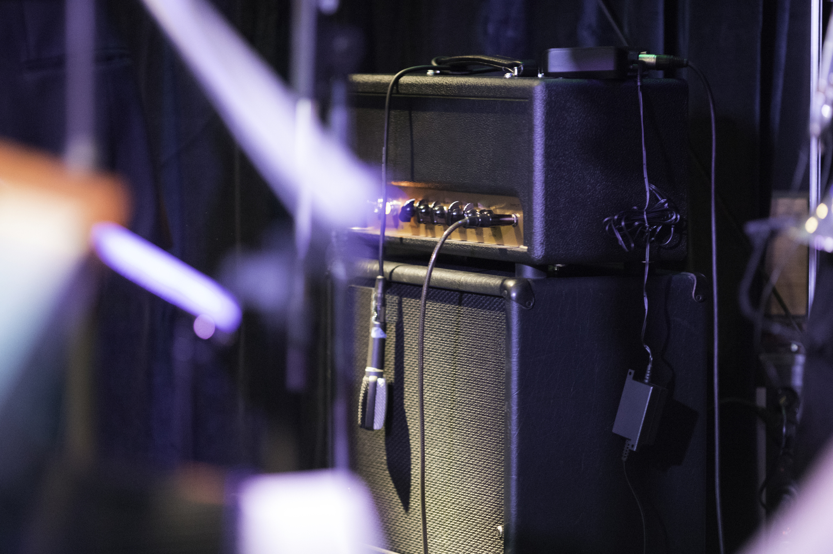
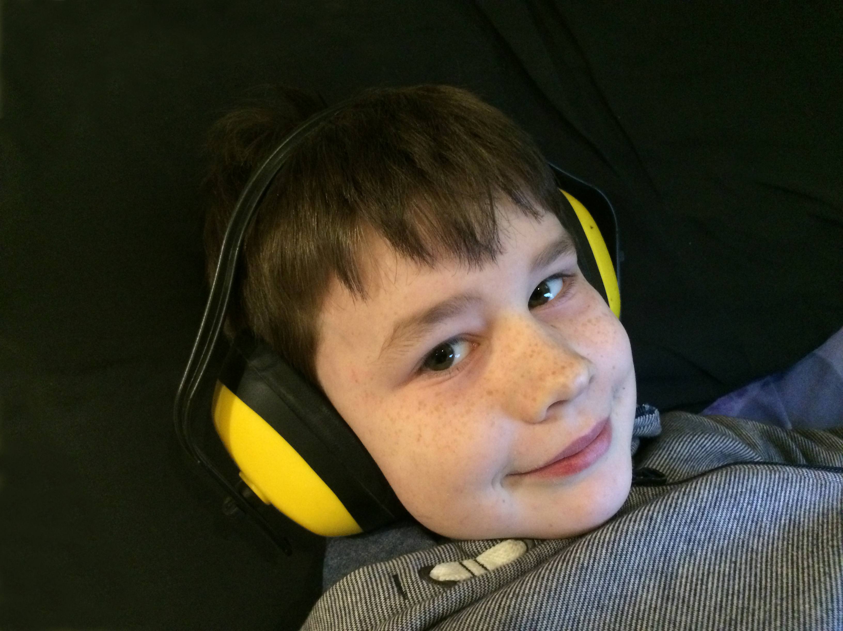
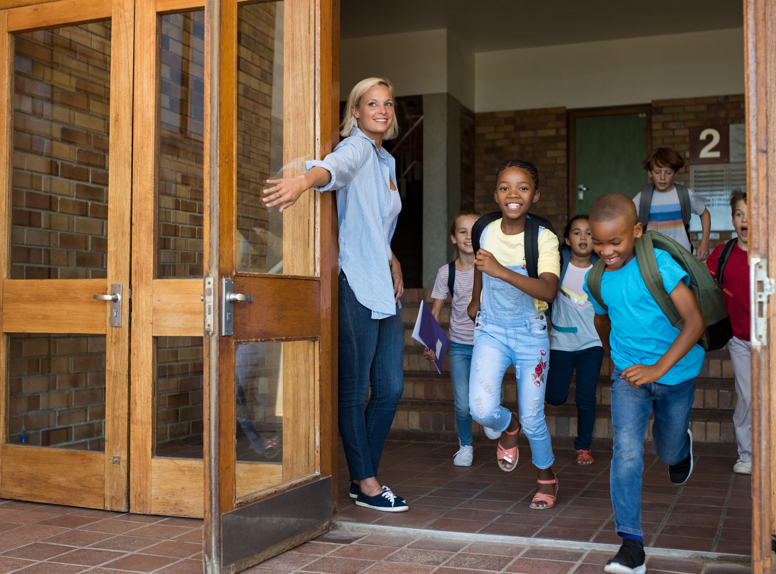
The Show
The show will have sounds and music.
If it is too loud, I can cover my ears or use ear defenders.
My class will be there.
Other schools might be there too.

Slide 6
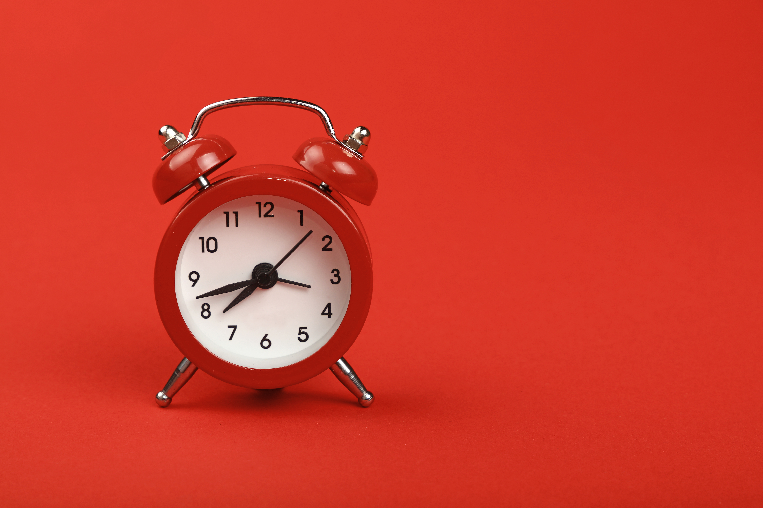
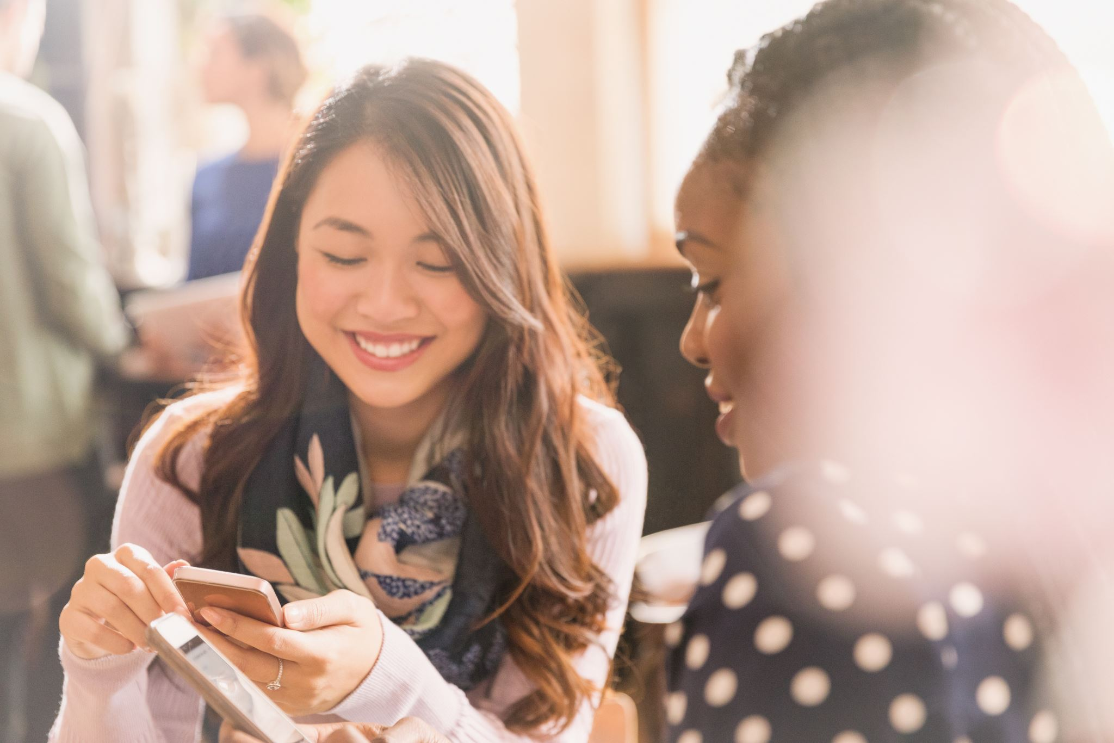
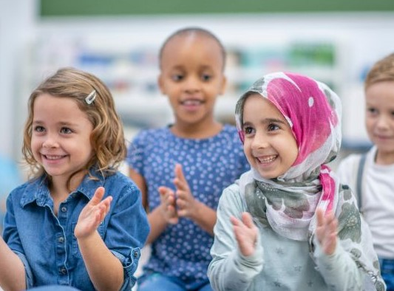
The Interval
There will be a short break in the middle of the show. This is called an interval.
The lights will come back on. The audience might clap.
People in the audience might talk and move around the theatre space.
When the interval ends and the show starts, it will go dark again.

Slide 7
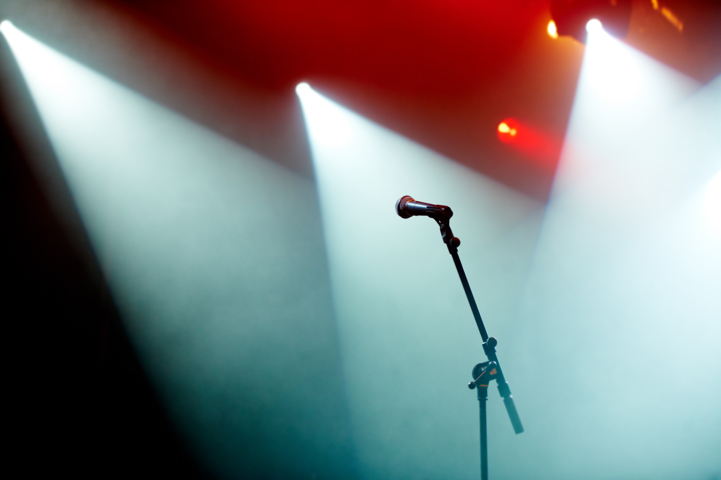
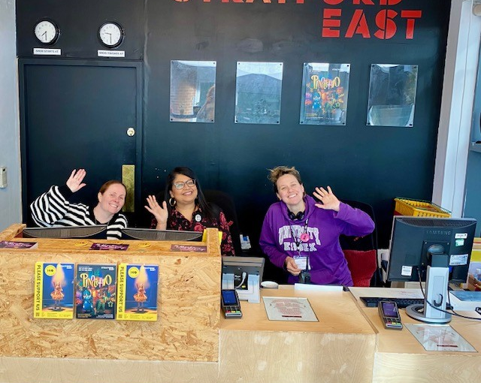
The End of the Show
When the show ends, the lights will come back on.
The audience might clap.
I will walk back to the main entrance.
I will say goodbye to the staff when I leave.
I will travel back to school with my teachers and class.

