Slide 1


Go & See – Theatre
Visual Guide Resource
A visual guide to support pupils’ understanding of going to see a theatre show at Polka Theatre in Wimbledon.
You can access additional resources on A New Direction’s website.
This visual guide could be particularly relevant to pupils who benefit from Social Stories. Teachers could read it with their classes before the trip and it could be shared as a handout for grownups to read at home too.
To find out more about Social Stories, please visit this website.
Go & See: Schools’ Resources

Slide 2
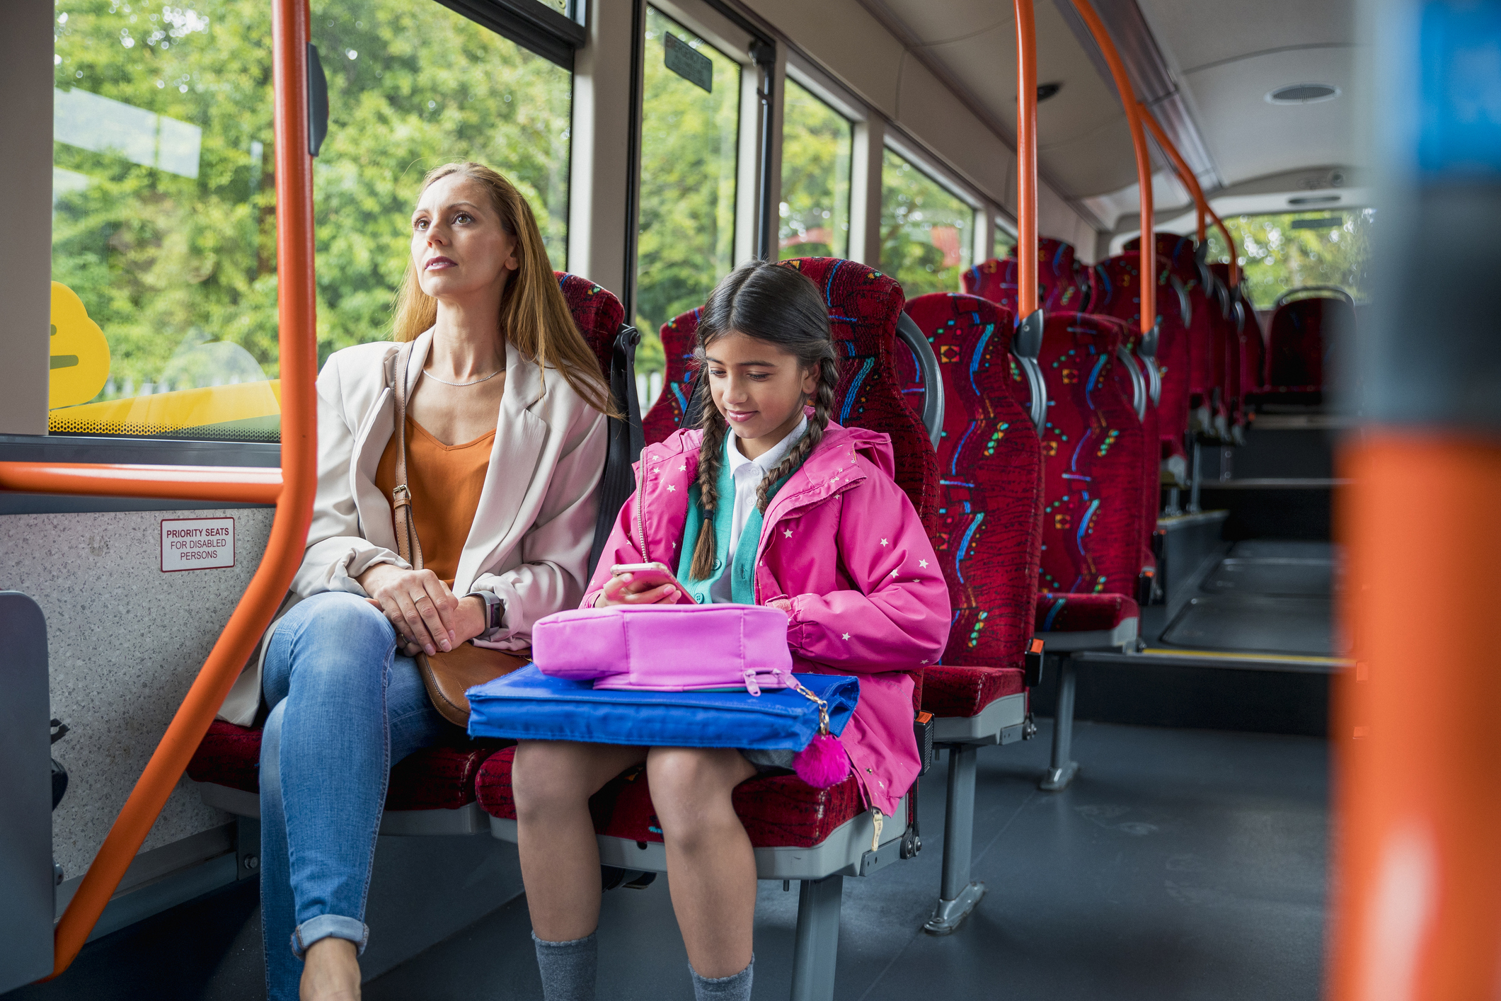
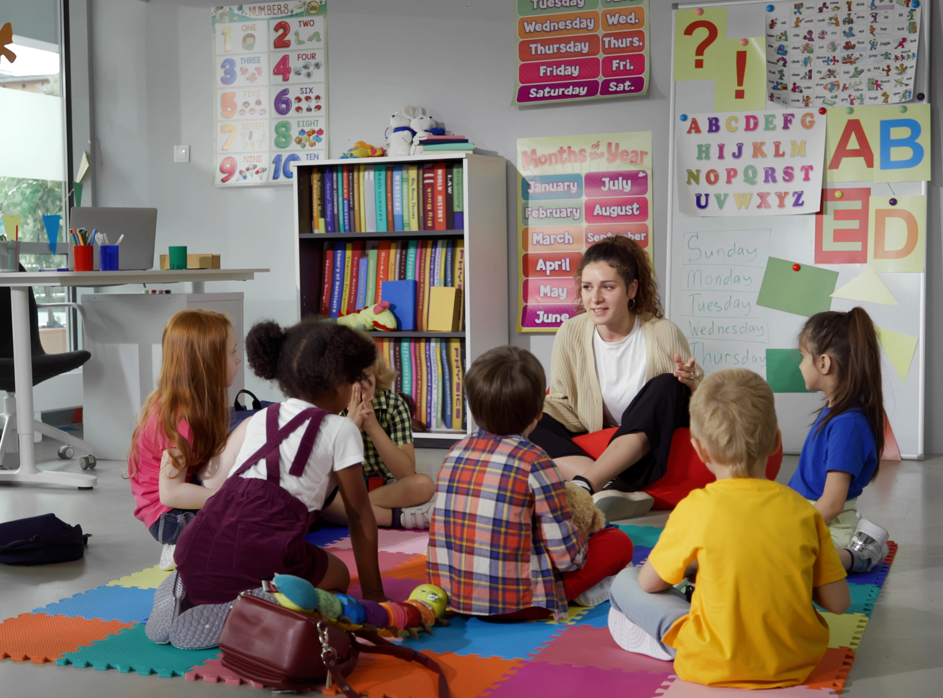
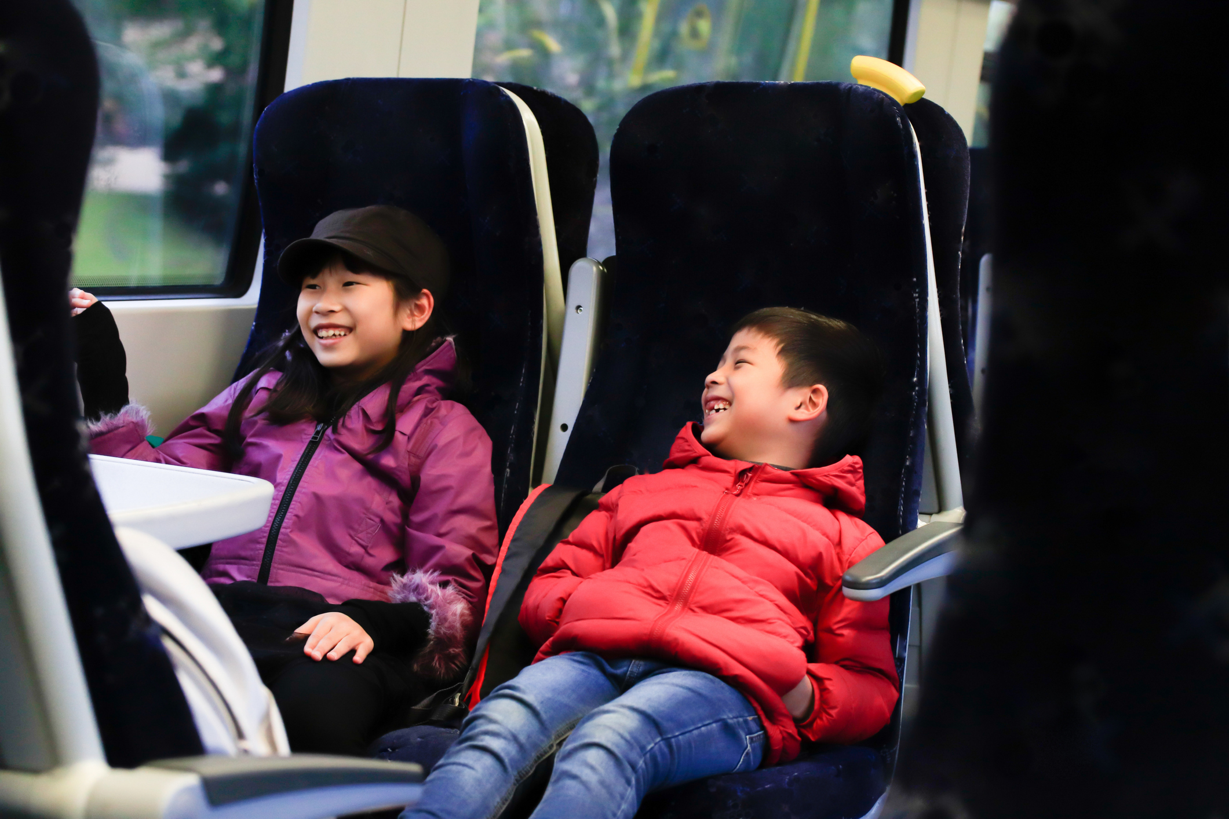

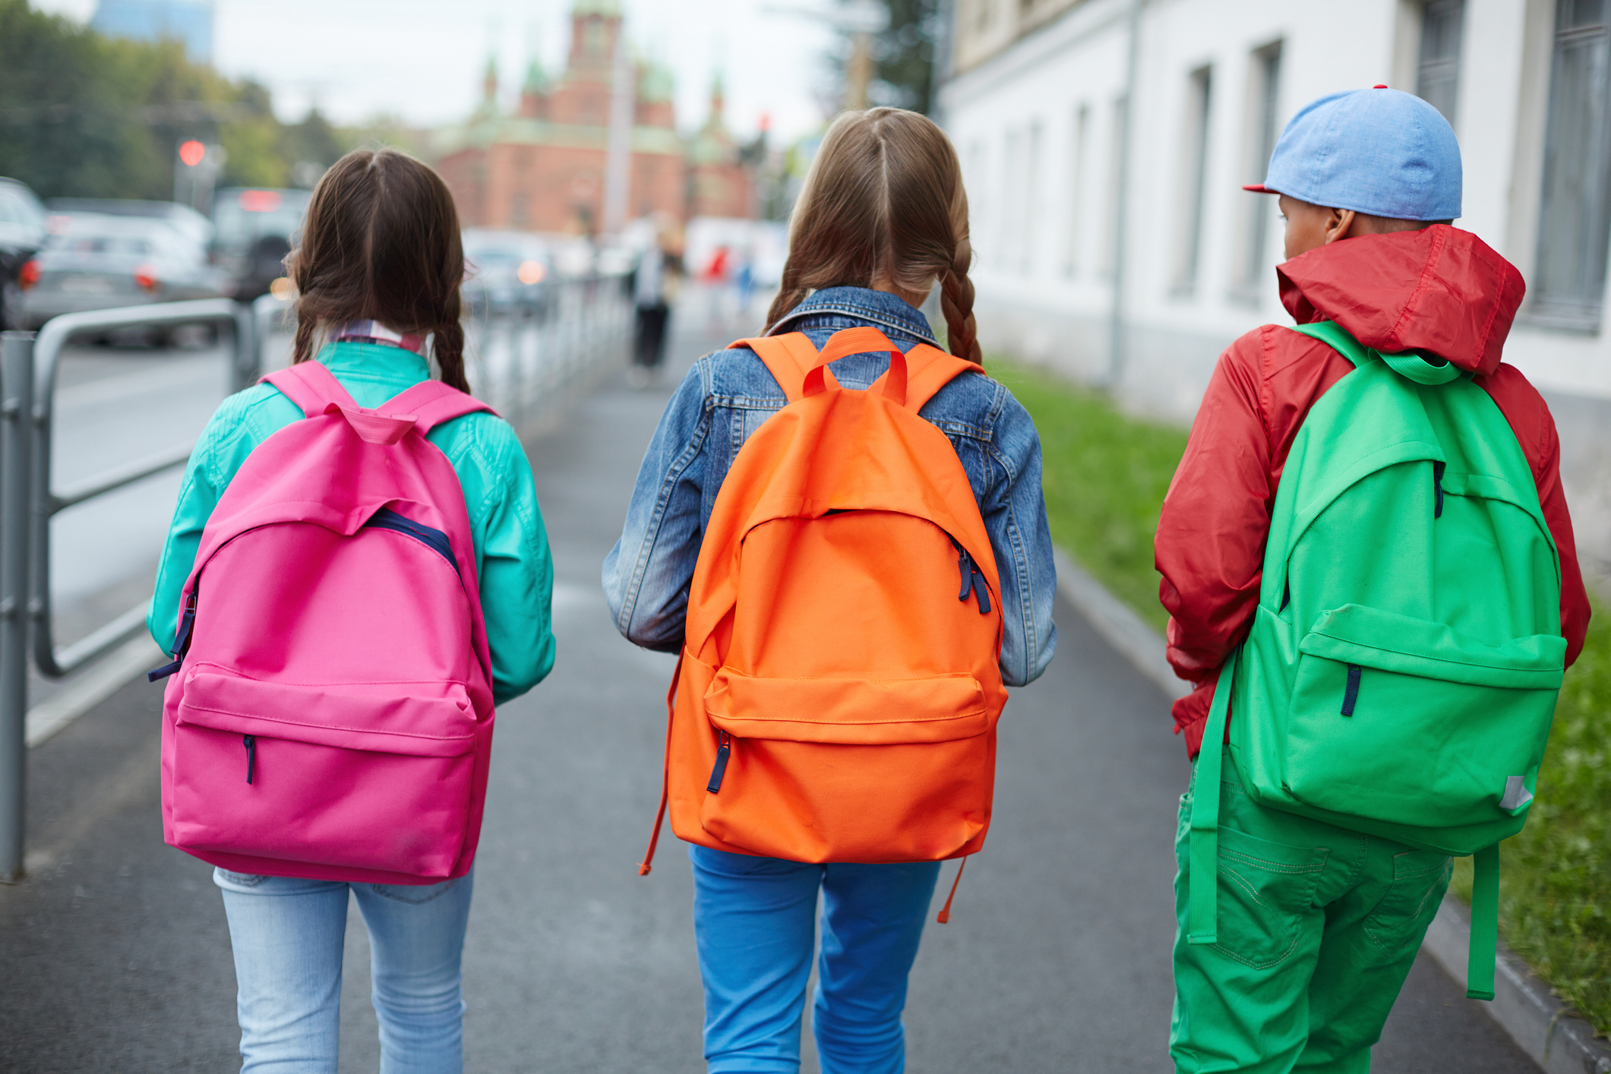
We’re going to the theatre!
I will travel to Polka Theatre.
I might be travelling by bus,
or by train,
or on foot.
My class will be going there too.
My teachers will going be there too.

Slide 3
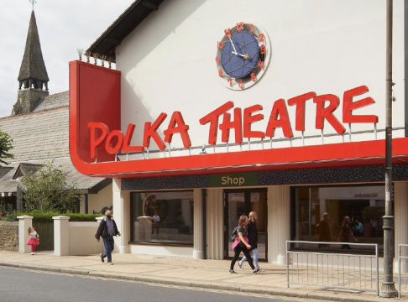
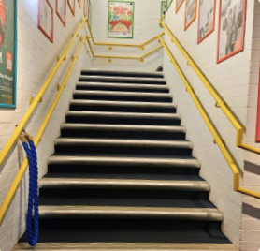
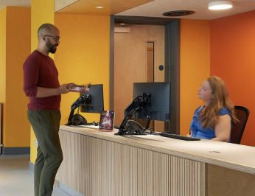
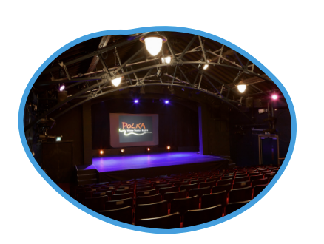
The Location
This This is the outside of P Polka Theatre.
When I go in the main entrance, entrance the Box Office will be my left.
Next to the Box Office there is a small walkway to s some stairs. I will go up to
I will go up to the main t theatre using the stairs. If I If I need to, I will use the lift.
This is where
I will watch the show.

Slide 4
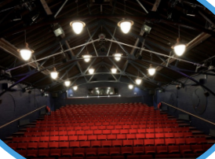
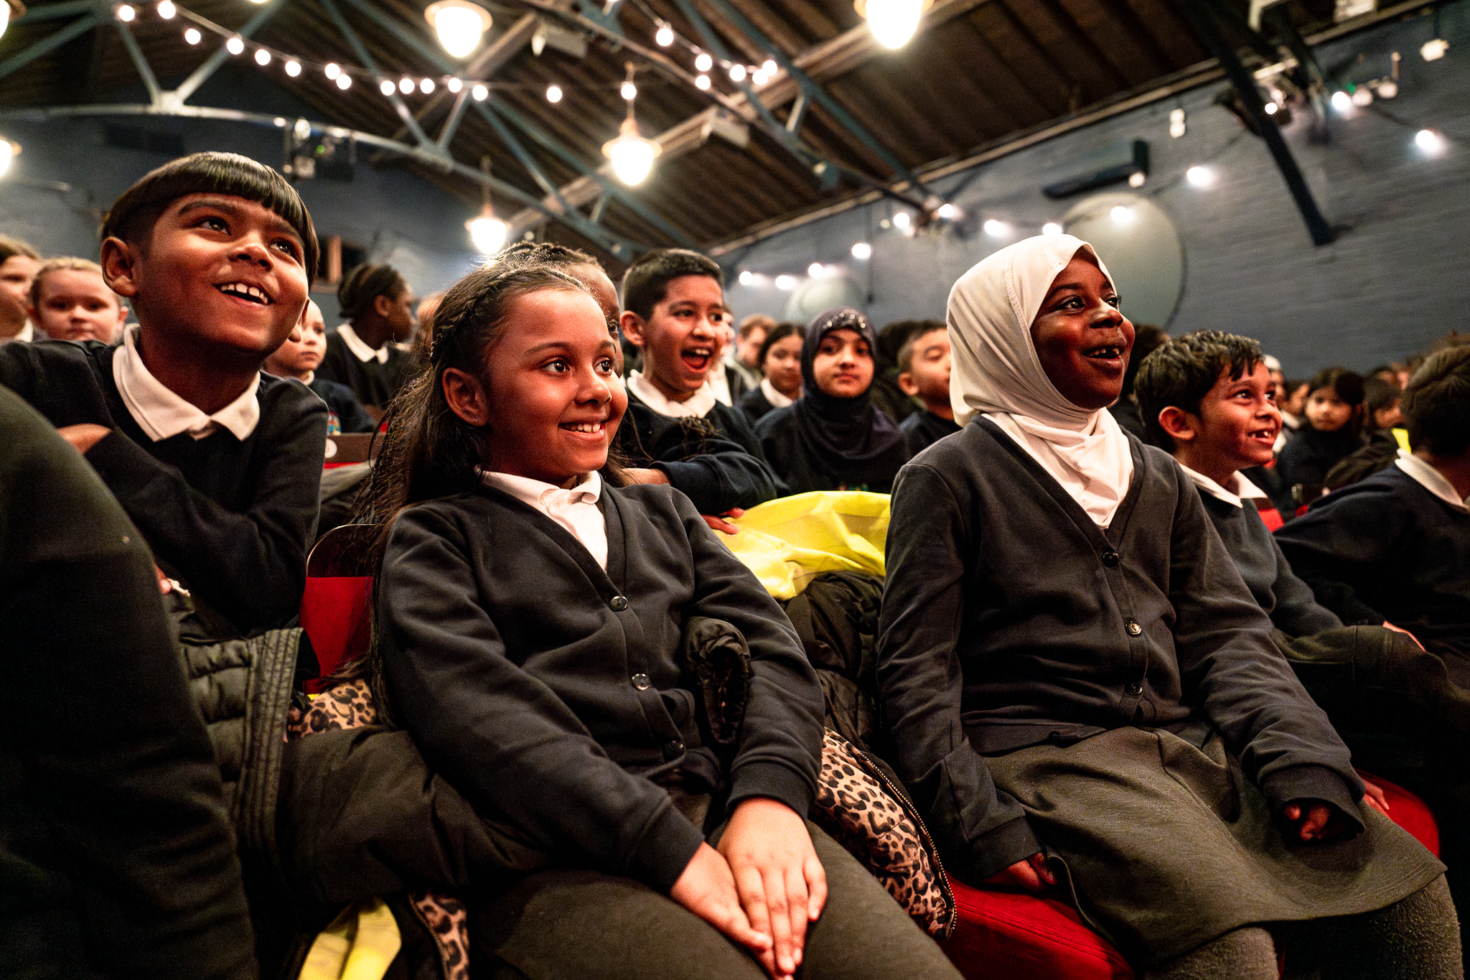
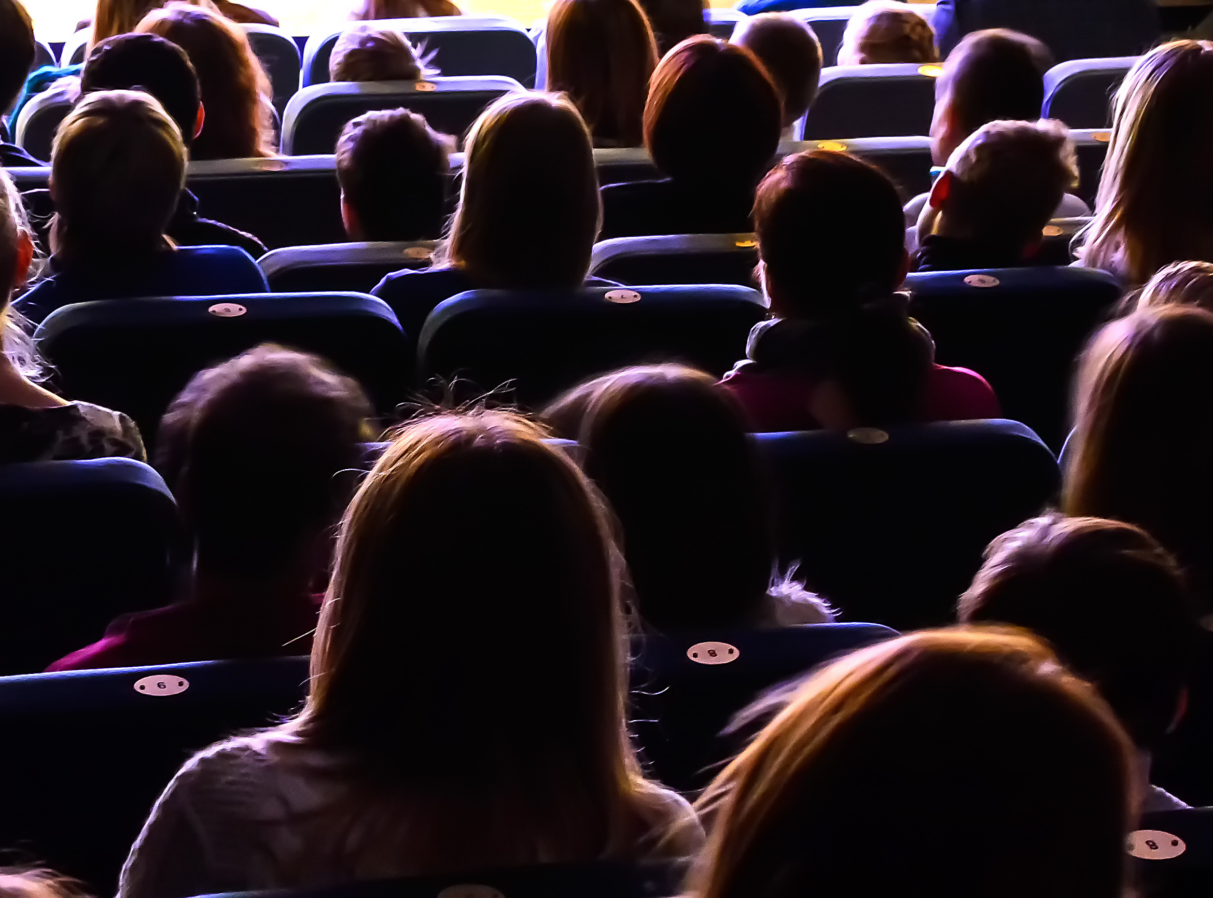
The Theatre
The venue staff will show me where to go and how to get to my seat.
The lights will be on to help me find my seat.
Once the show starts, it will go dark.
Here is some more information about the show:
About the show Lila dreams of becoming a Master Firework-Maker just like her father, but to become one she must go on an epic journey that will push her to her limits. Only then can she discover the closely guarded secret to becoming a true firework master.
Time is beginning to run out. When her father’s life depends on her winning the firework competition and pulling off the best display the world has ever seen, can Lila’s skills save the day and light up the skies?
Join Lila on the quest of a lifetime as she faces friend and foe on her illuminating, adventurous journey of self-discovery.
I will see a show called The Firework Maker's Daughter.
It is 1 hour 20 minutes long.
It has a break in the middle called an interval.

Slide 5
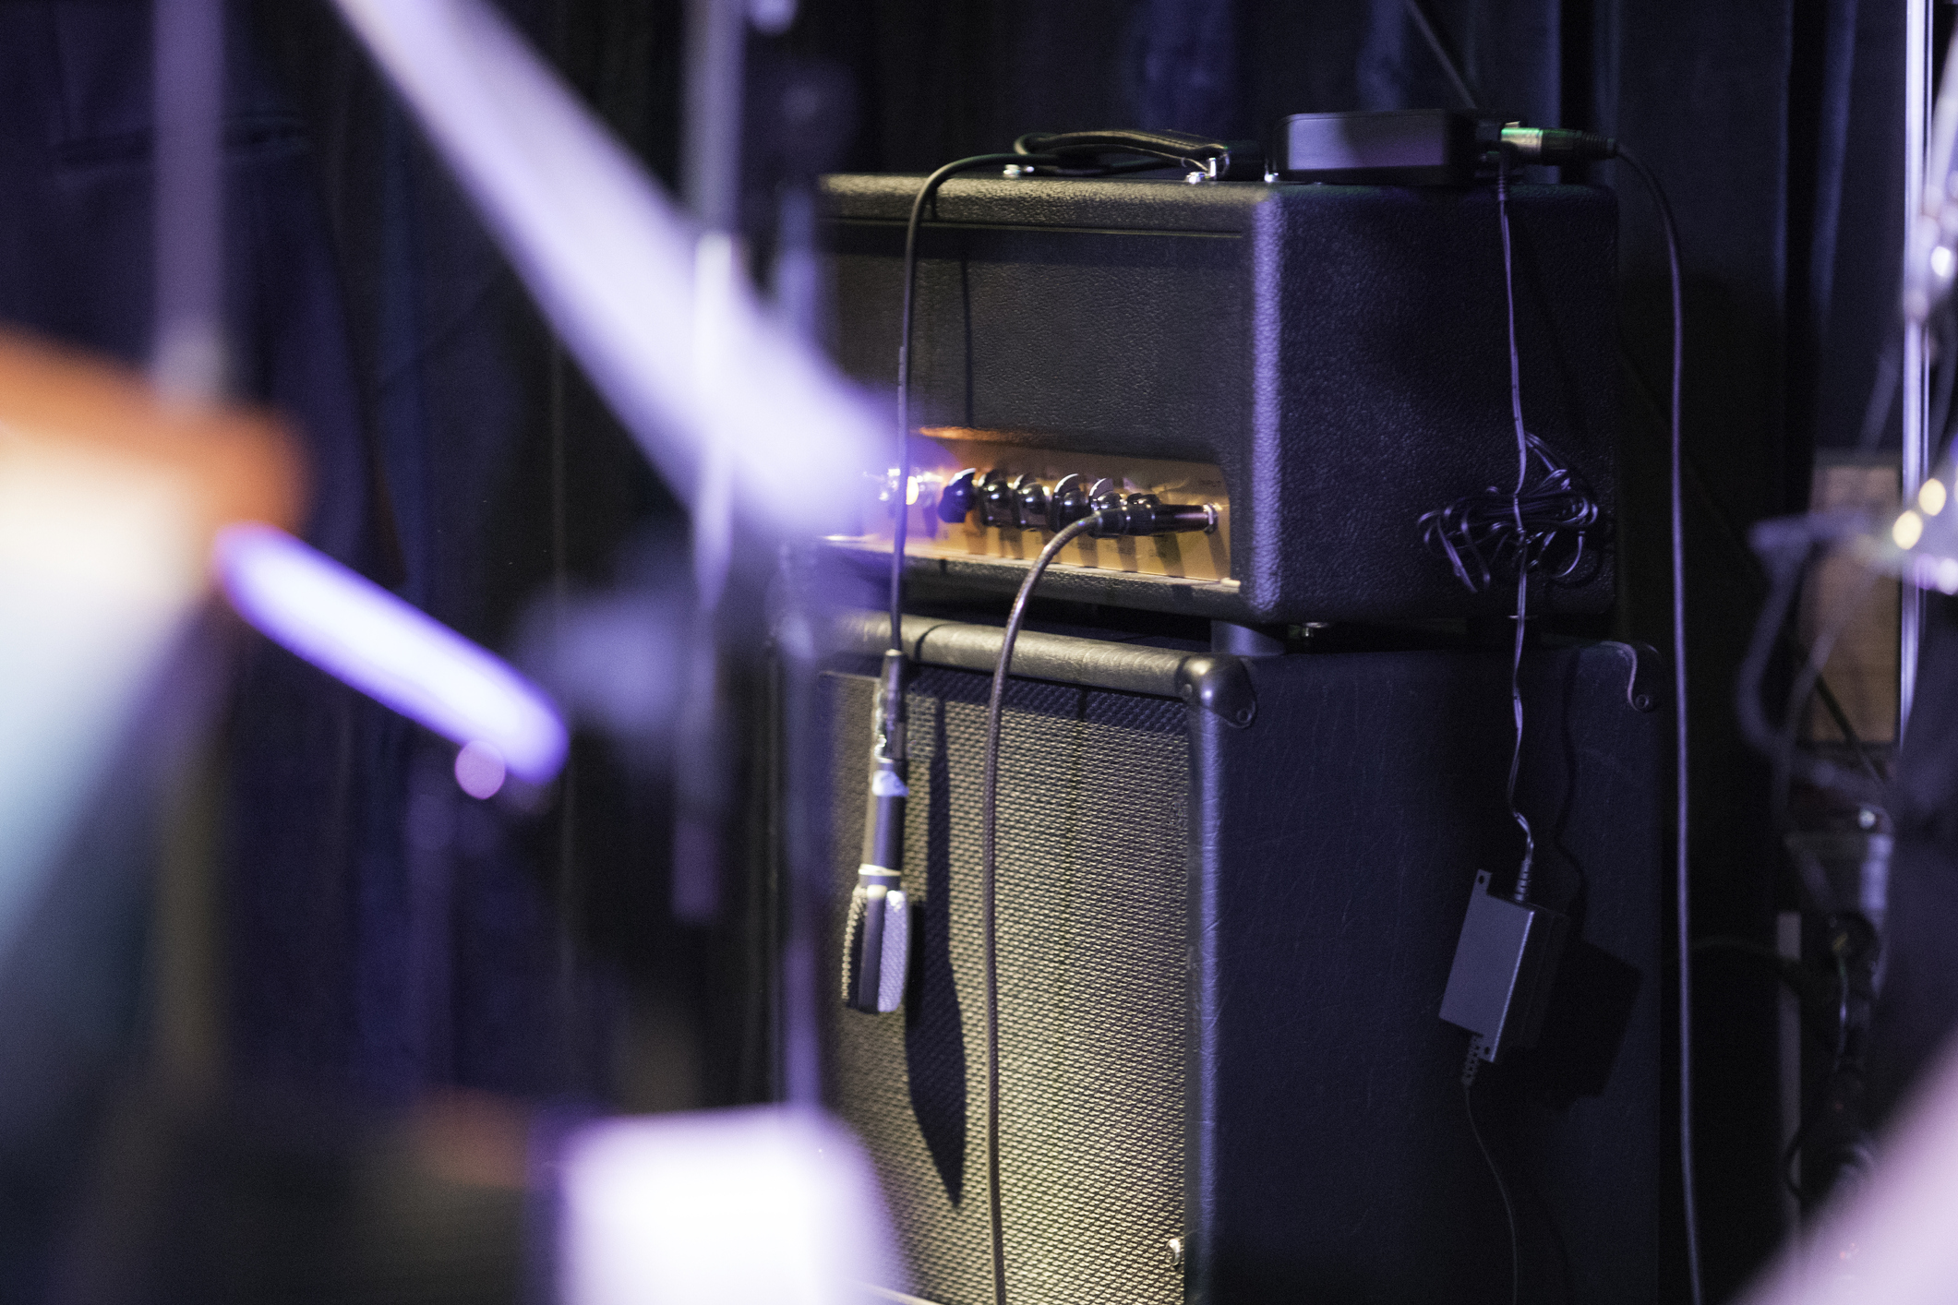
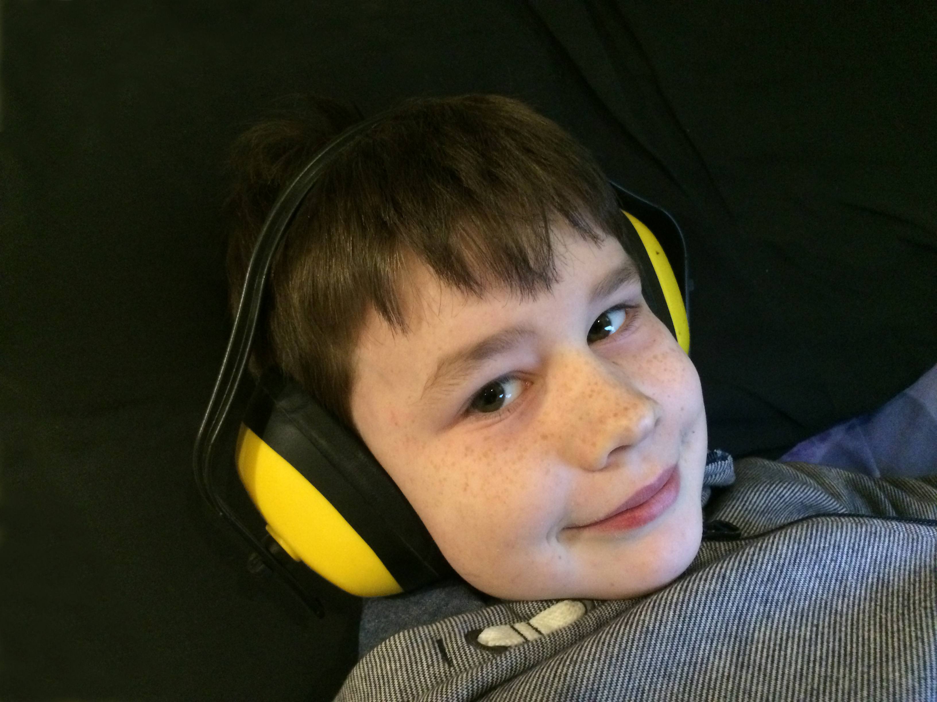
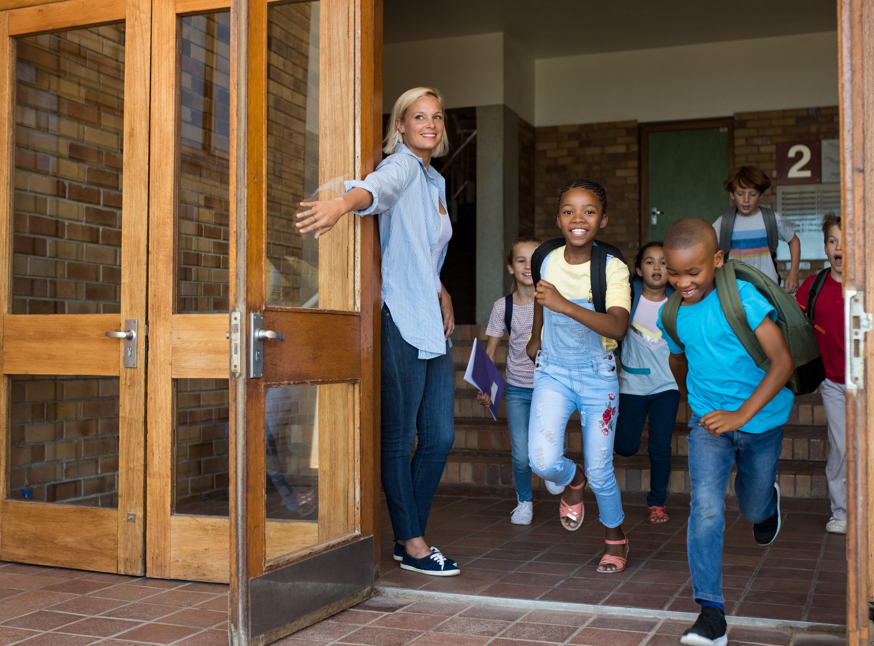
The Show
The show will have sounds and music.
If it is too loud, I can cover my ears or use ear defenders.
My class will be there.
Other schools might be there too.

Slide 6

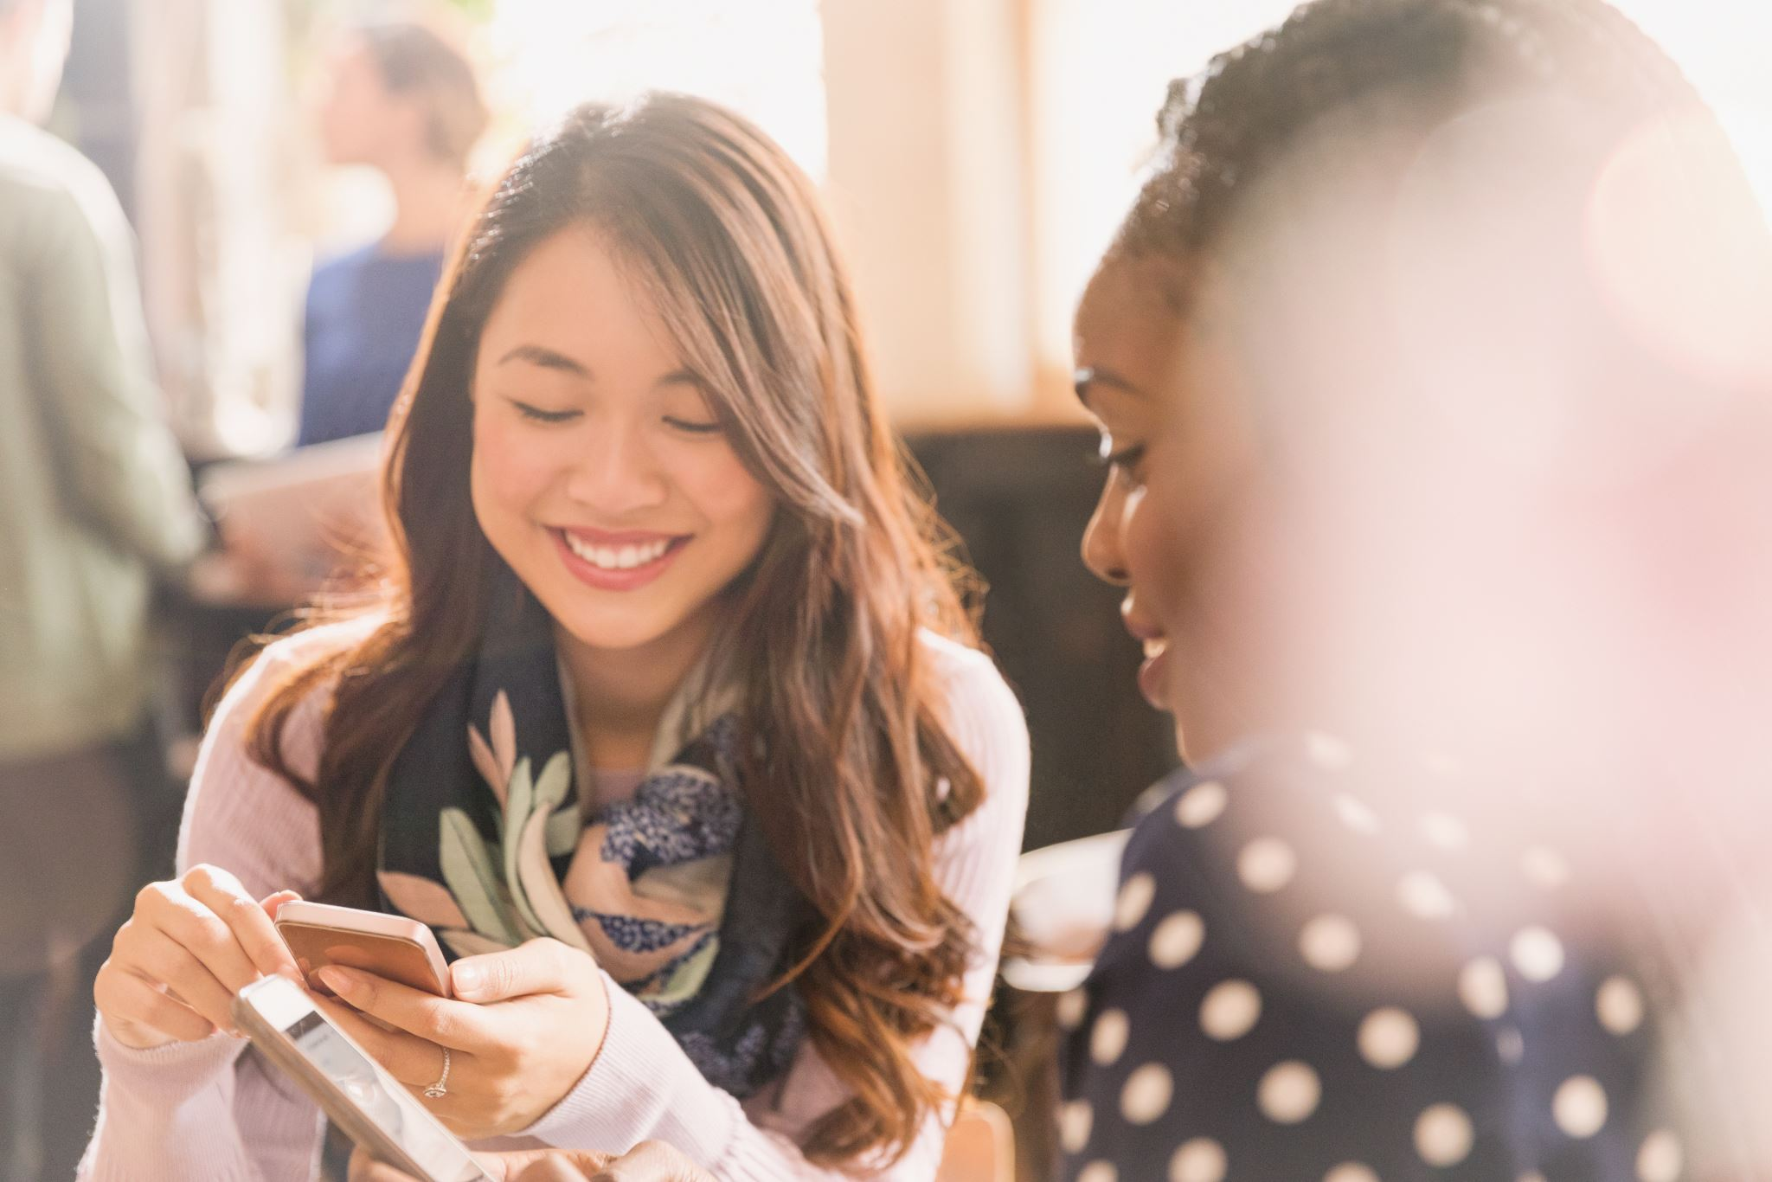

The Interval
There will be a short break in the middle of the show. This is called an interval.
The lights will come back on. The audience might clap.
People in the audience might talk and move around the theatre space.
When the interval ends and the show starts, it will go dark again.

Slide 7
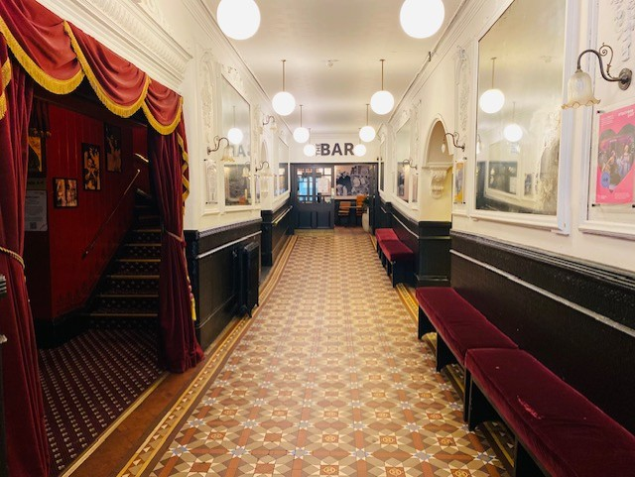

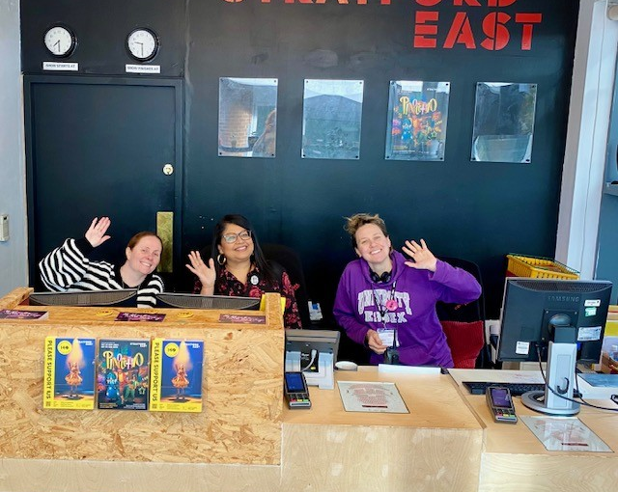
The End of the Show
When the show ends, the lights will come back on.
The audience might clap.
I will walk back to the main entrance.
I will say goodbye to the staff when I leave.
I will travel back to school with my teachers and class.

