Slide 1
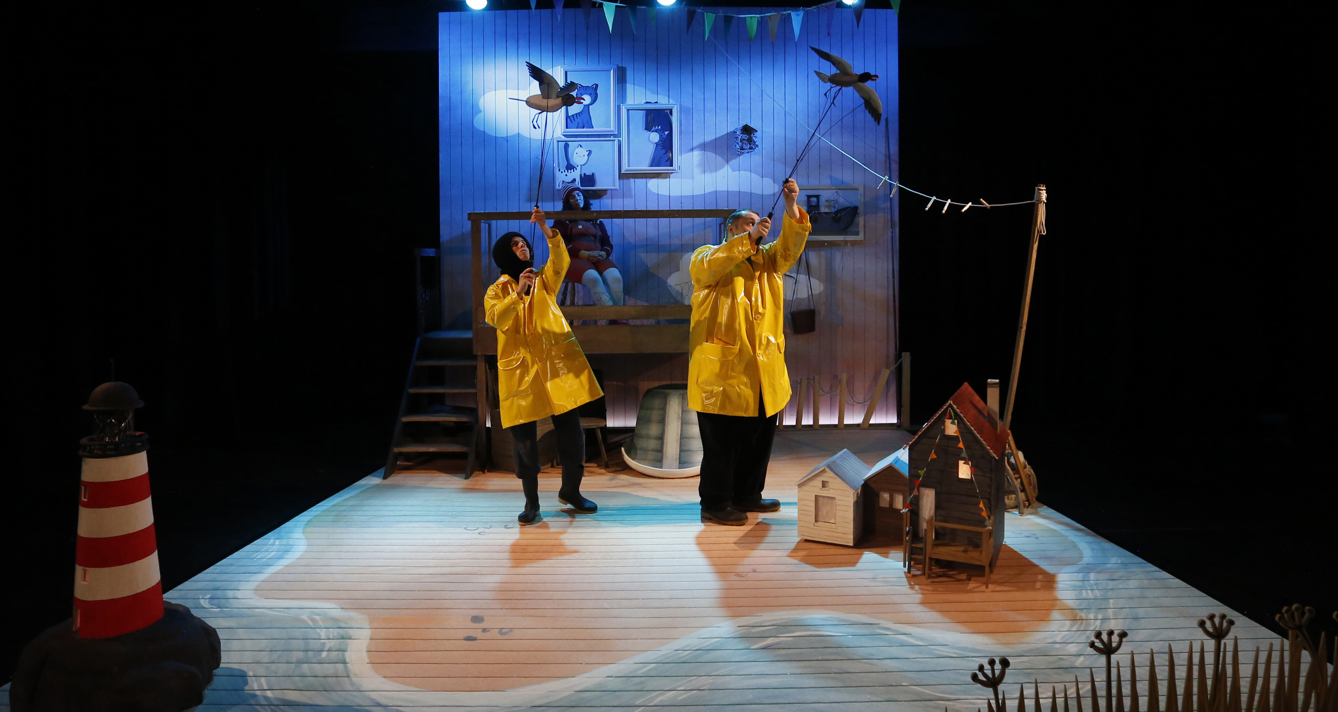

Go & See – Theatre
Visual Guide Resource
A visual guide to support pupils’ understanding of going to see a theatre show at Little Angel Studios in Islington.
You can access additional resources on A New Direction’s website.
This visual guide could be particularly relevant to pupils who benefit from Social Stories. Teachers could read it with their classes before the trip and it could be shared as a handout for grownups to read at home too.
To find out more about Social Stories, please visit this website.
Go & See: Schools’ Resources

Slide 2
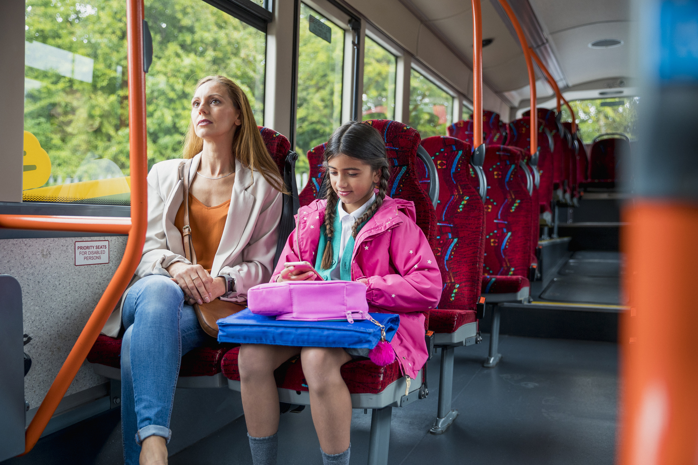
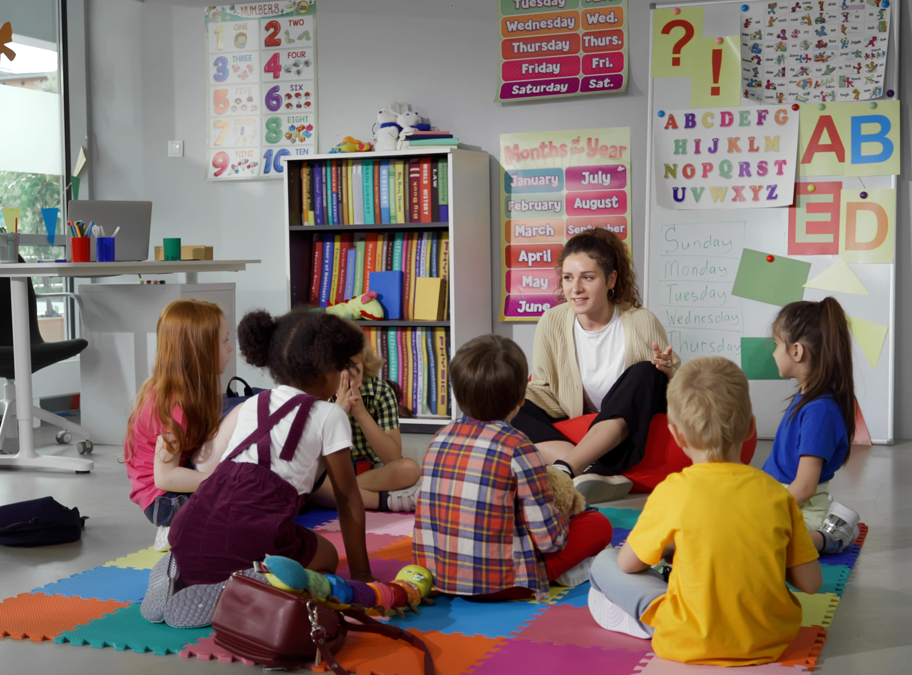
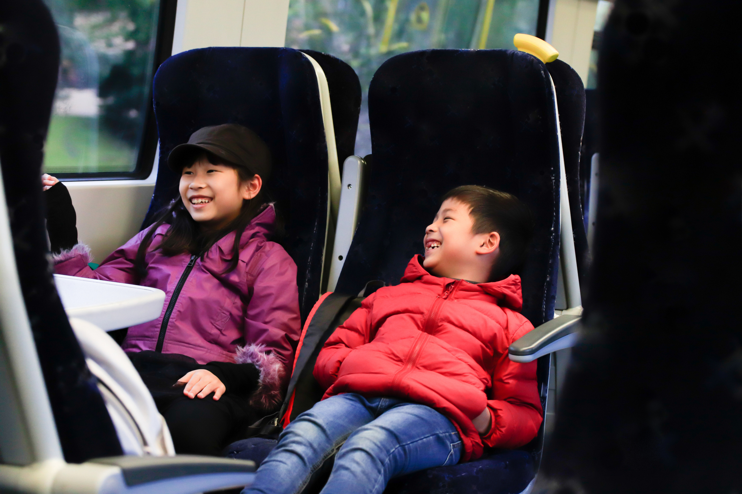
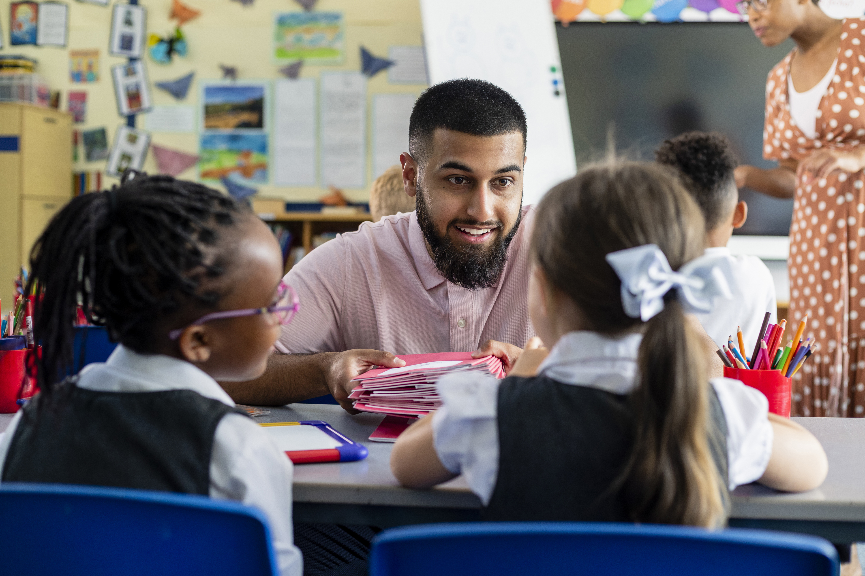
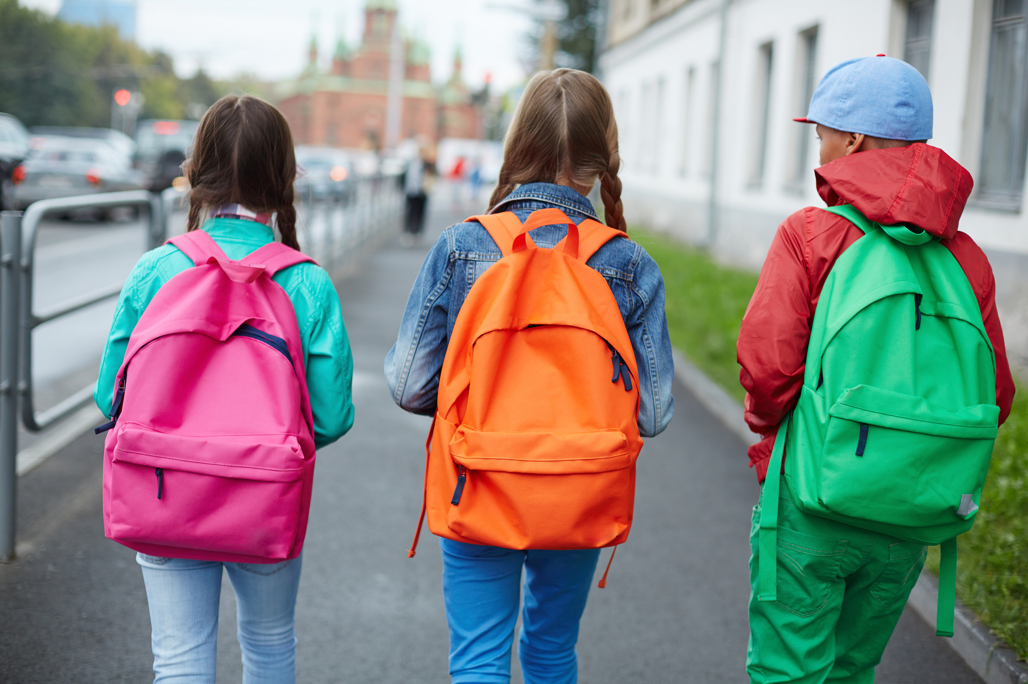
We’re going to the theatre!
I will travel to Little Angel Theatre.
I might be travelling by bus,
or by train,
or on foot.
My class will be going there too.
My teachers will going be there too.

Slide 3
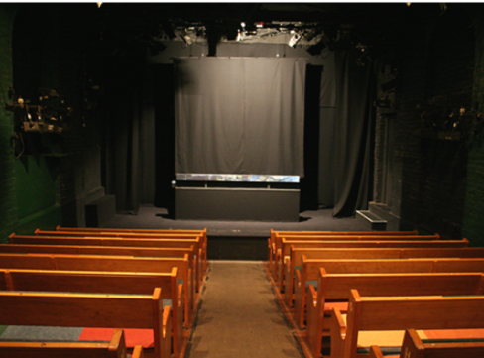
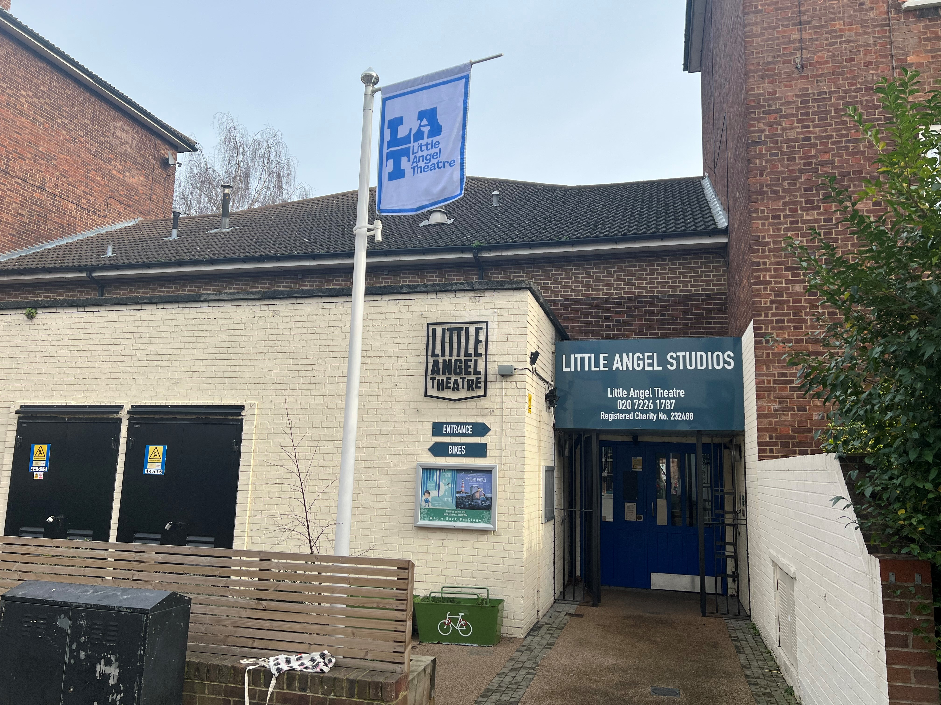
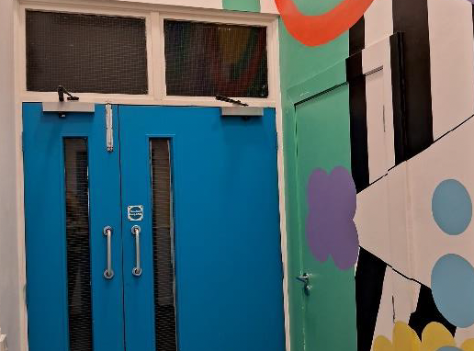
The Location
This is the outside of Little Angel Studios.
This is where I will watch the show.
This is the door you go through to enter the auditorium

Slide 4

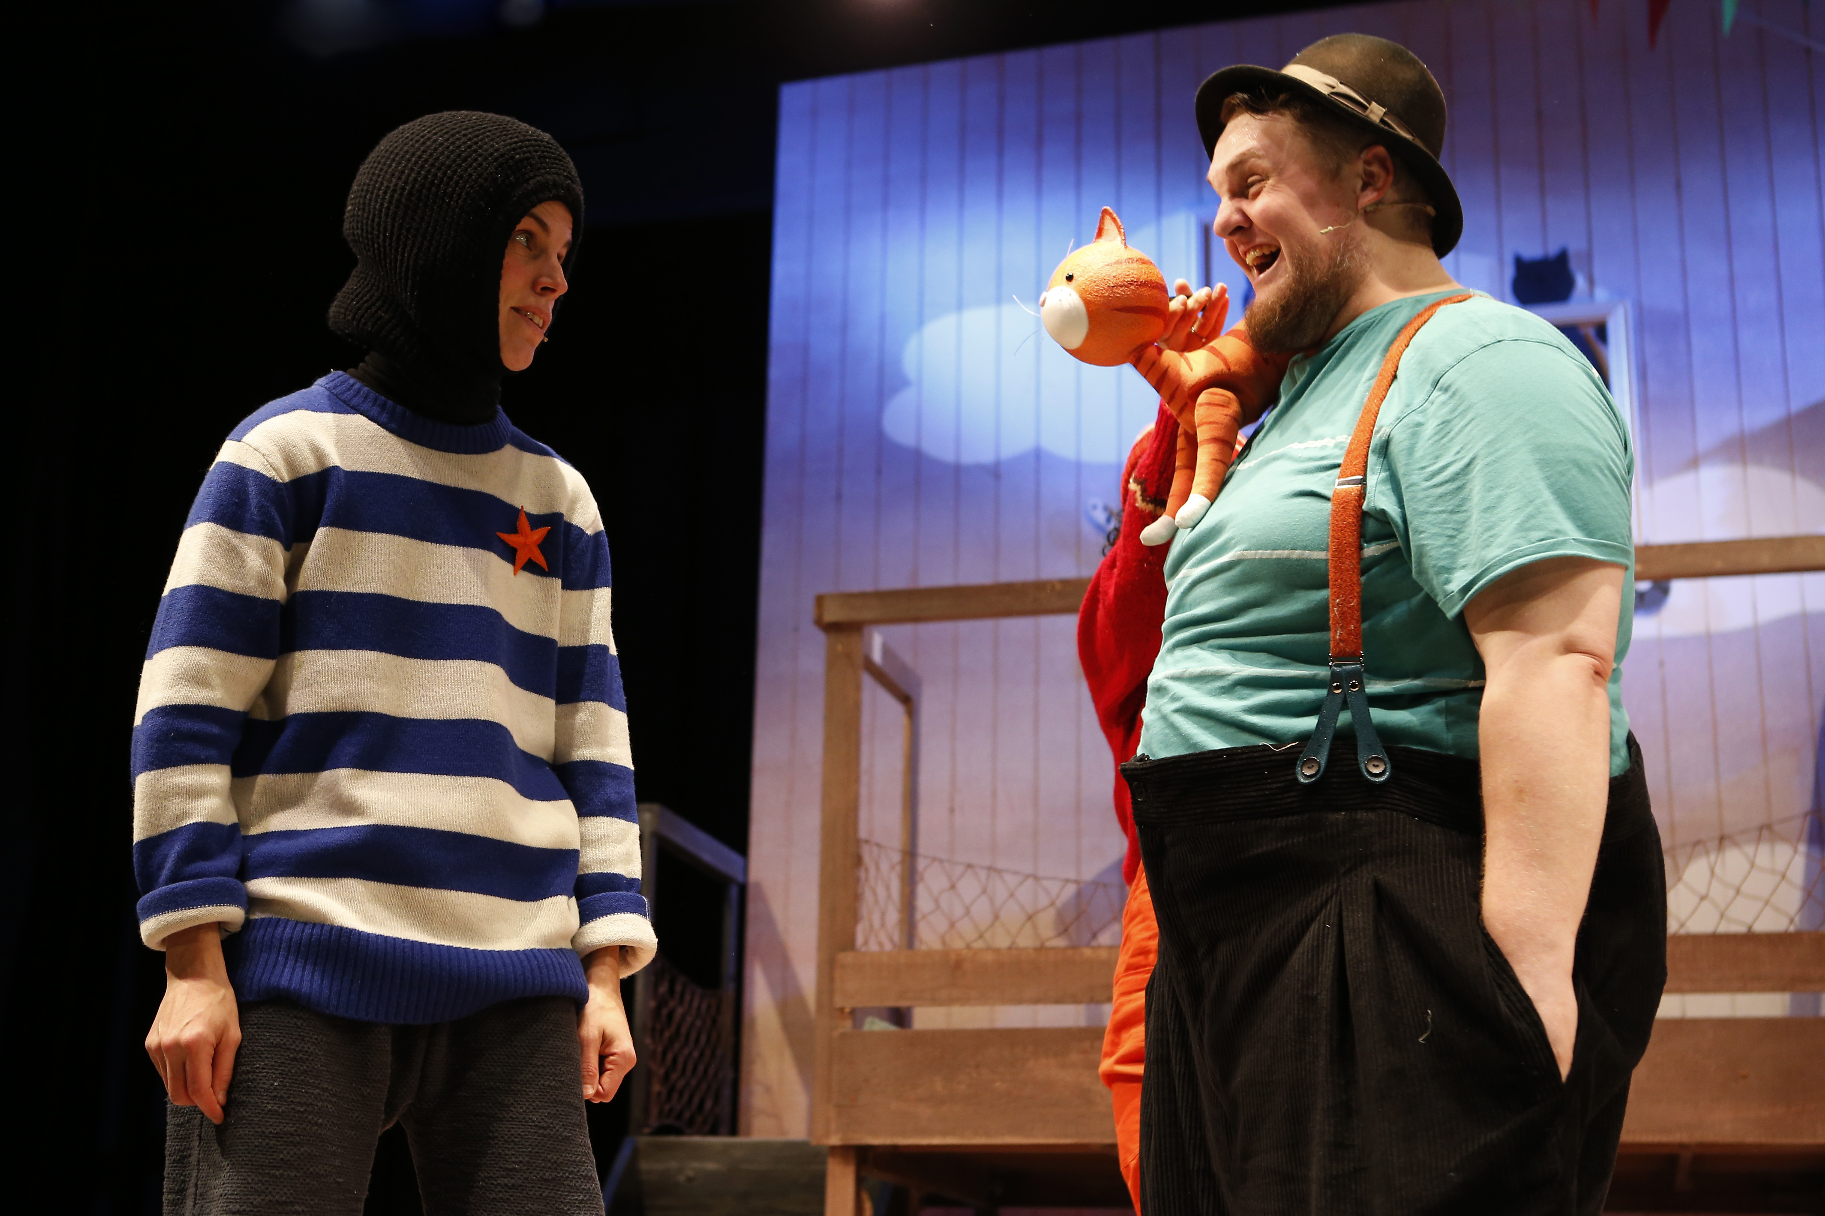
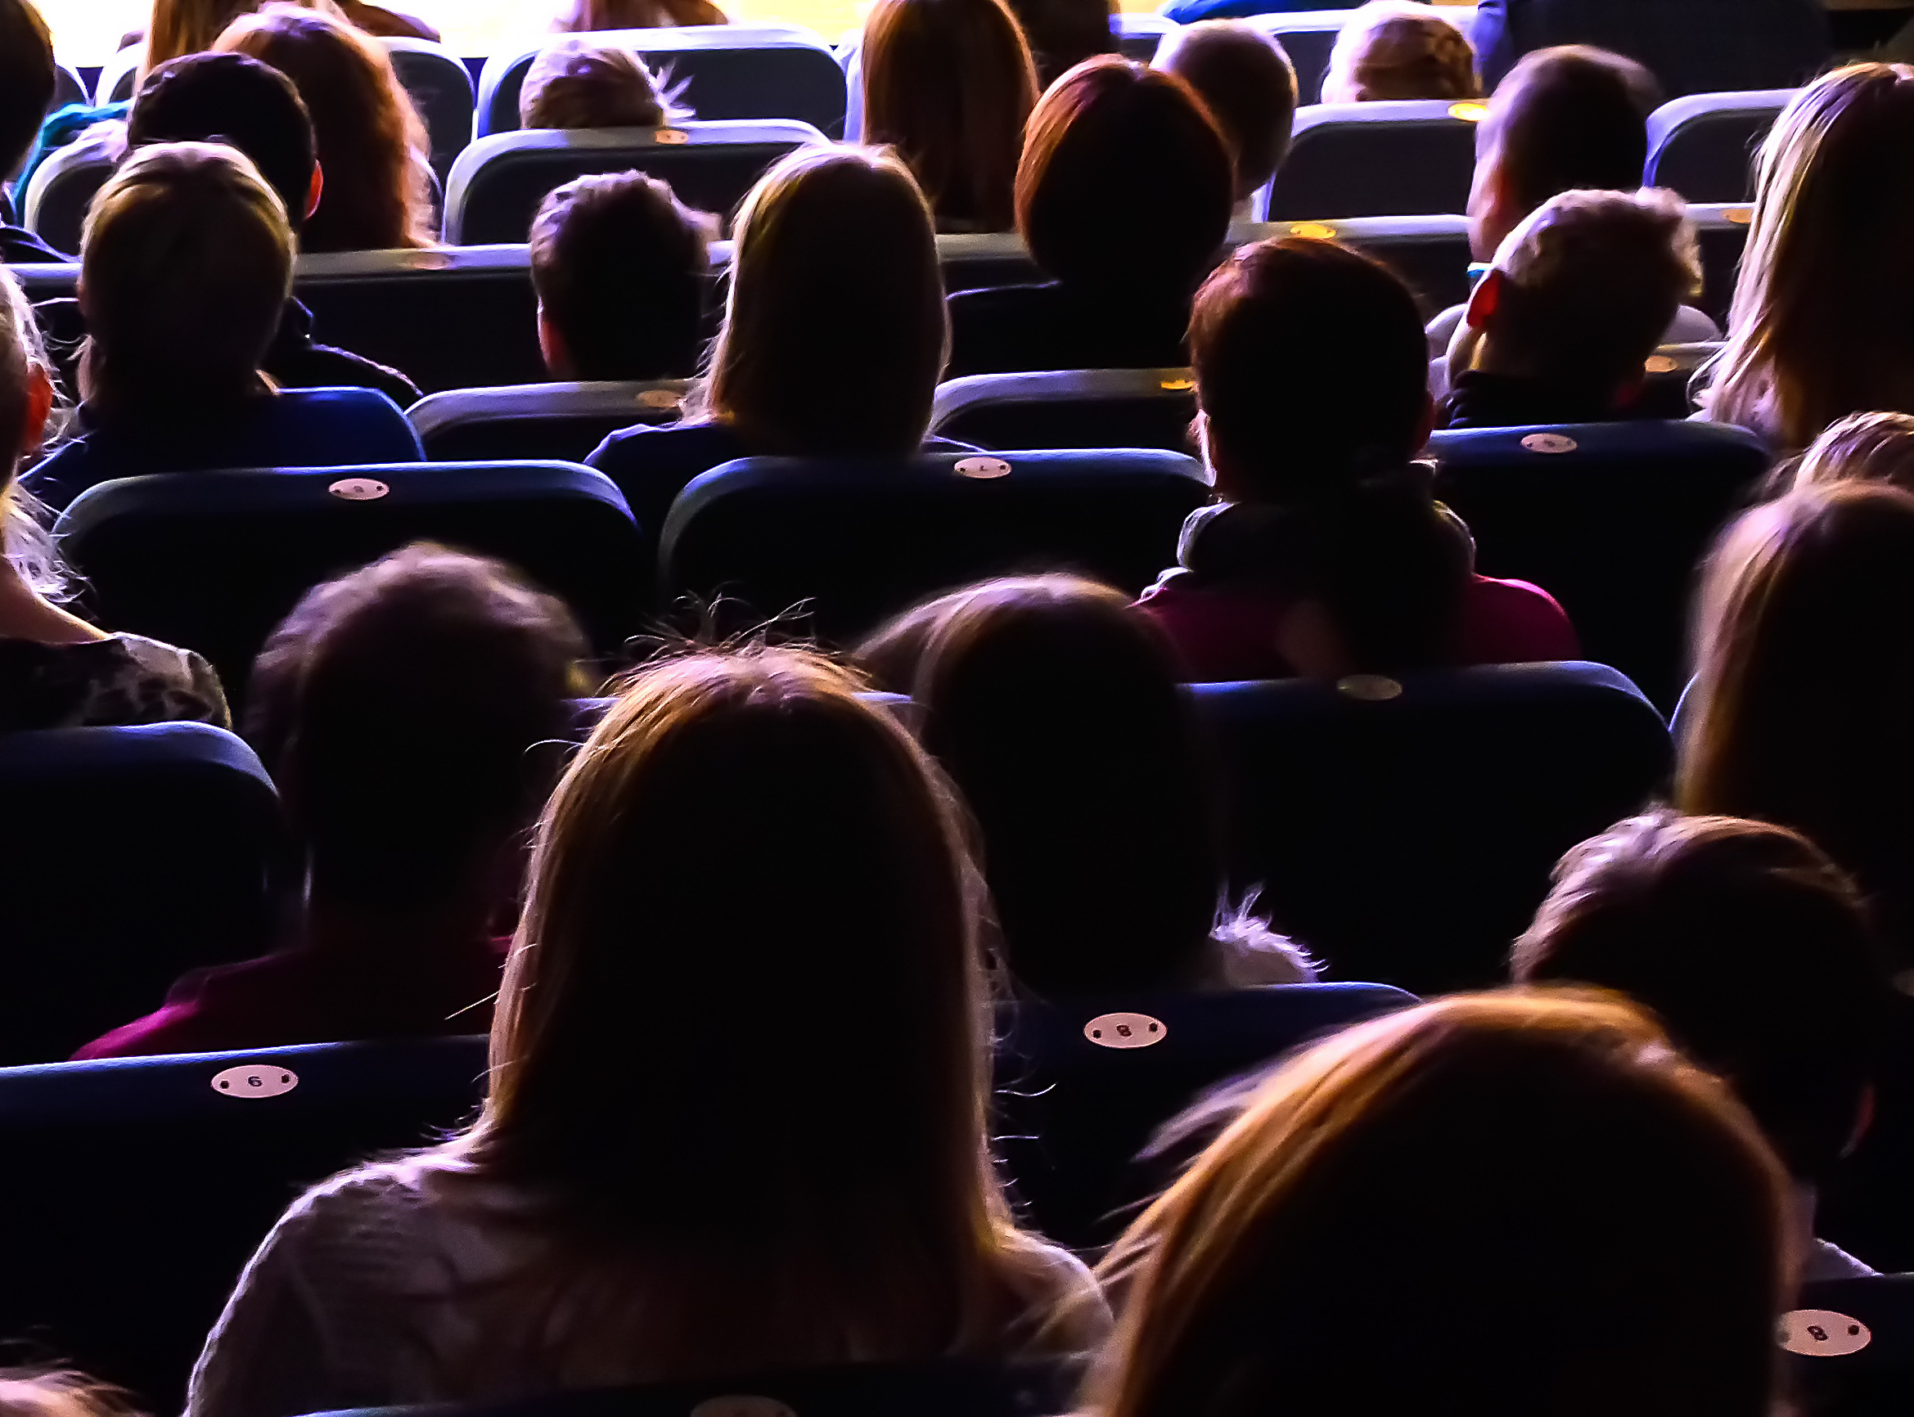
The Theatre
The venue staff will show me where to go and how to get to my seat.
The lights will be on to help me find my seat.
Once the show starts, it will go dark.
I will see the show The Storm Whale
It is 50 minutes long.
Here is some more information about the show:
The Storm Whale is based on Benji Davies’ award winning books The Storm Whale and The Storm Whale in Winter.
The story follows Noi, who lives with his dad and six cats by the sea. One summer, while his dad was busy at work, Noi rescued a little whale that washed up on the beach. A friendship began that changed their lives forever. The following winter his dad takes one last trip in his fishing boat. Noi is alone once more and longs to see his friend again. Will it take another storm to bring them back together?

Slide 5
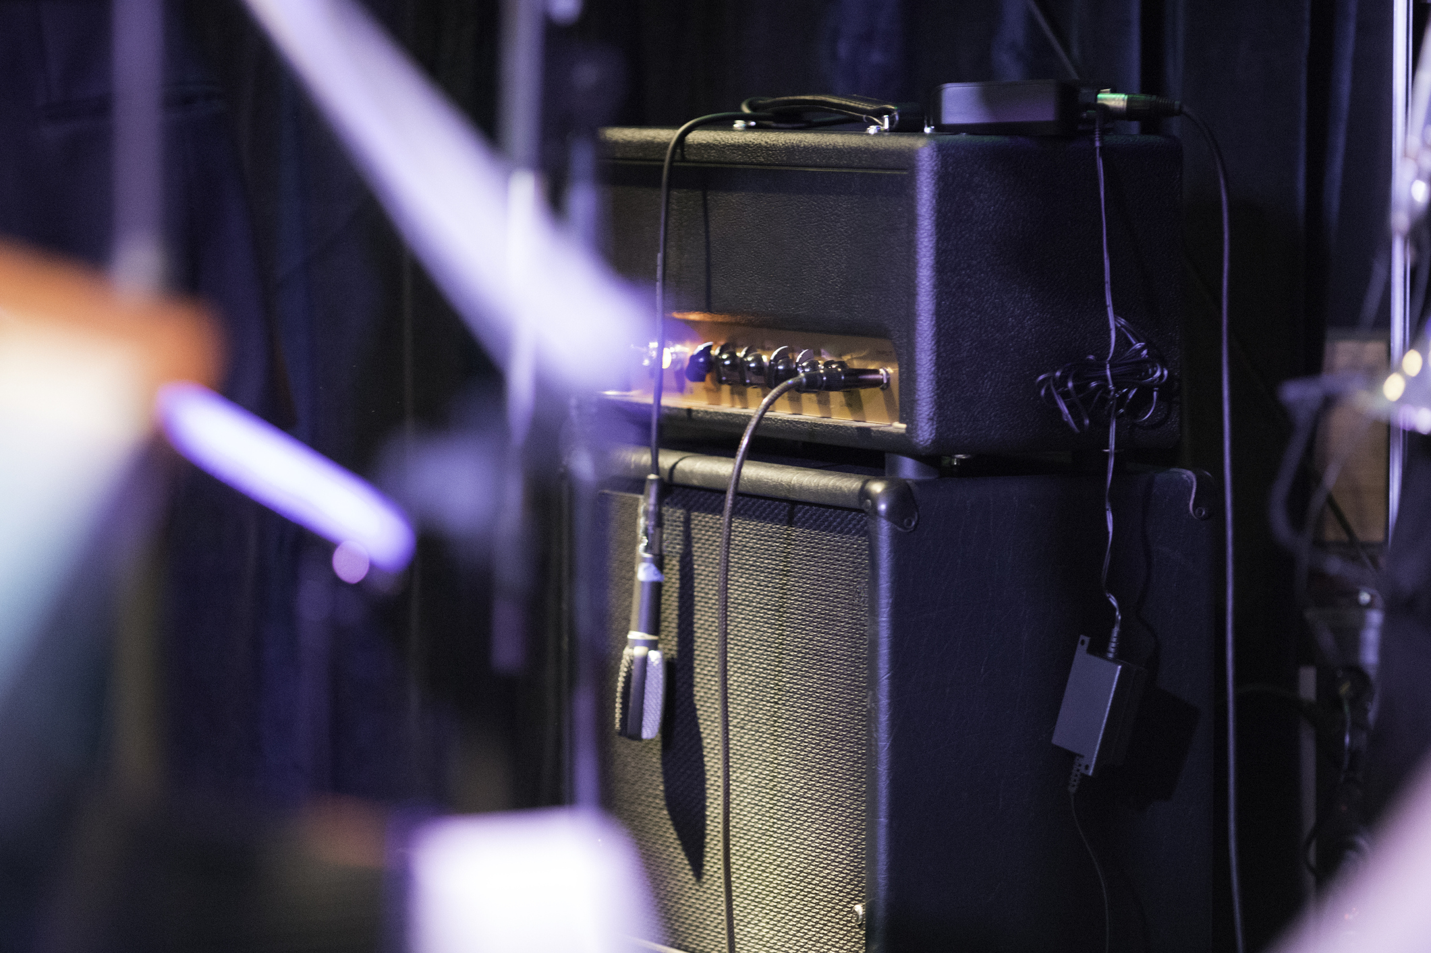
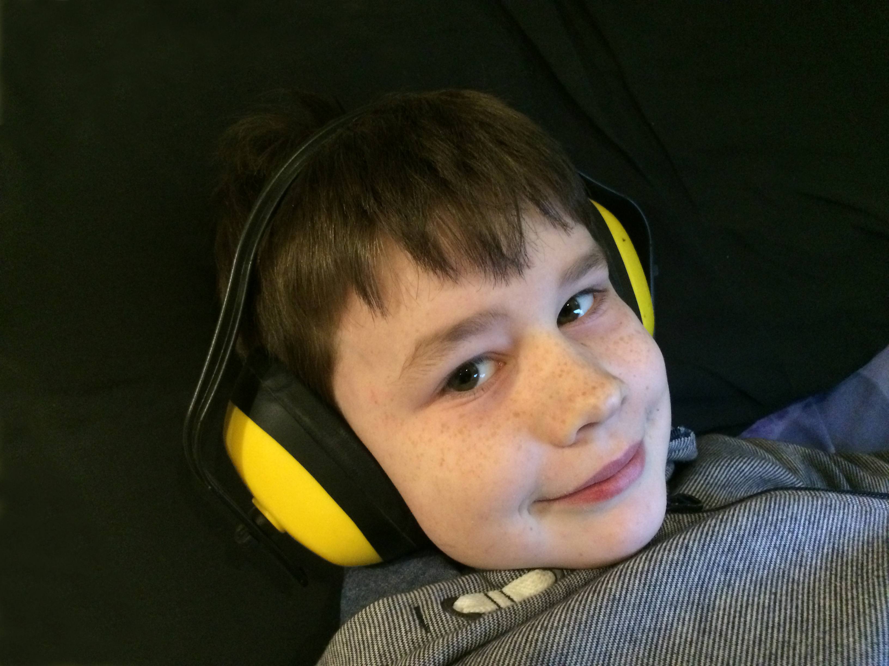
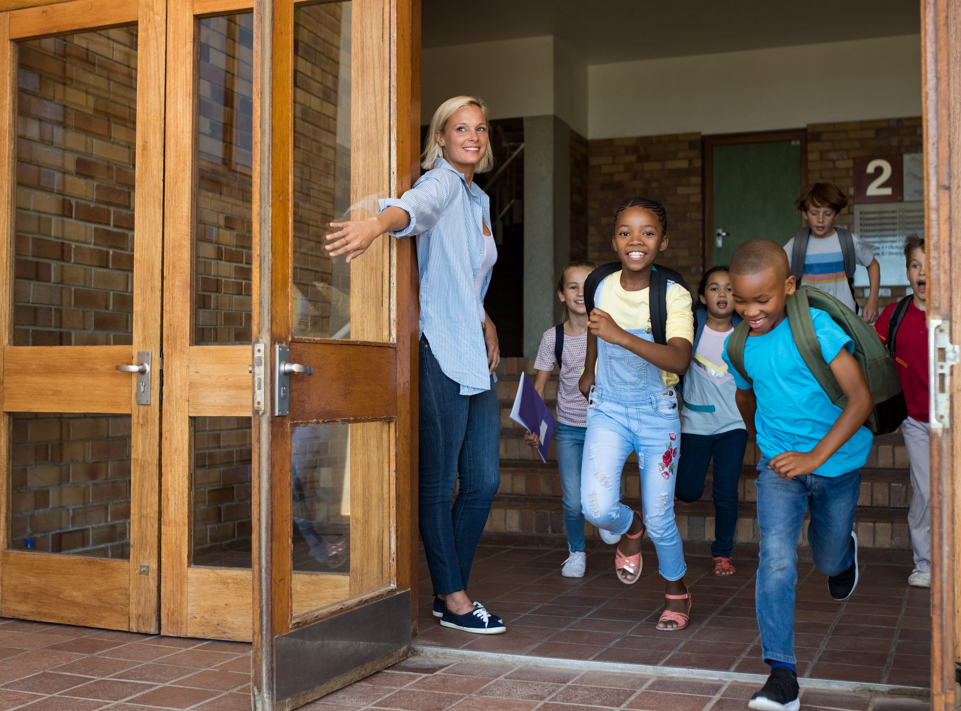
The Show
The show will have sounds and music.
If it is too loud, I can cover my ears or use ear defenders.
My class will be there.
Other schools might be there too.

Slide 6
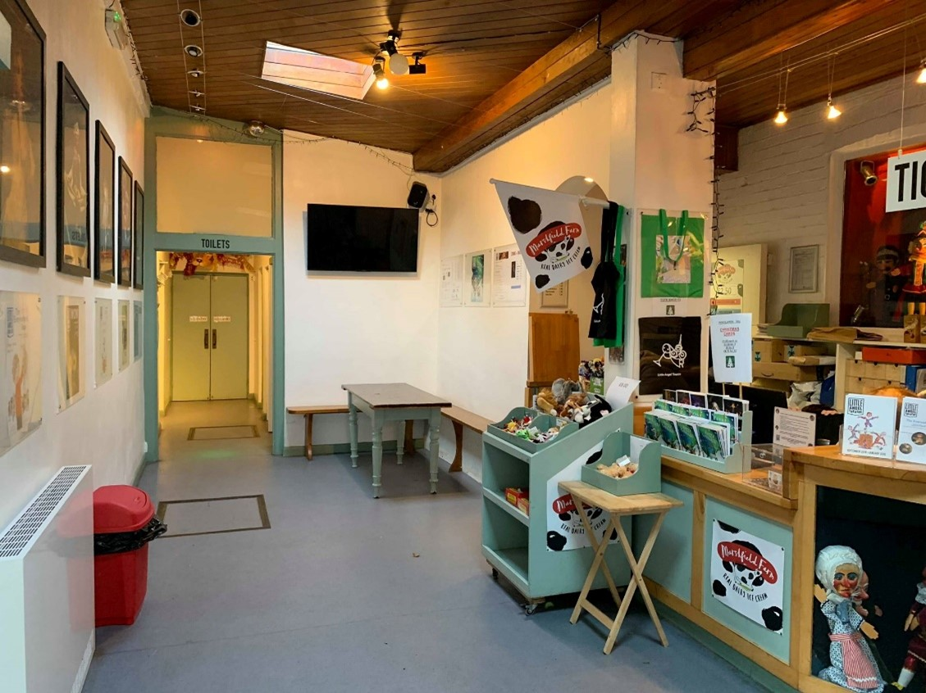

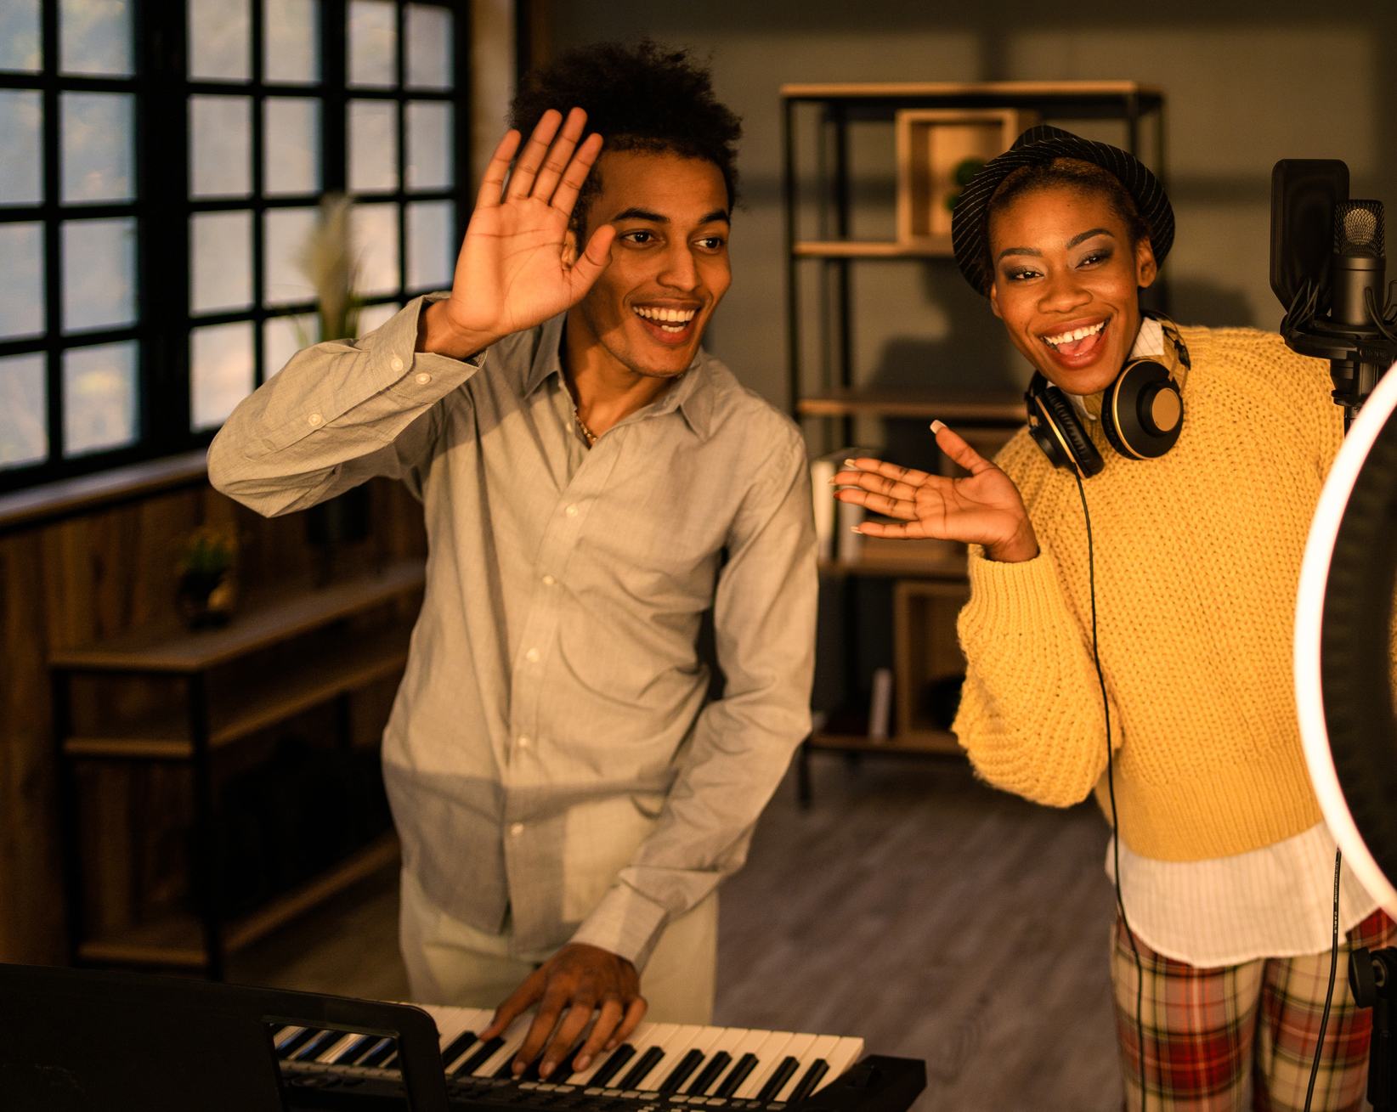
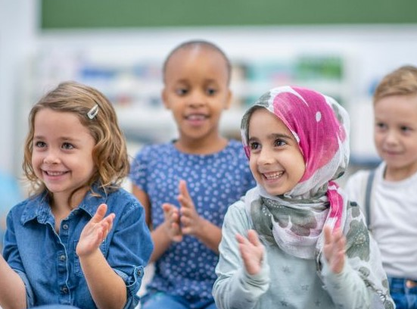
The End of the Show
When the show ends, the lights will come back on.
The audience might clap.
I will walk back to the main entrance.
I will say goodbye to the staff when I leave.
I will travel back to school with my teachers and class.

