Slide 1
Go & See – Theatre
Visual Guide Resource
A visual guide to support pupils’ understanding of going to see a theatre show at Polka Theatre in Wimbledon.
You can access additional resources on A New Direction’s website.
This visual guide could be particularly relevant to pupils who benefit from Social Stories. Teachers could read it with their classes before the trip and it could be shared as a handout for grownups to read at home too.
To find out more about Social Stories, please visit this website.
Go & See: Schools’ Resources

Slide 2
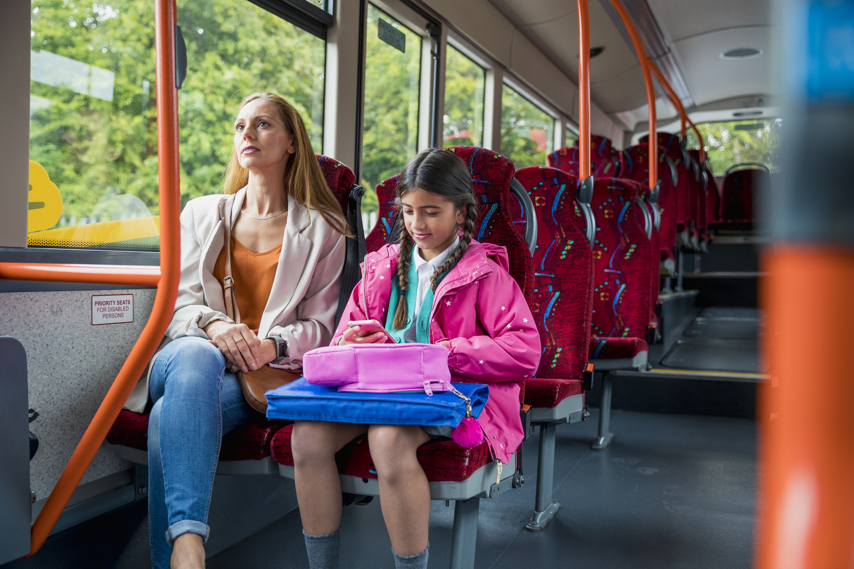
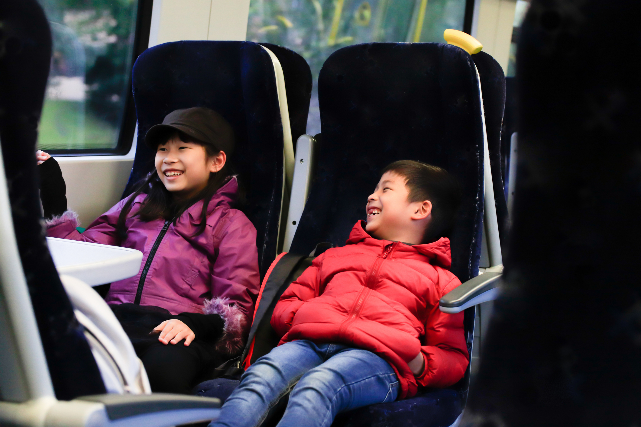
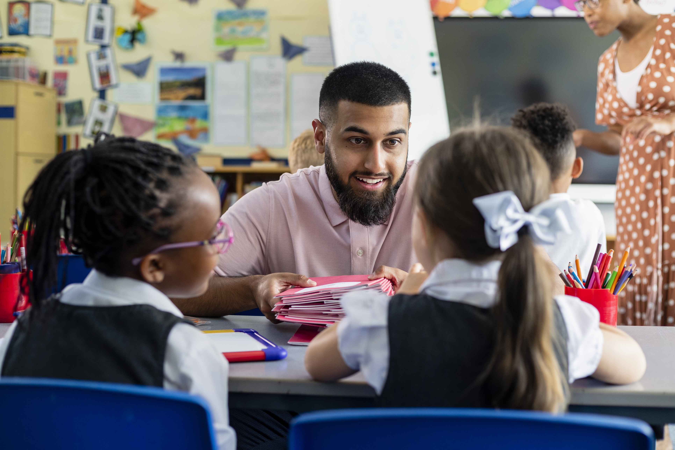
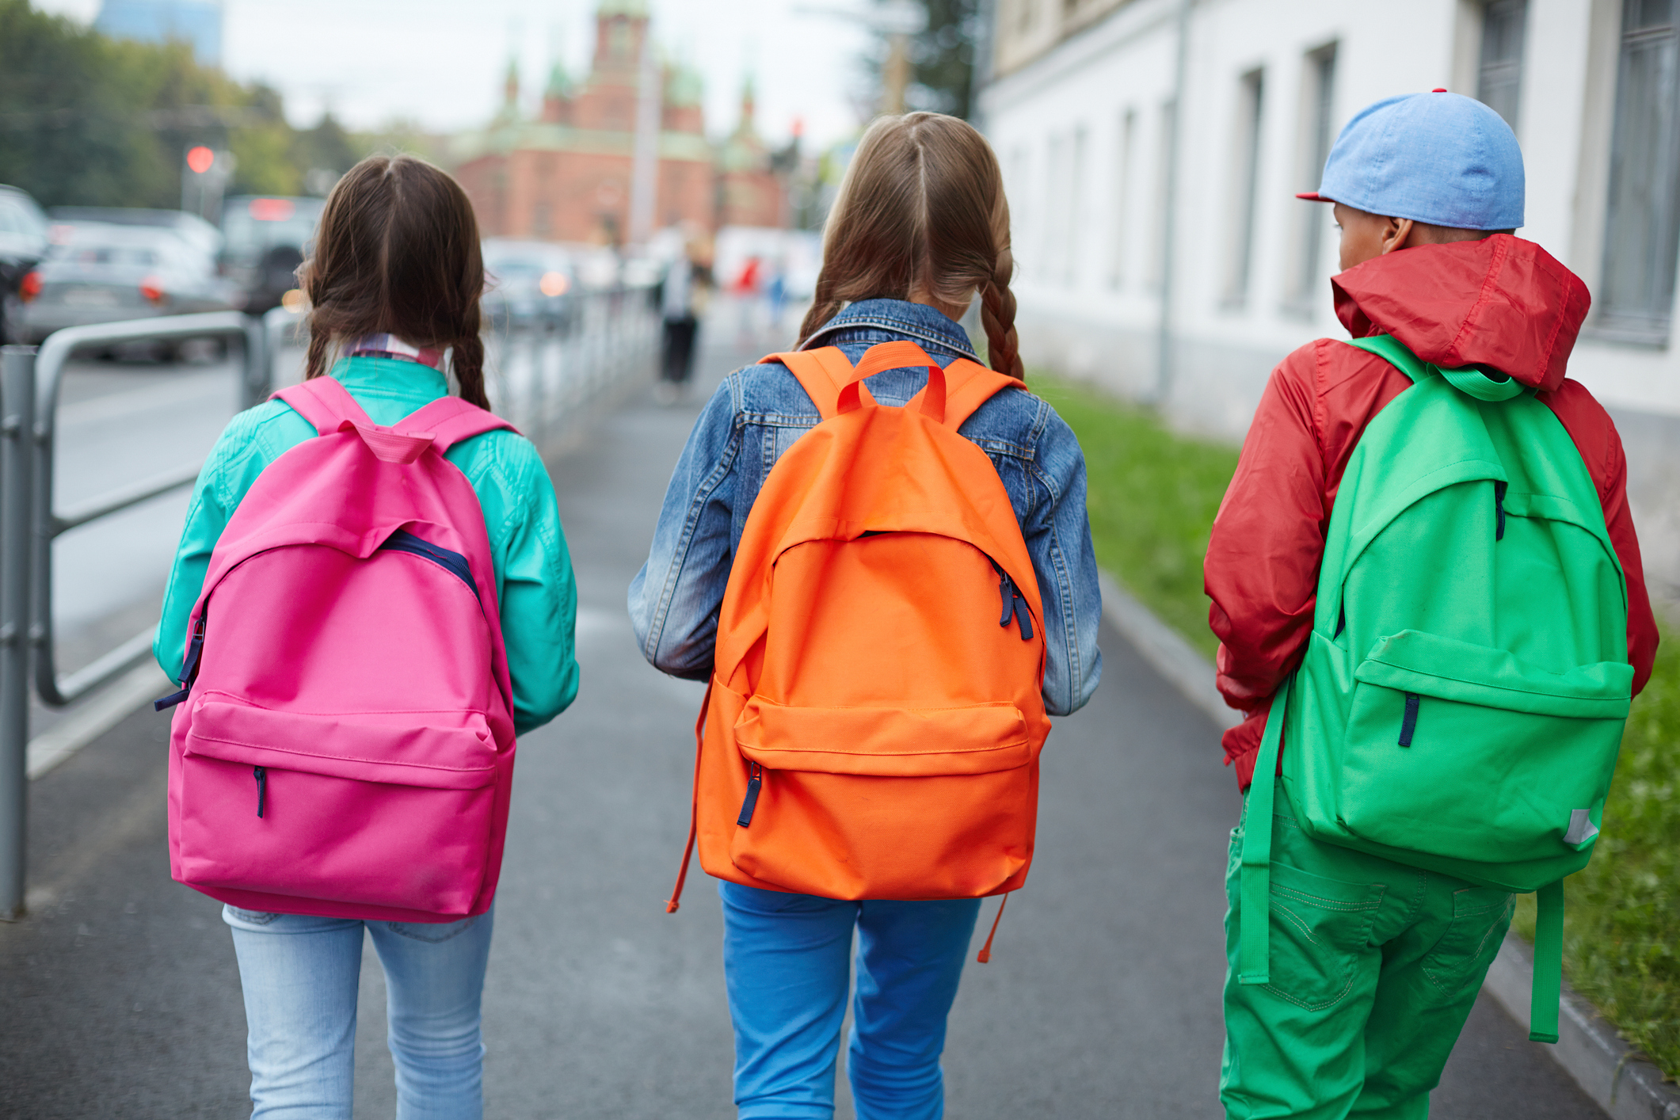
We’re going to the theatre!
I will travel to Polka Theatre.
I might be travelling by bus,
or by train,
or on foot.
My class will be going there too.
My teachers will going be there too.

Slide 3
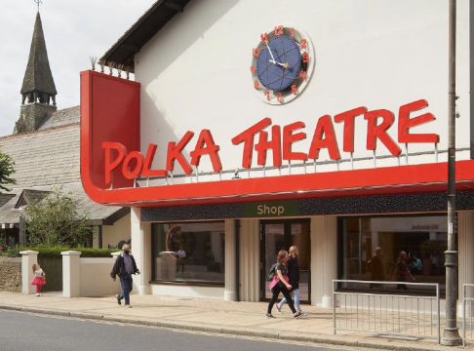
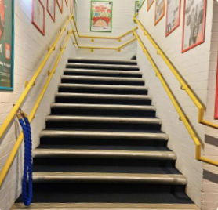
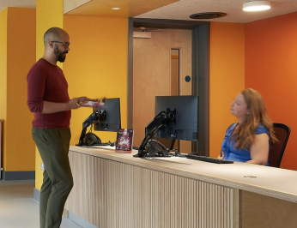
The Location
This This is the outside of P Polka Theatre.
When I go in the main entrance, entrance the Box Office will be my left.
Next to the Box Office there is a small walkway to s some stairs. I will go up to
I will go up to the main t theatre using the stairs. If I If I need to, I will use the lift.
This is where
I will watch the show.

Slide 4
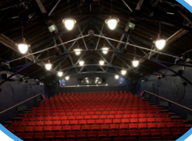
The Theatre
The venue staff will show me where to go and how to get to my seat.
The lights will be on to help me find my seat.
Once the show starts, it will go dark.
I will see the show
The Boy with Wings.
It is 1 hour 15 minutes long.
It has a break in the middle
called an interval.
Here is some more information about the show:
When Tunde sprouts wings and learns that his father is a ferocious alien warrior, he’s all that stands between the galaxy and total destruction – suddenly homework and school aren’t all he has to contend with. Luckily, his rag-tag friendship group have his back, and with his new powers, Tunde’s ready to fly in the face of danger. Adapted by Arvind Ethan David from Sir Lenny Henry’s hilarious book, The Boy with Wings is an interstellar adventure about friendships, being brave, and how our differences are our super-power.

Slide 5
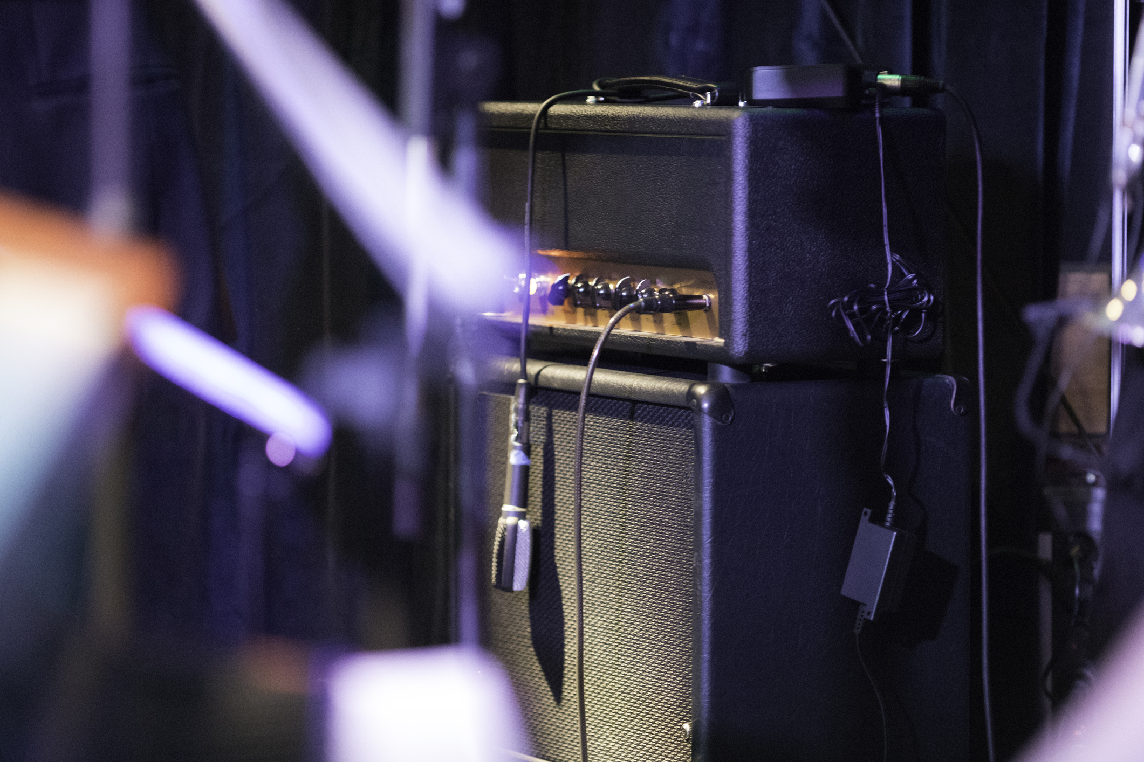
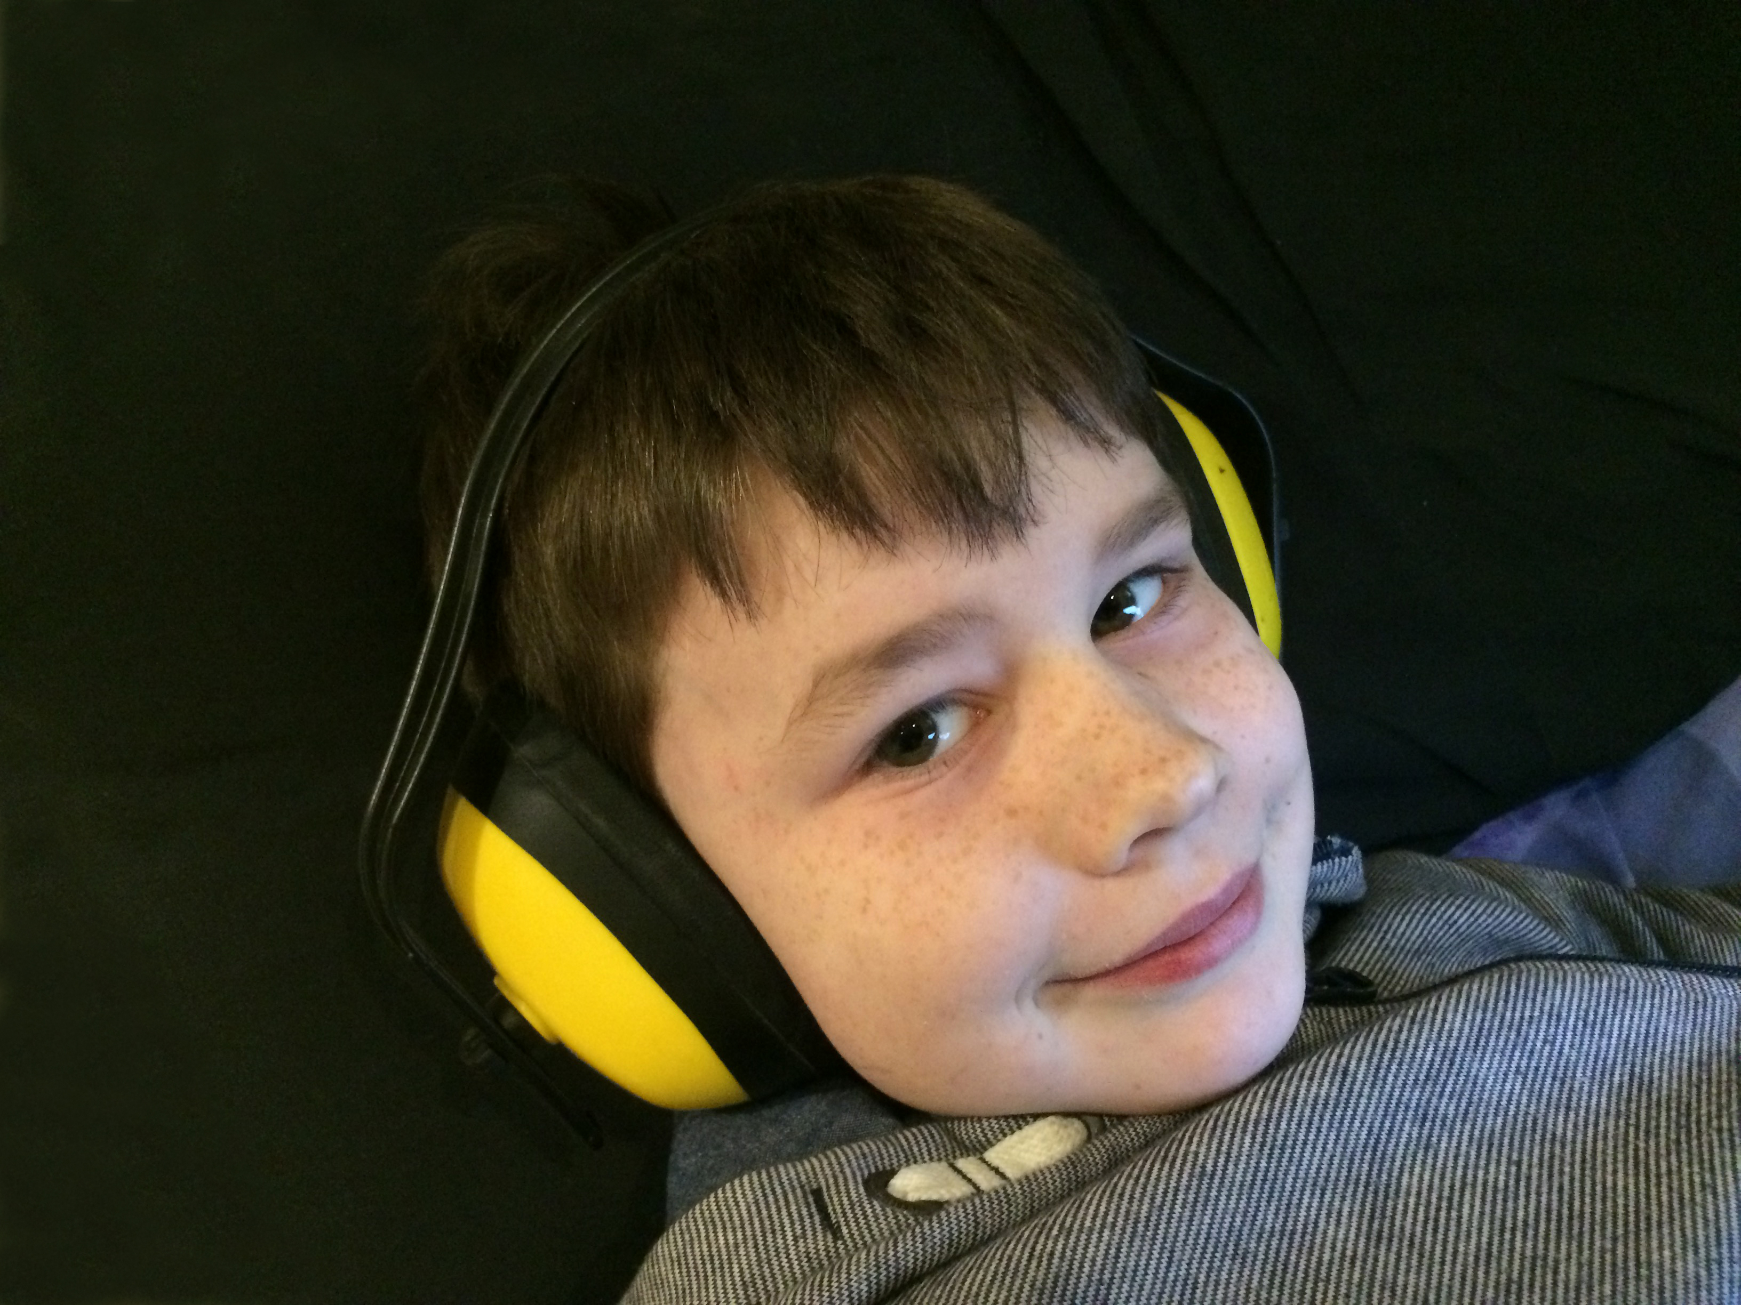
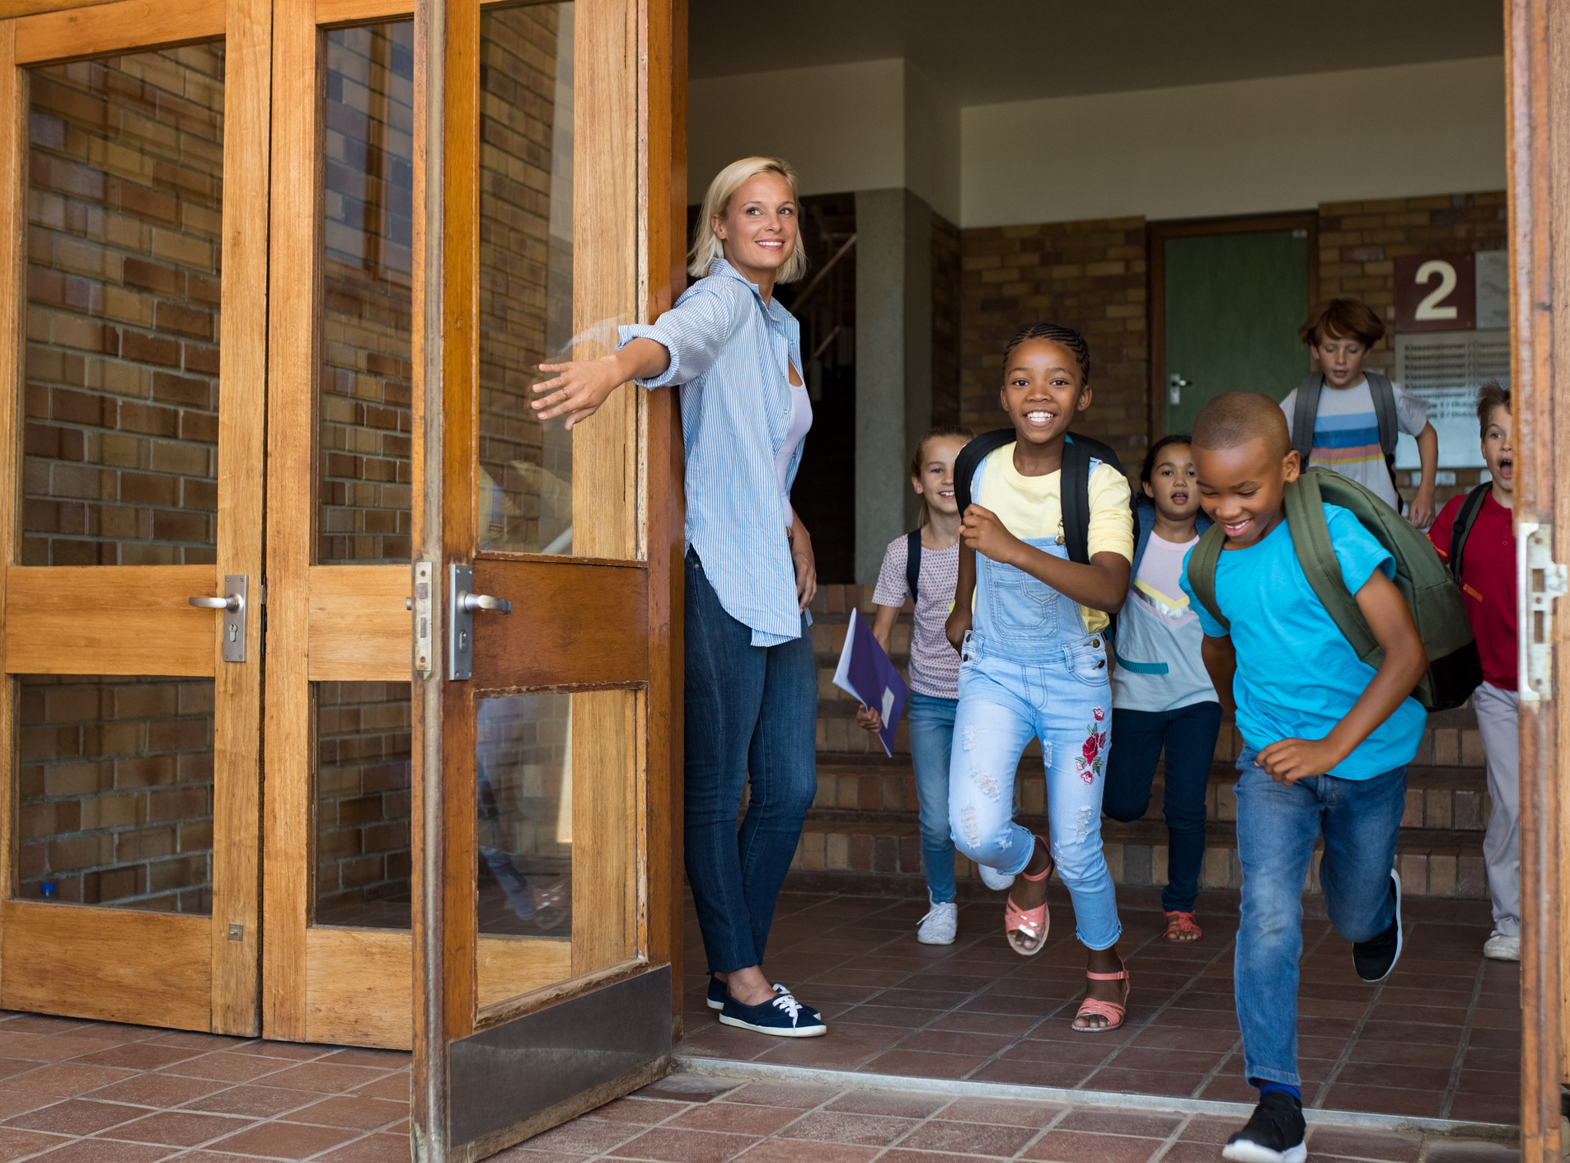
The Show
The show will have sounds and music.
If it is too loud, I can cover my ears or use ear defenders.
My class will be there.
Other schools might be there too.

Slide 6
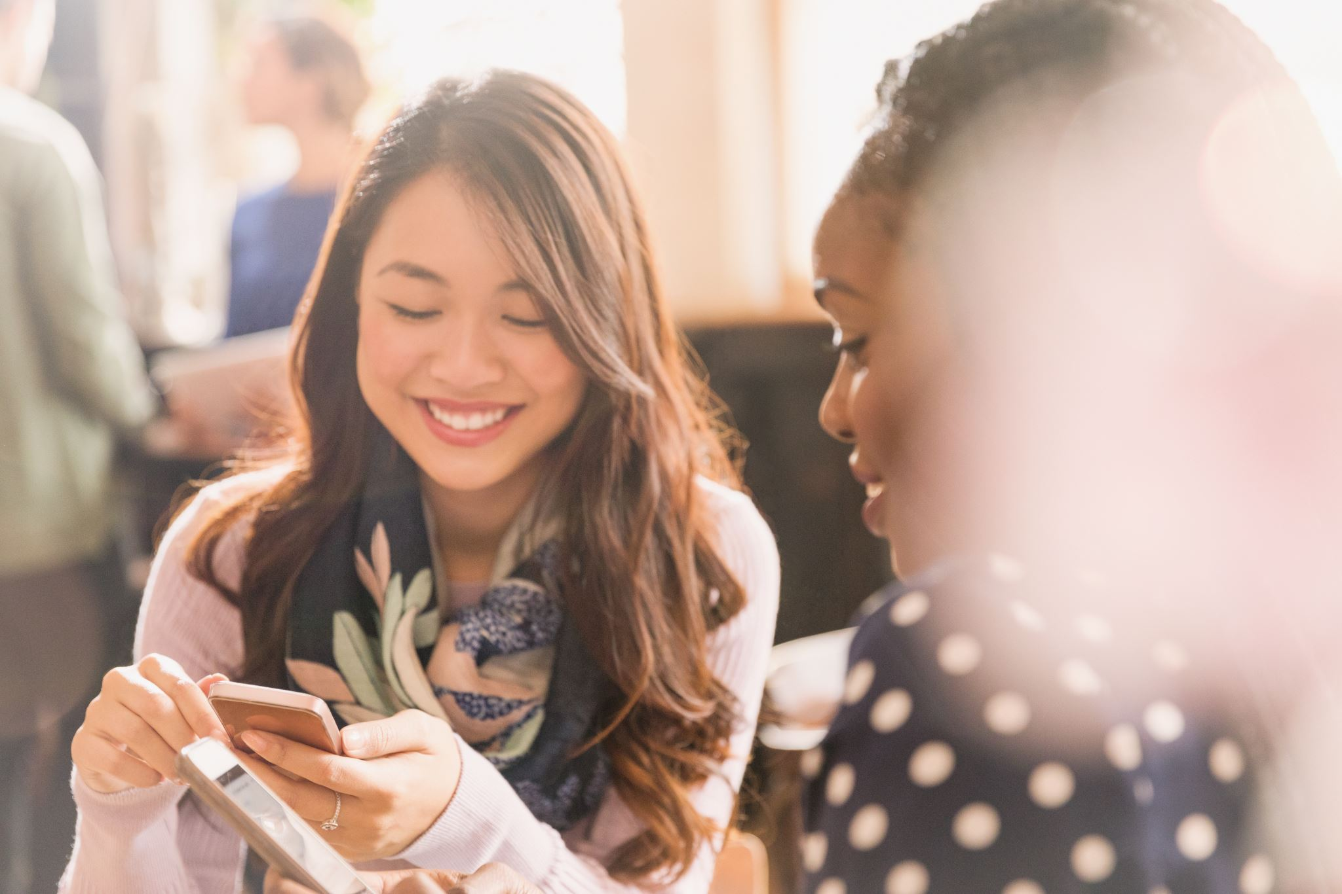
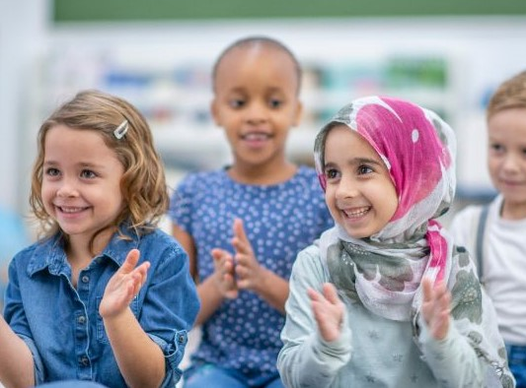
The Interval
There will be a short break in the middle of the show. This is called an interval.
The lights will come back on. The audience might clap.
People in the audience might talk and move around the theatre space.
When the interval ends and the show starts, it will go dark again.

Slide 7
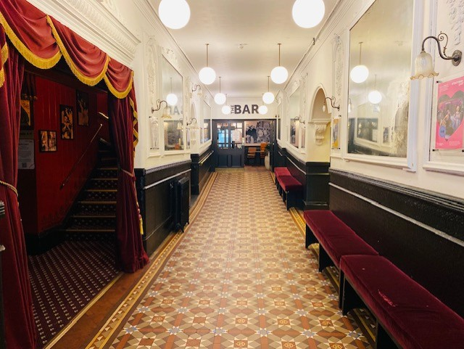
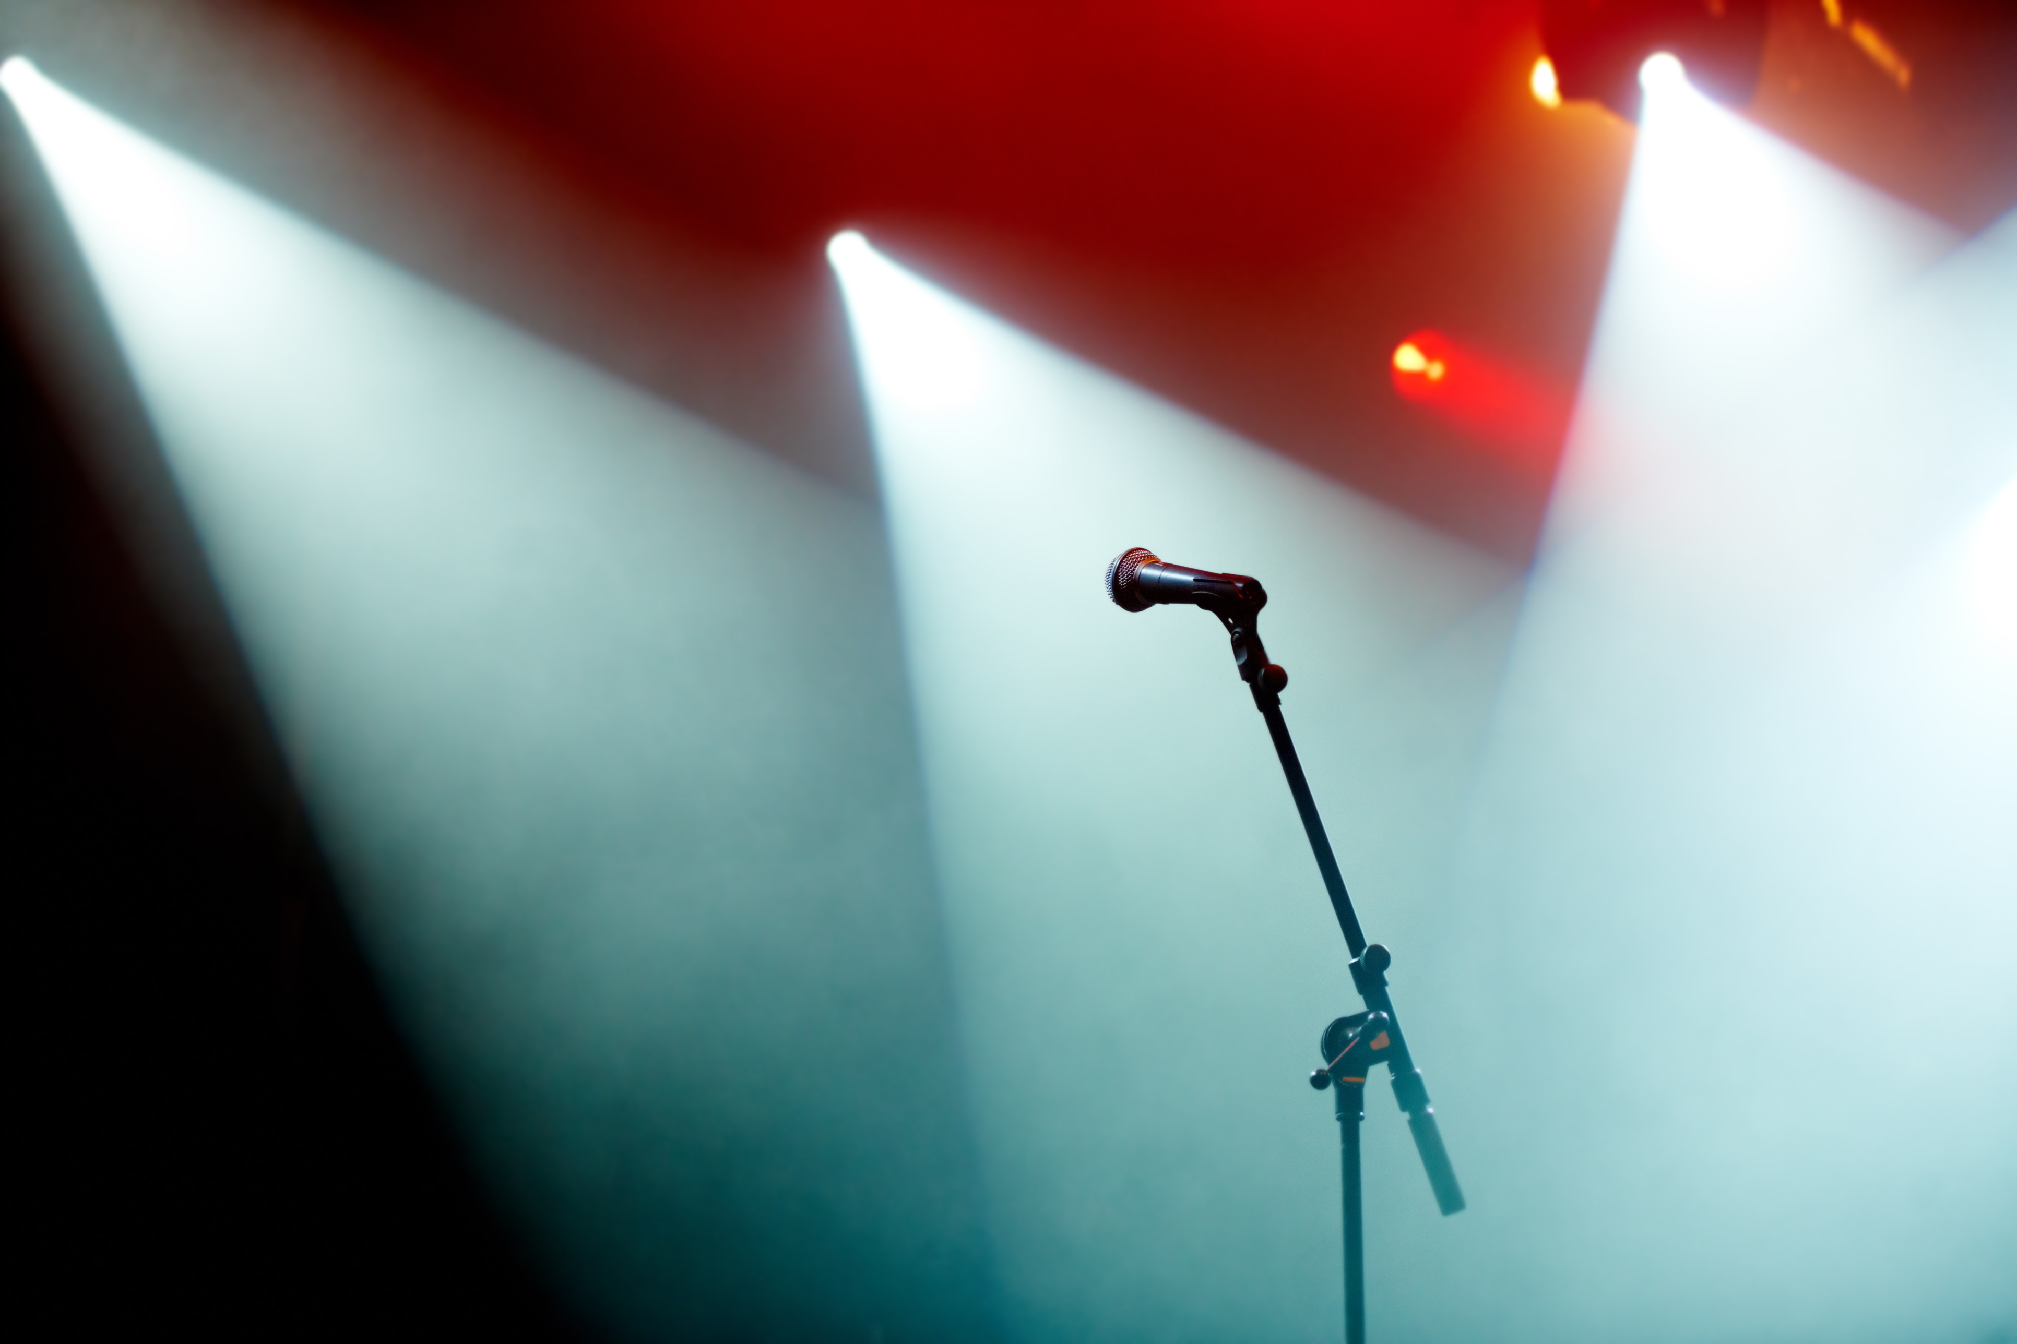
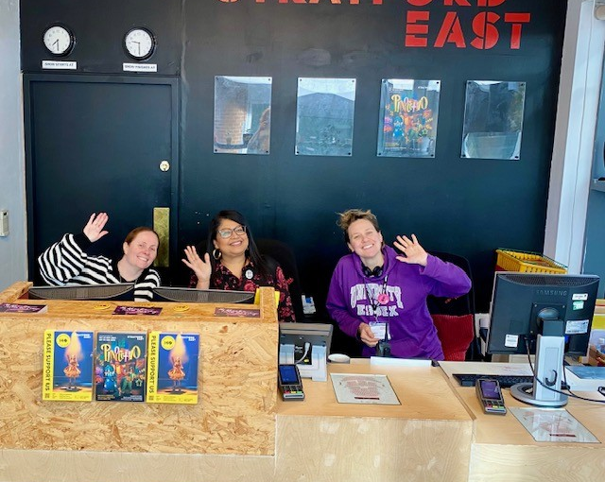
The End of the Show
When the show ends, the lights will come back on.
The audience might clap.
I will walk back to the main entrance.
I will say goodbye to the staff when I leave.
I will travel back to school with my teachers and class.

