Slide 1
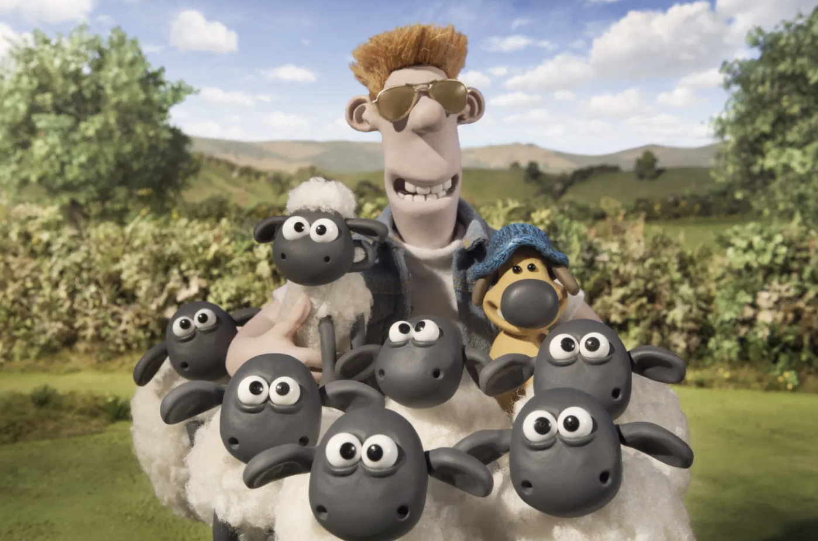

Go & See – Film
Visual Guide Resource
A visual guide to support pupils’ understanding of going to see a film at BFI at Southbank.
You can access additional resources on A New Direction’s website.
This visual guide could be particularly relevant to pupils who benefit from Social Stories. Teachers could read it with their classes before the trip and it could be shared as a handout for grownups to read at home too.
To find out more about Social Stories, please visit this website.
Go & See: Schools’ Resources

Slide 2
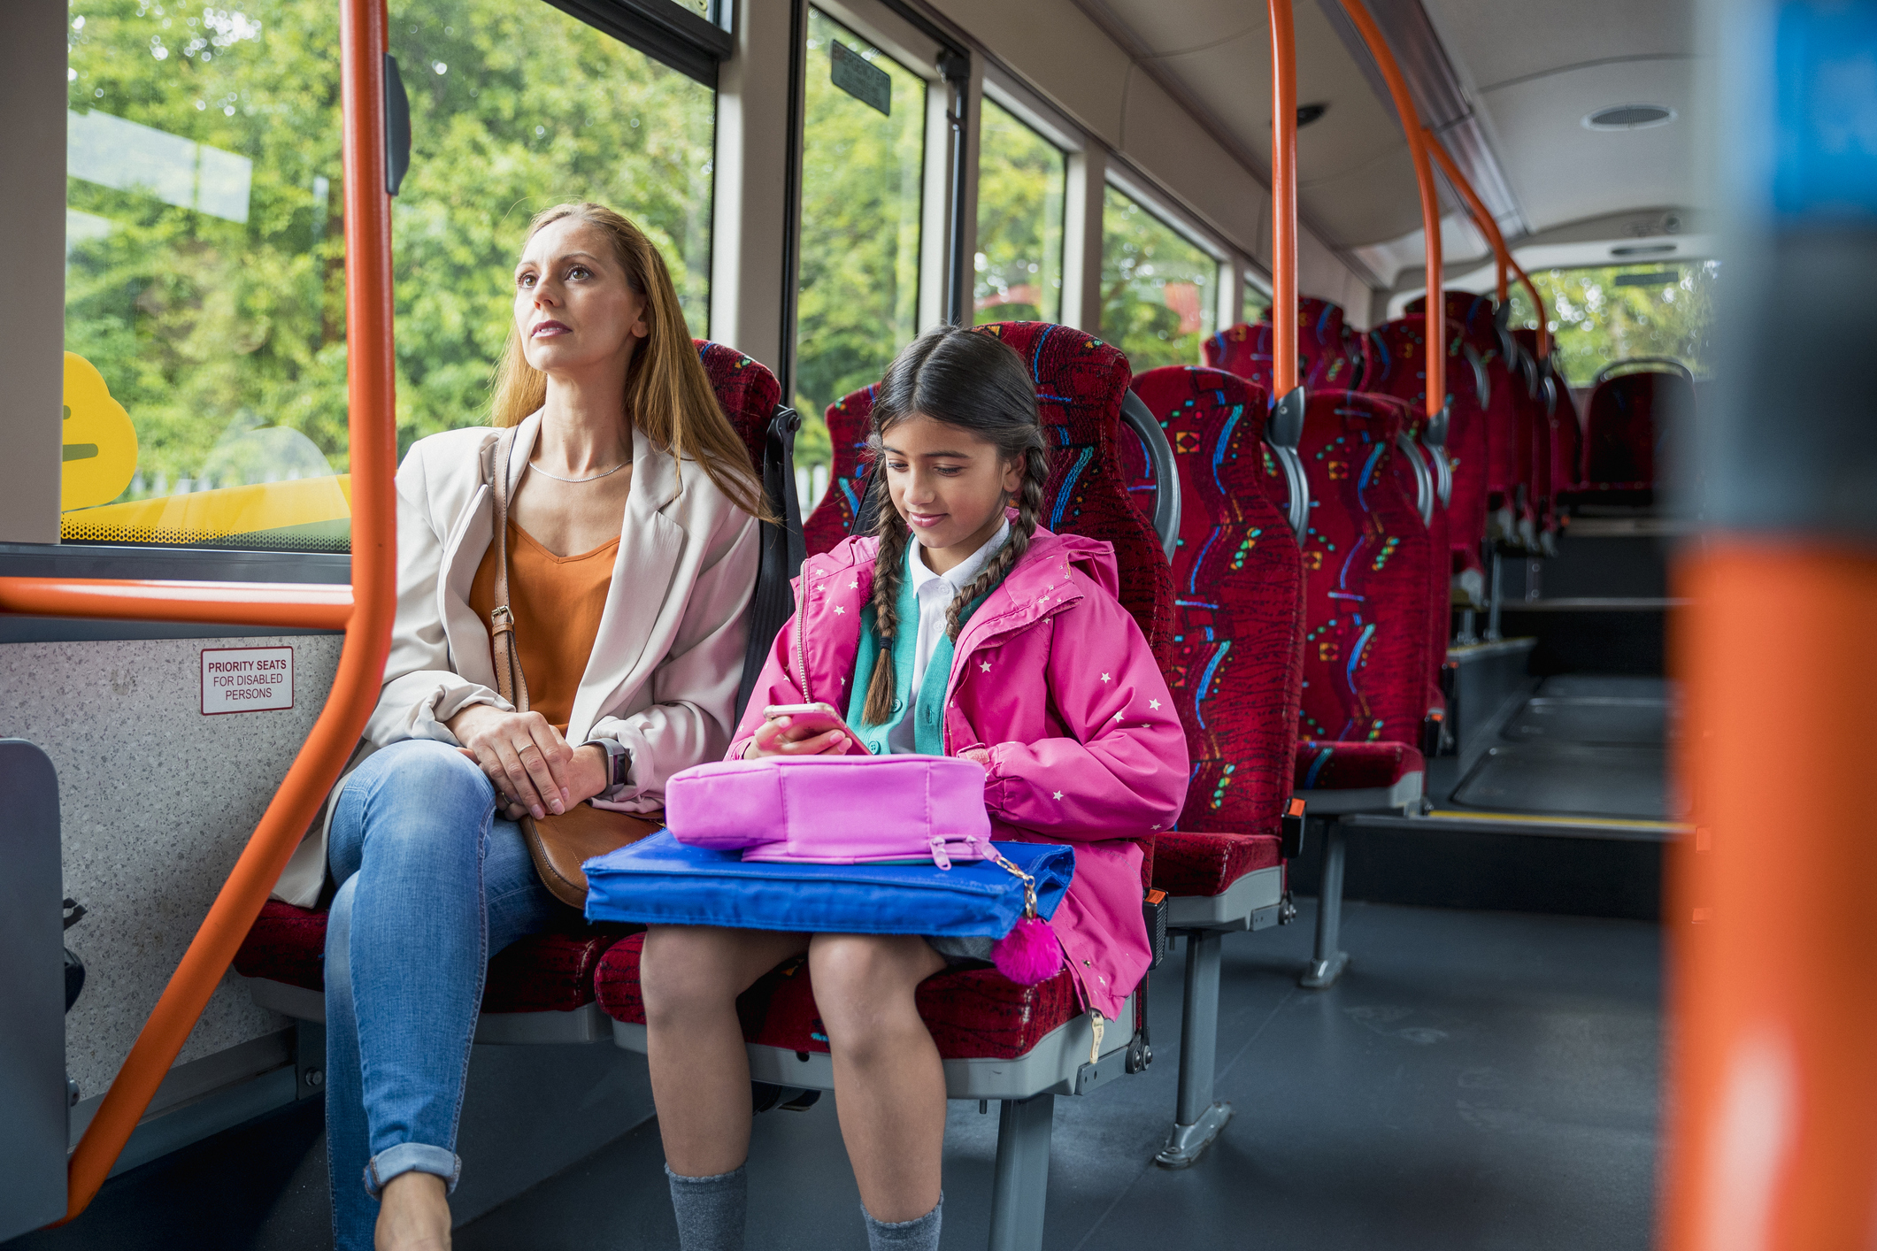
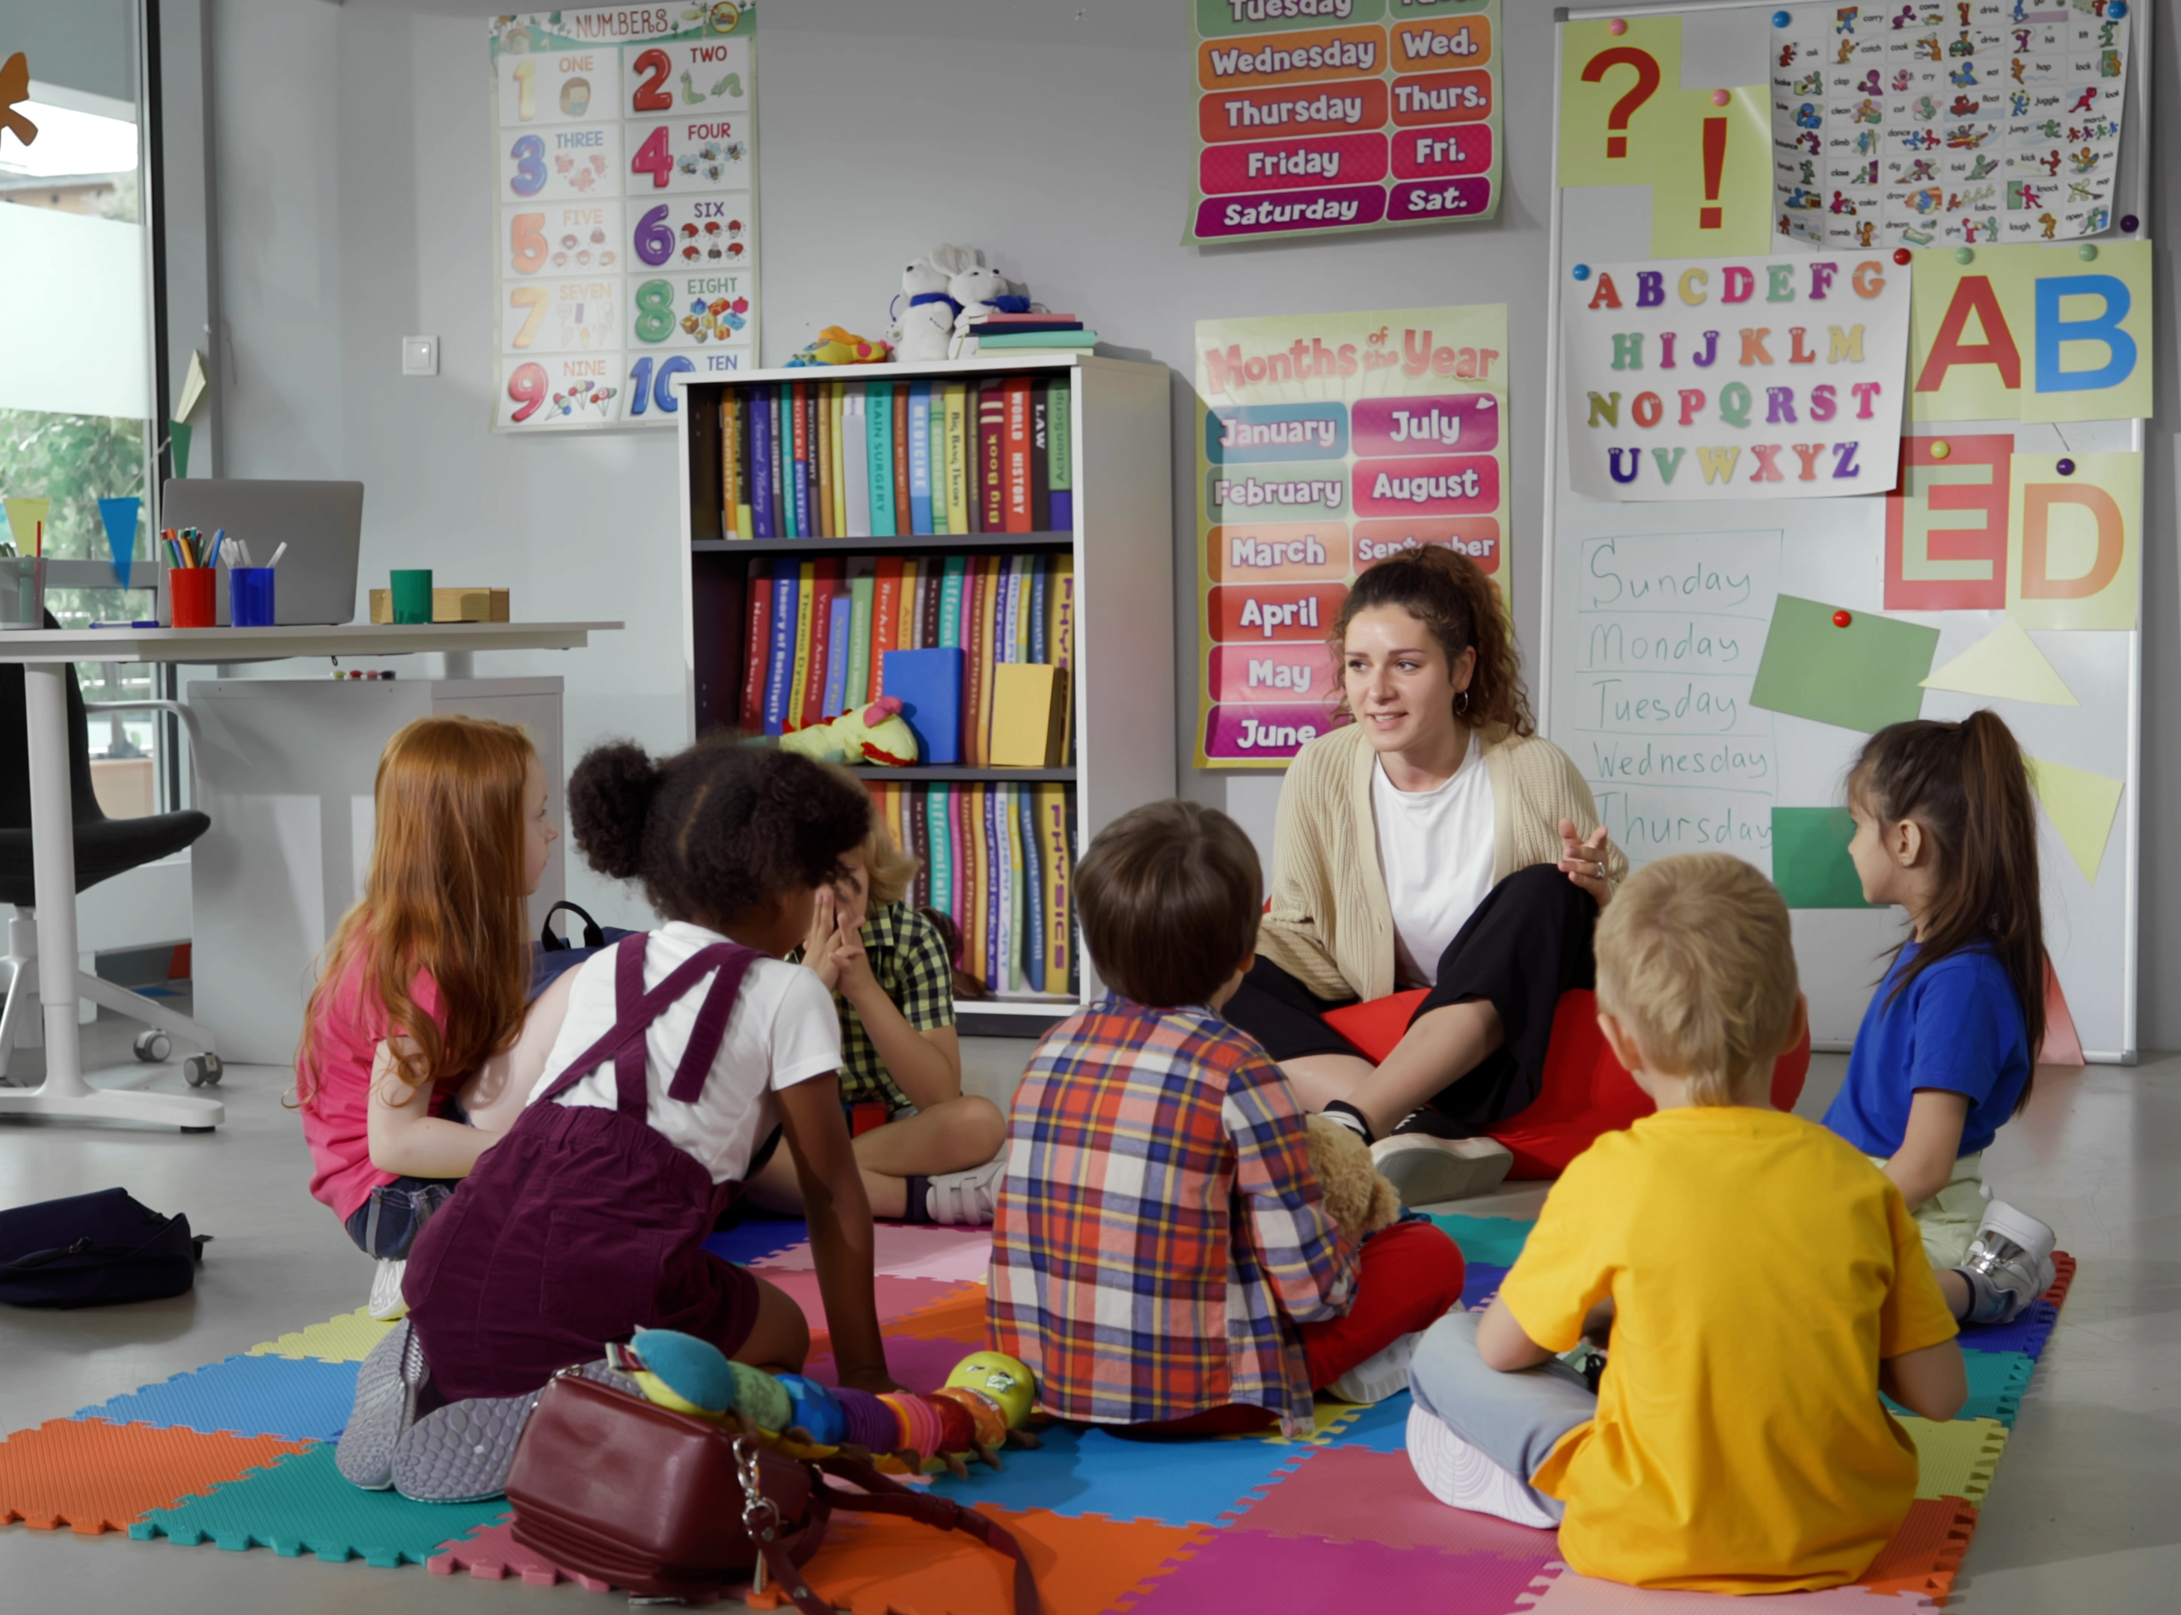
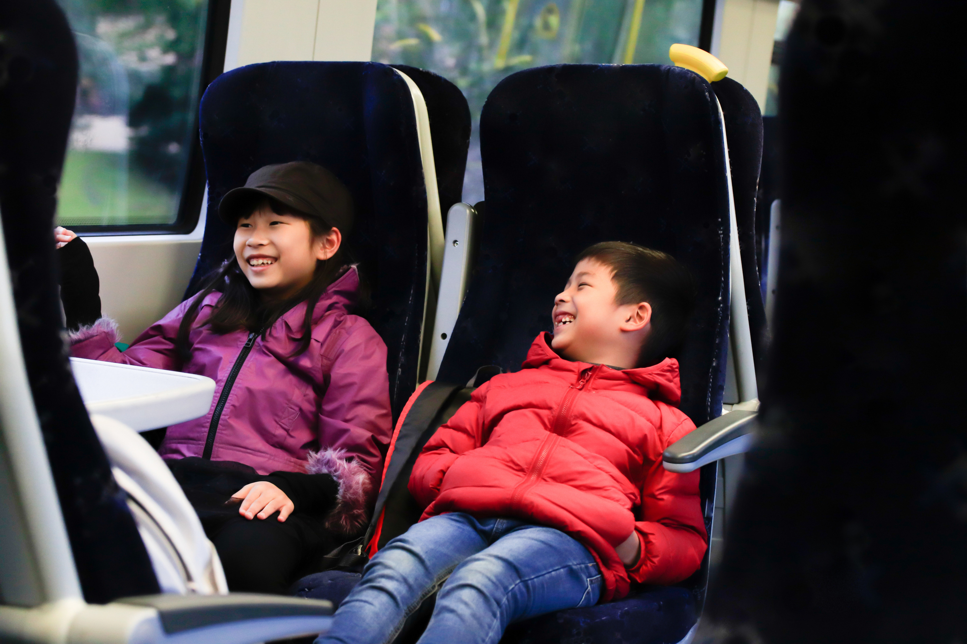
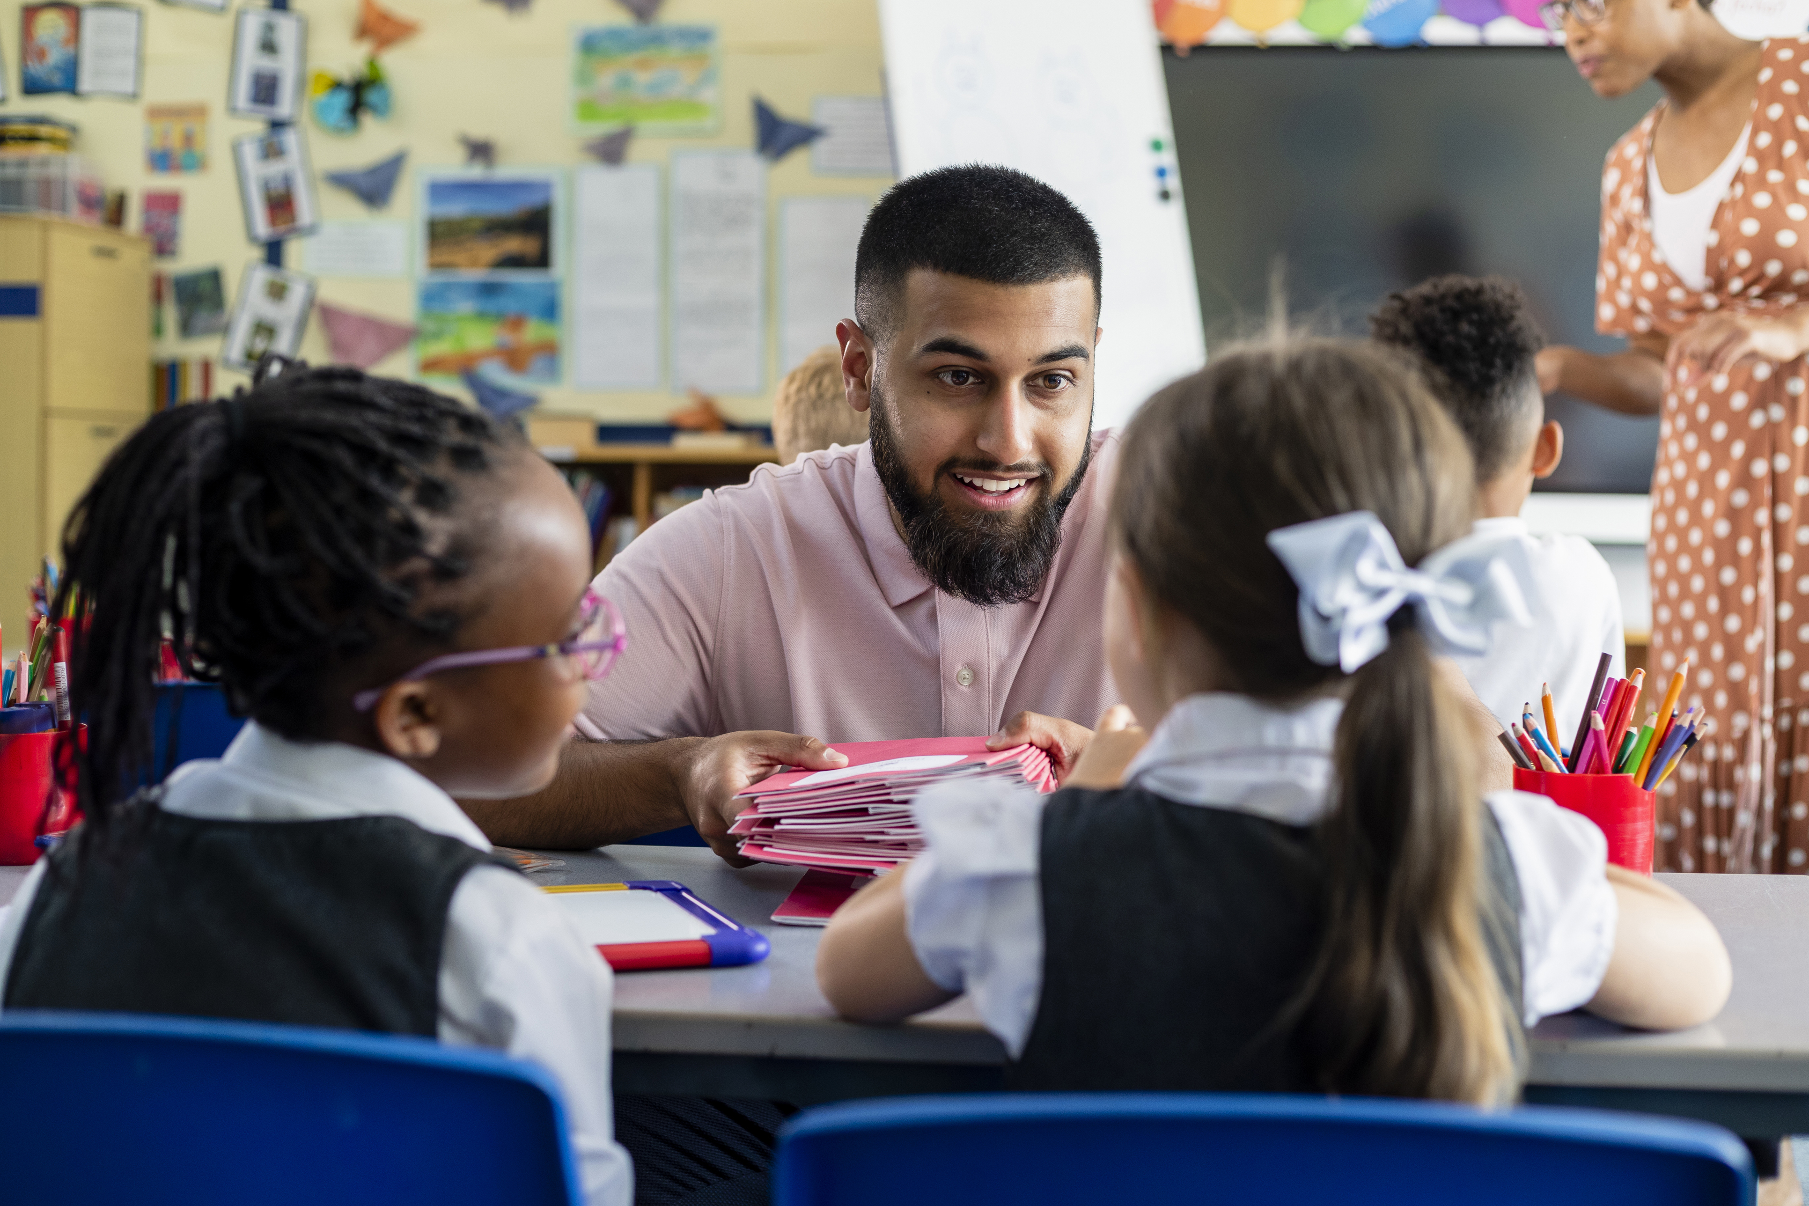
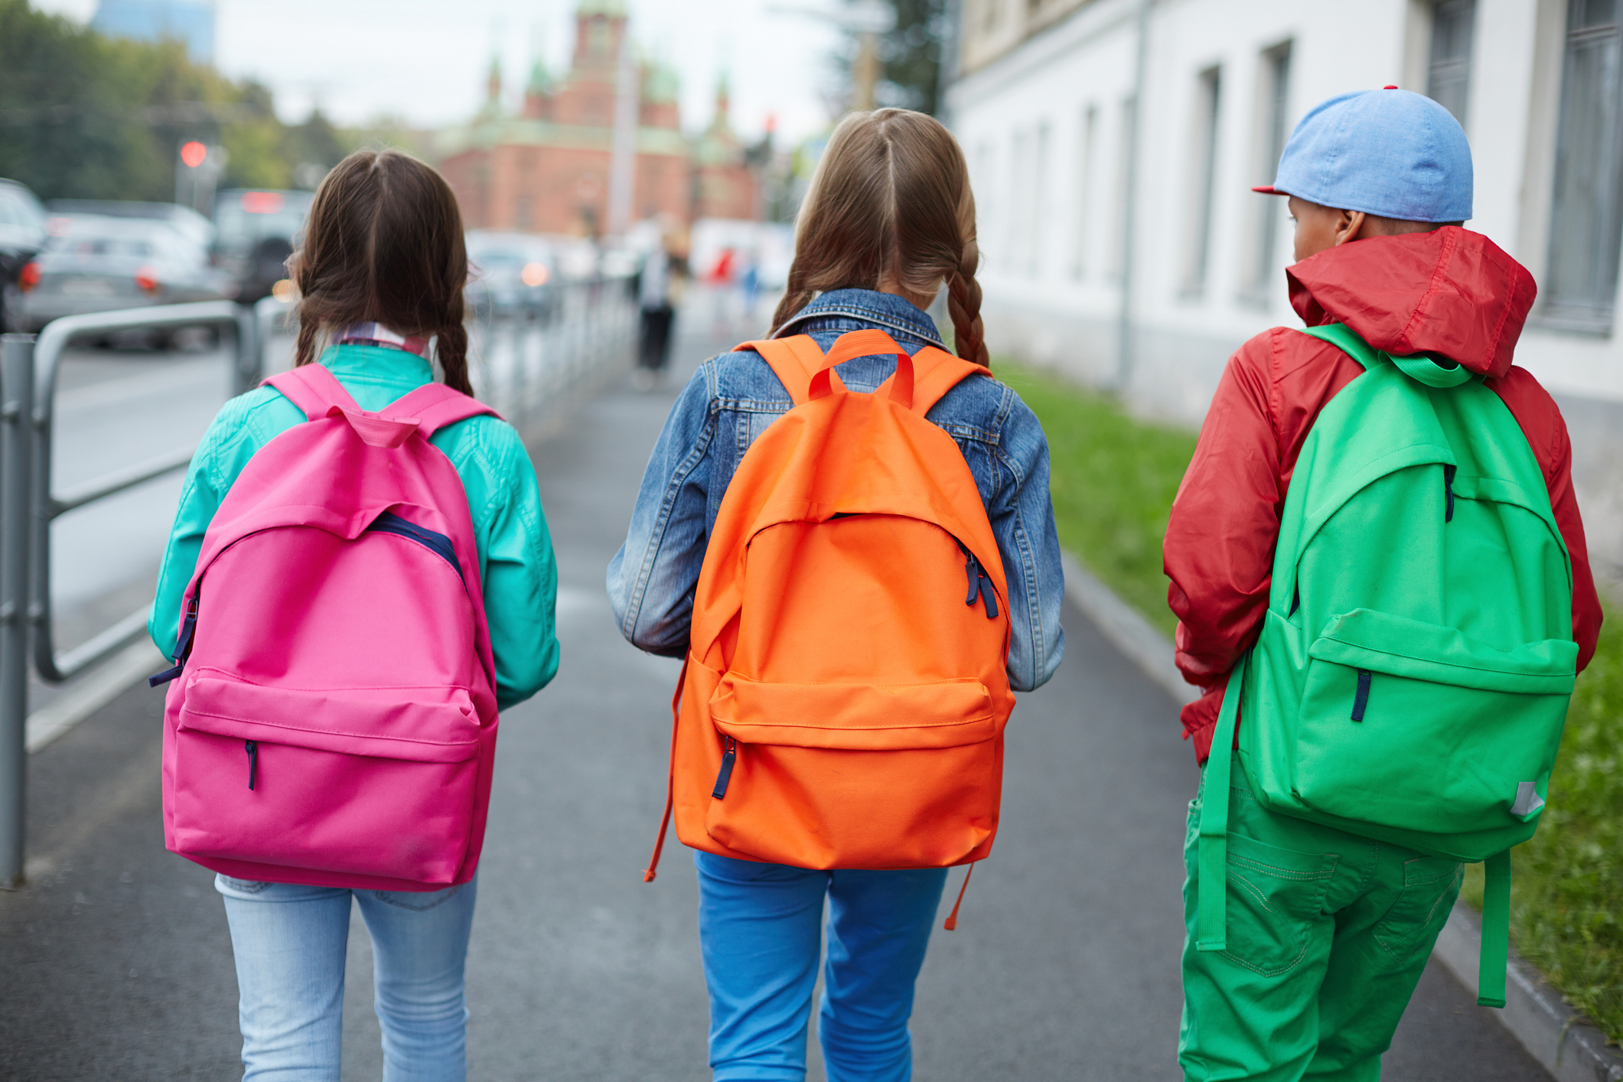
We’re going to the theatre!
I will travel to BFI Southbank.
I might be travelling by bus,
or by train,
or on foot.
My class will be going there too.
My teachers will going be there too.

Slide 3
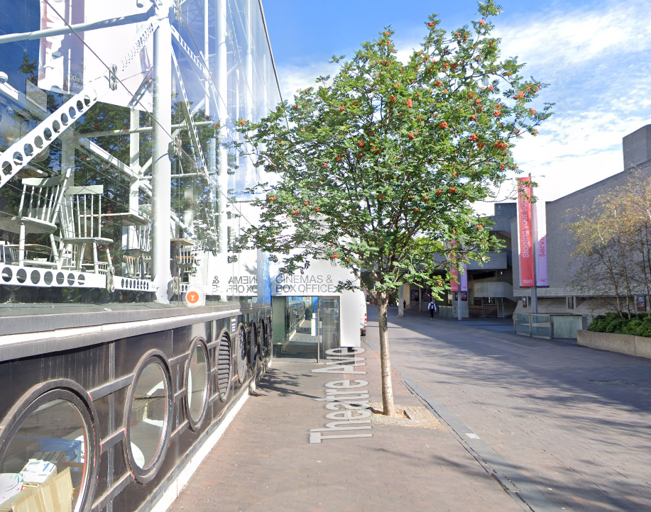
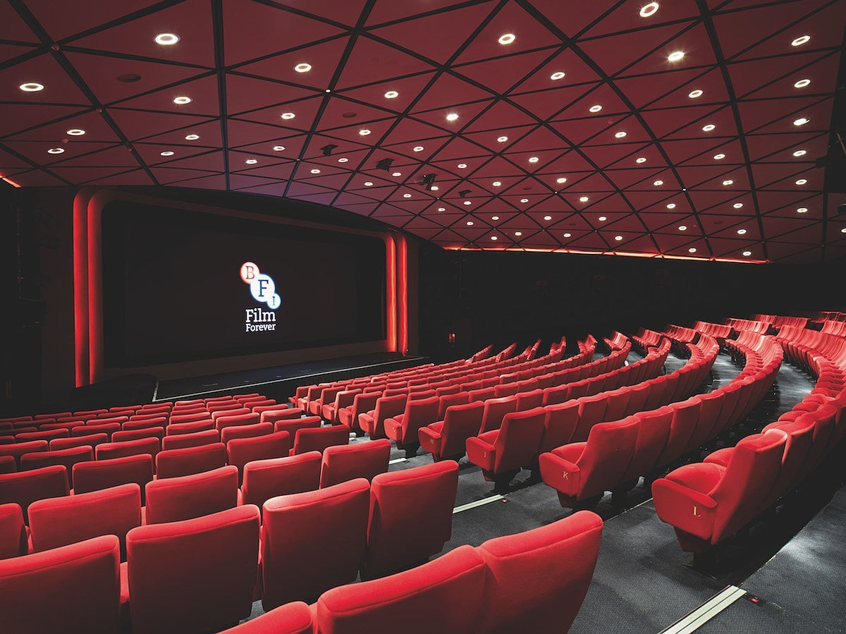
The Location
This is where I will watch the show.
The screen is called NFT1.
This is the entrance we will use outside the BFI Southbank

Slide 4
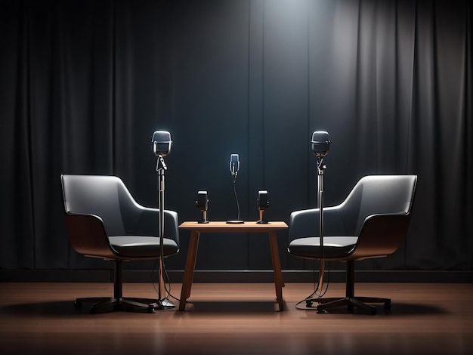
The Location
There will be a Q&A on stage. This is where someone answers some questions about the film.
The person answering questions will be Lucy Izzard. She makes animations for Aardman, the company who made the film.

Slide 5
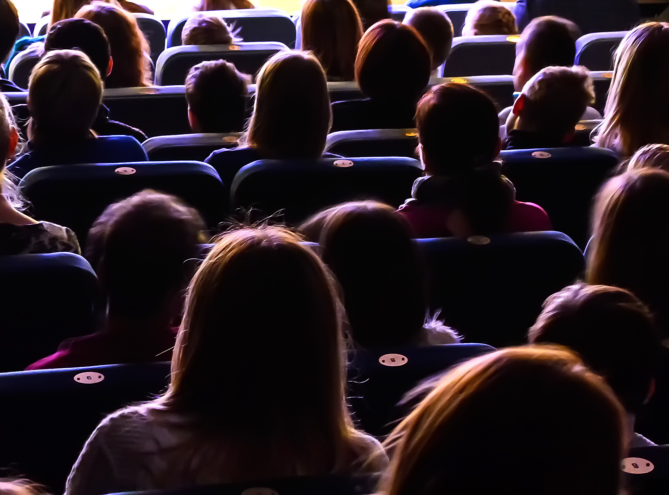
The Screening
Here is some more information about the film:
Explore the wonderful world of a woolly superstar - Shaun the Sheep, in a film screening featuring a live introduction with Aardman Animations. As a cheeky sheep and leader of the flock, Shaun’s curiosity and love of adventure lead him into all kinds of trouble... but as a smart and resourceful sheep he can always find a solution, with themes of friendship throughout.
I will see Shaun the Sheep: The Movie.
It is 1 hour 45 minutes there is no break in the middle of the film.
After the Q&A the lights in the room will go down and the film will start on the screen.

Slide 6
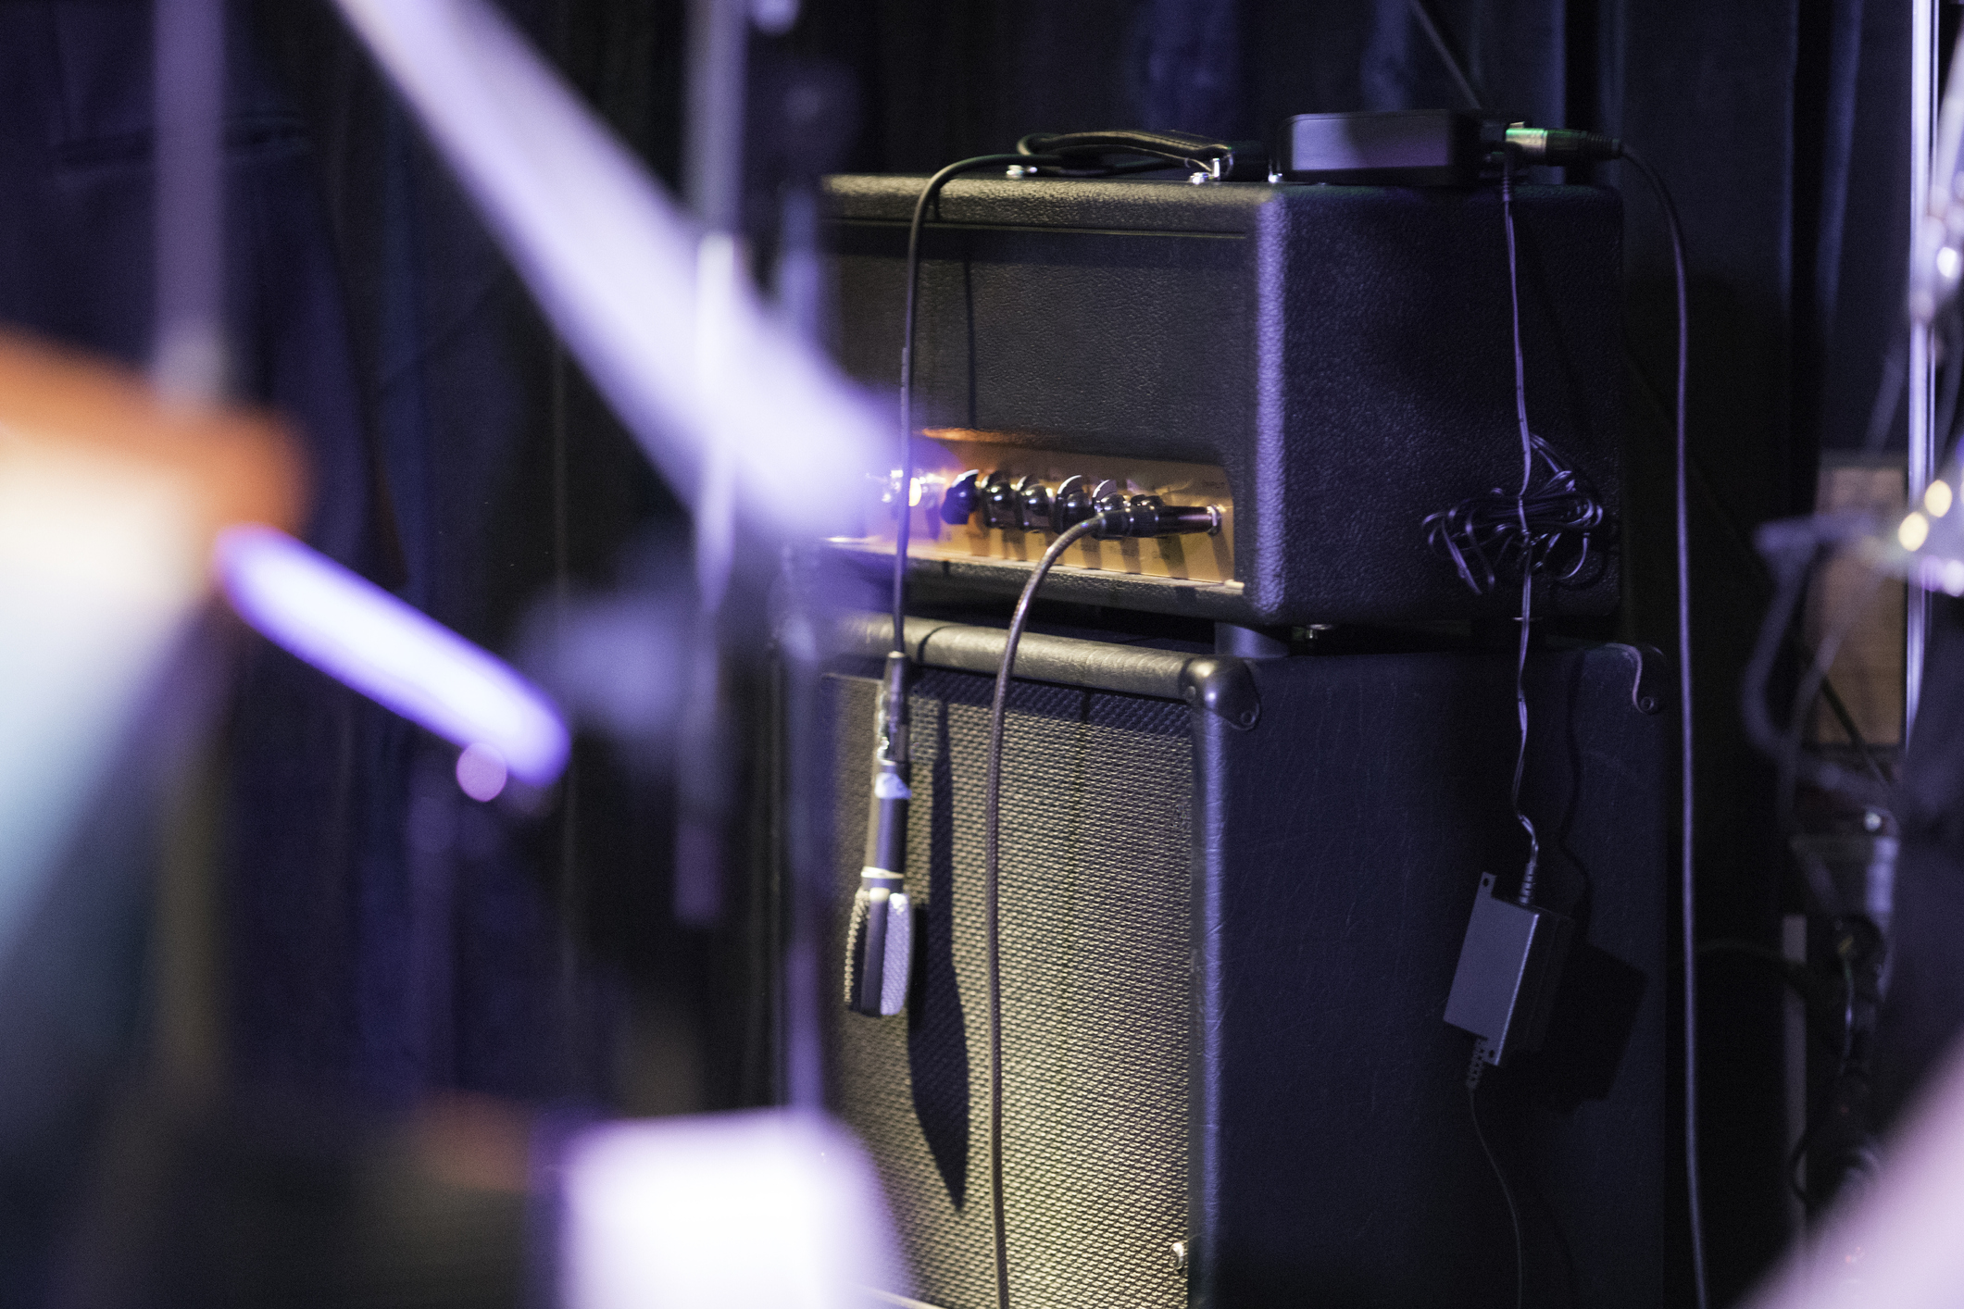
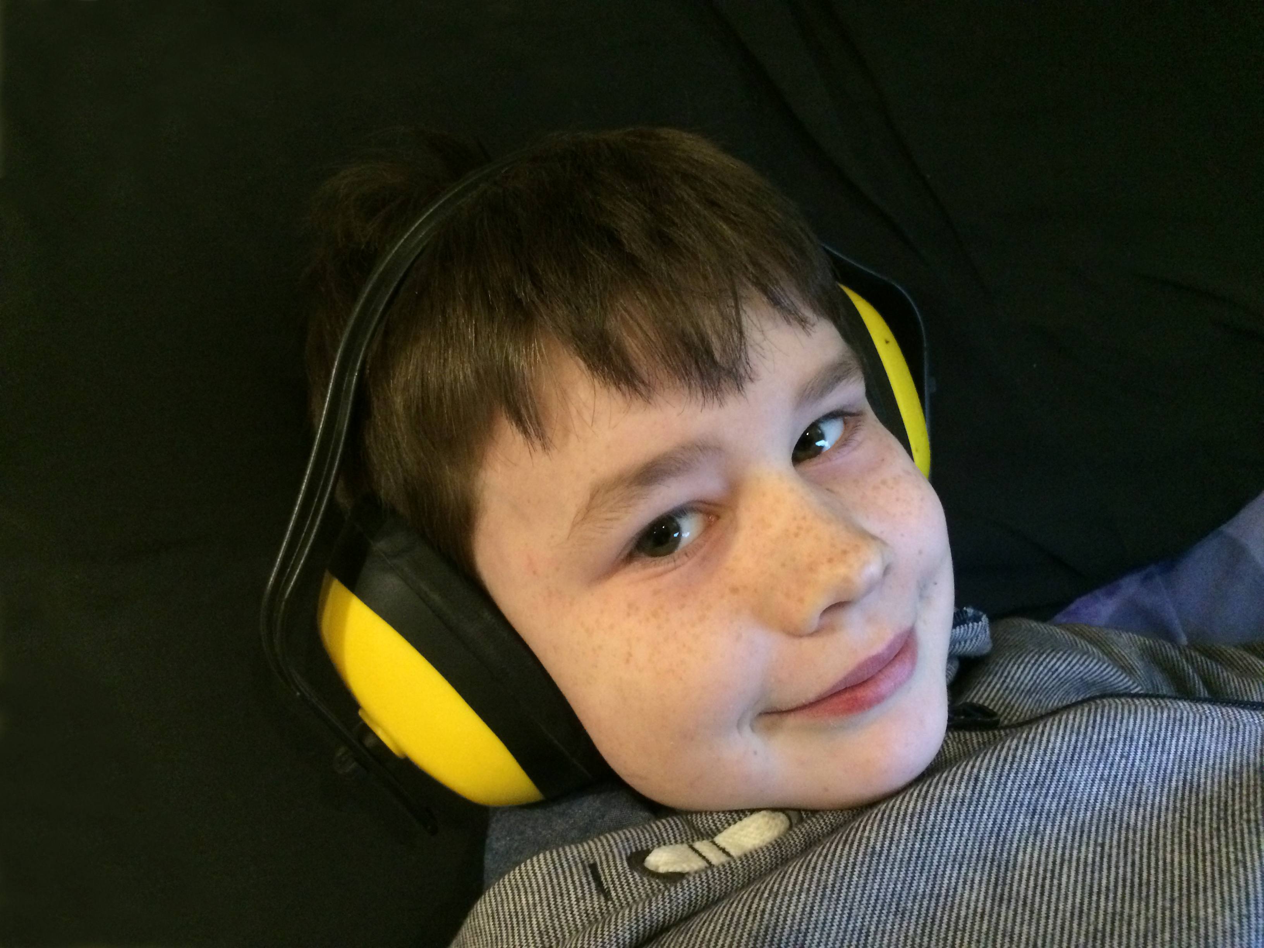
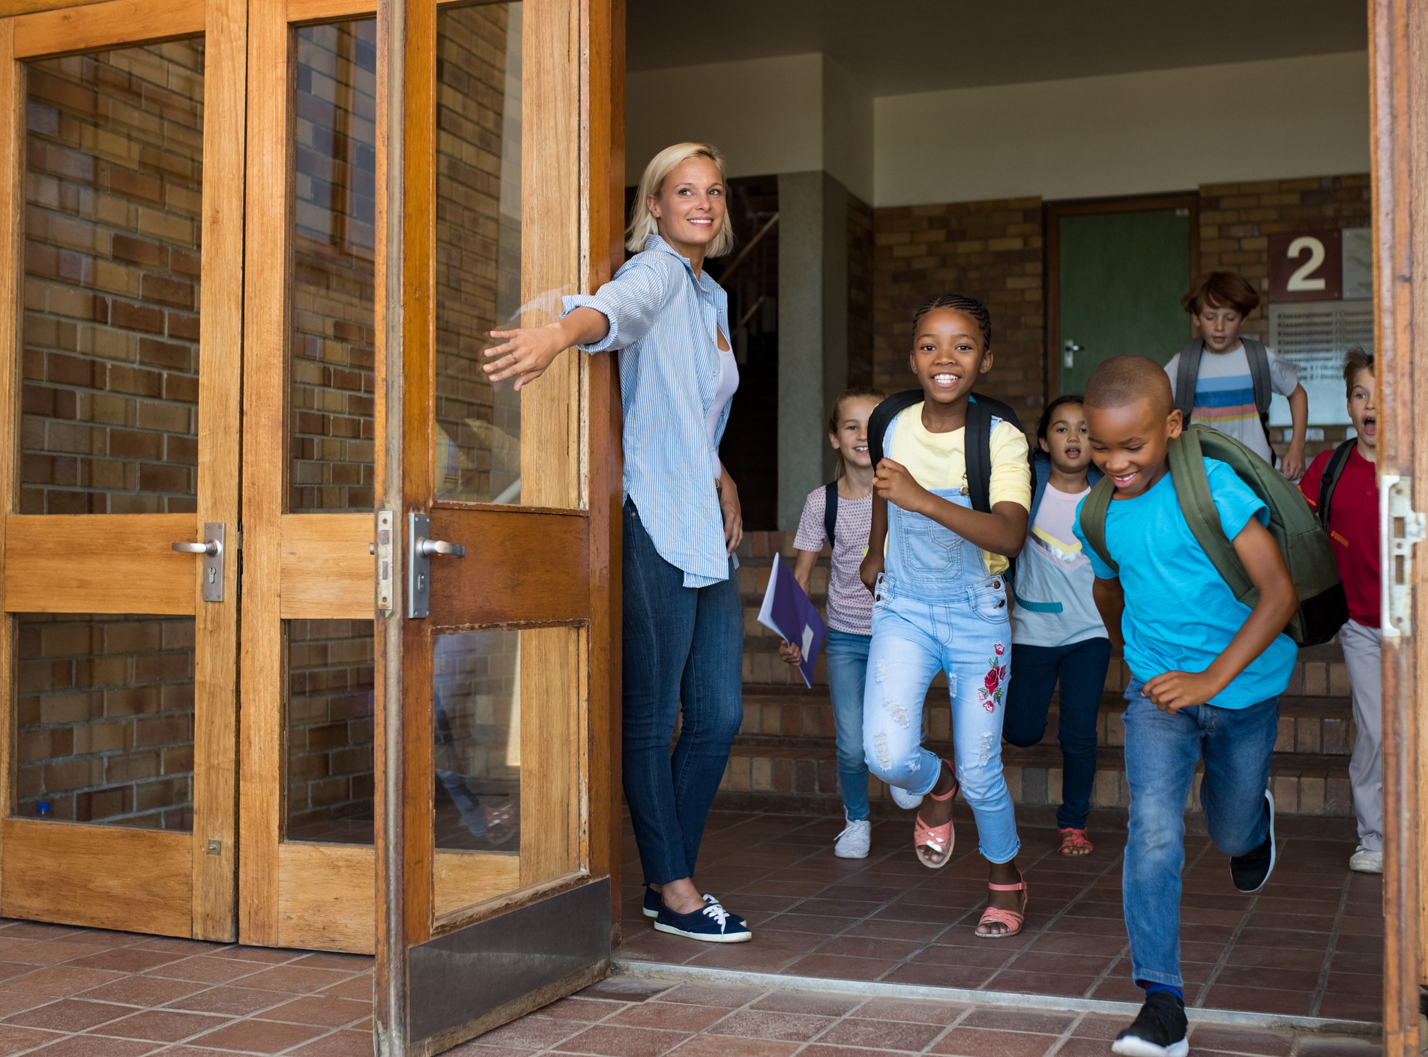
The Show
The film will have sounds and music.
If it is too loud, I can cover my ears or use ear defenders.
My class will be there.
Other schools might be there too.

Slide 7
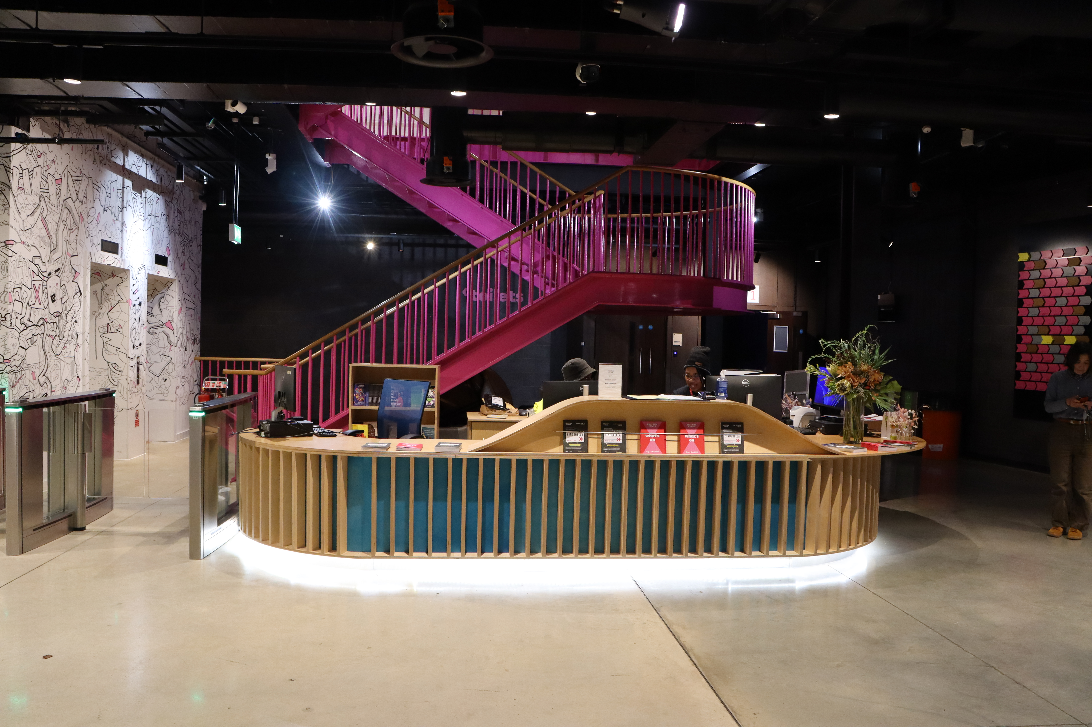

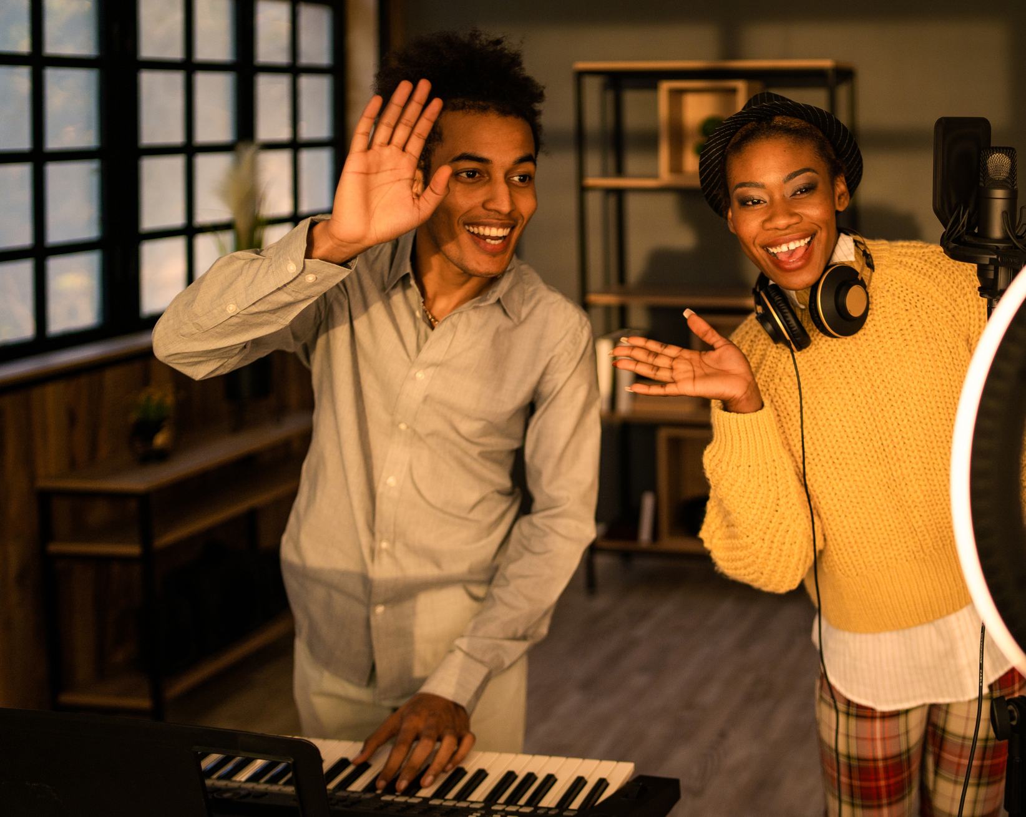
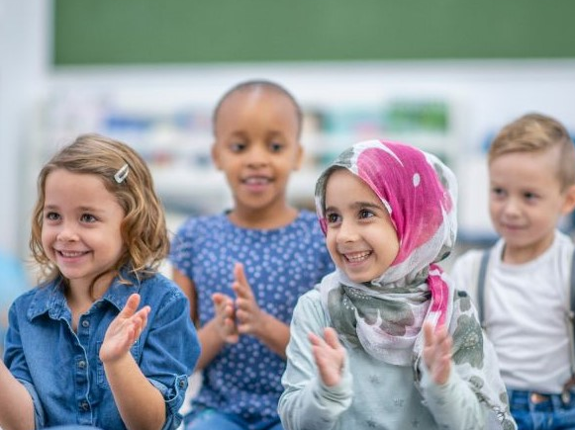
The End of the Show
When the show ends, the lights will come back on.
The audience might clap.
I will walk back to the main entrance.
I will say goodbye to the staff when I leave.
I will travel back to school with my teachers and class.

